Slide 1
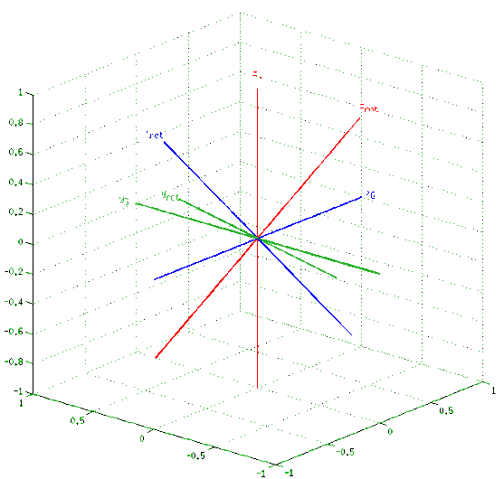
Fused Angles for Body Orientation Representation
Philipp Allgeuer and Sven Behnke
Institute for Computer Science VI
Autonomous Intelligent Systems
University of Bonn

Slide 2
Motivation
What is a rotation representation?
A parameterisation of the manifold of all rotations in three-dimensional Euclidean space
Why do we need them?
To perform calculations relating to rotations
Existing rotation representations?
Rotation matrices, quaternions, Euler angles, …
Why develop a new representation?
Desired for the analysis and control of balancing bodies in 3D (e.g. a biped robot)

Slide 3
Problem Definition
The problem:
Find a representation that describes the state of balance in an intuitive and problem-relevant way, and yields information about the components of the rotation in the three major planes (xy, yz, xz)
Orientation
A rotation relative to a global fixed frame
Relevant as an expression of attitude for balance
Environment
Fixed, z-axis points ‘up’ (i.e. opposite to gravity)

Slide 4
Problem Definition
The solution:
Fused angles
(and the intermediate tilt angles representation)

Slide 5
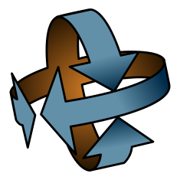
Uses of Fused Angles to Date
Attitude Estimator ^{[1] [2]}
Internally based on the concept of fused angles for orientation resolution
NimbRo ROS Soccer Package ^{[4] [5]}
Intended for the NimbRo-OP humanoid robot
Fused angles are used for state estimation and the walking control engine
Matlab/Octave Rotations Library ^{[6]}
Library for computations related to rotations in 3D (supports both fused angles and tilt angles)

Slide 6
Existing Representations
Rotation matrices
Quaternions
Euler angles
Axis-angle
Rotation vectors
Vectorial parameterisations

Slide 7
Intrinsic ZYX Euler Angles
Containing set:
Parameters: 3 ⇒ Minimal
Constraints: None
Singularities: Gimbal lock at the limits of β
Features: Splits rotation into a sequence of elemental rotations, numerically problematic near the singularities, computationally inefficient

Slide 8
Intrinsic ZYX Euler Angles
Relevant feature:
Quantifies the amount of rotation about the x, y and z axes ≈ in the three major planes
Problems:
Proximity of both gimbal lock singularities to normal working ranges, high local sensitivity
Requirement of an order of elemental rotations, leading to asymmetrical definitions of pitch/roll
Unintuitive non-axisymmetric behaviour of the yaw angle due to the reliance on axis projection

Slide 9
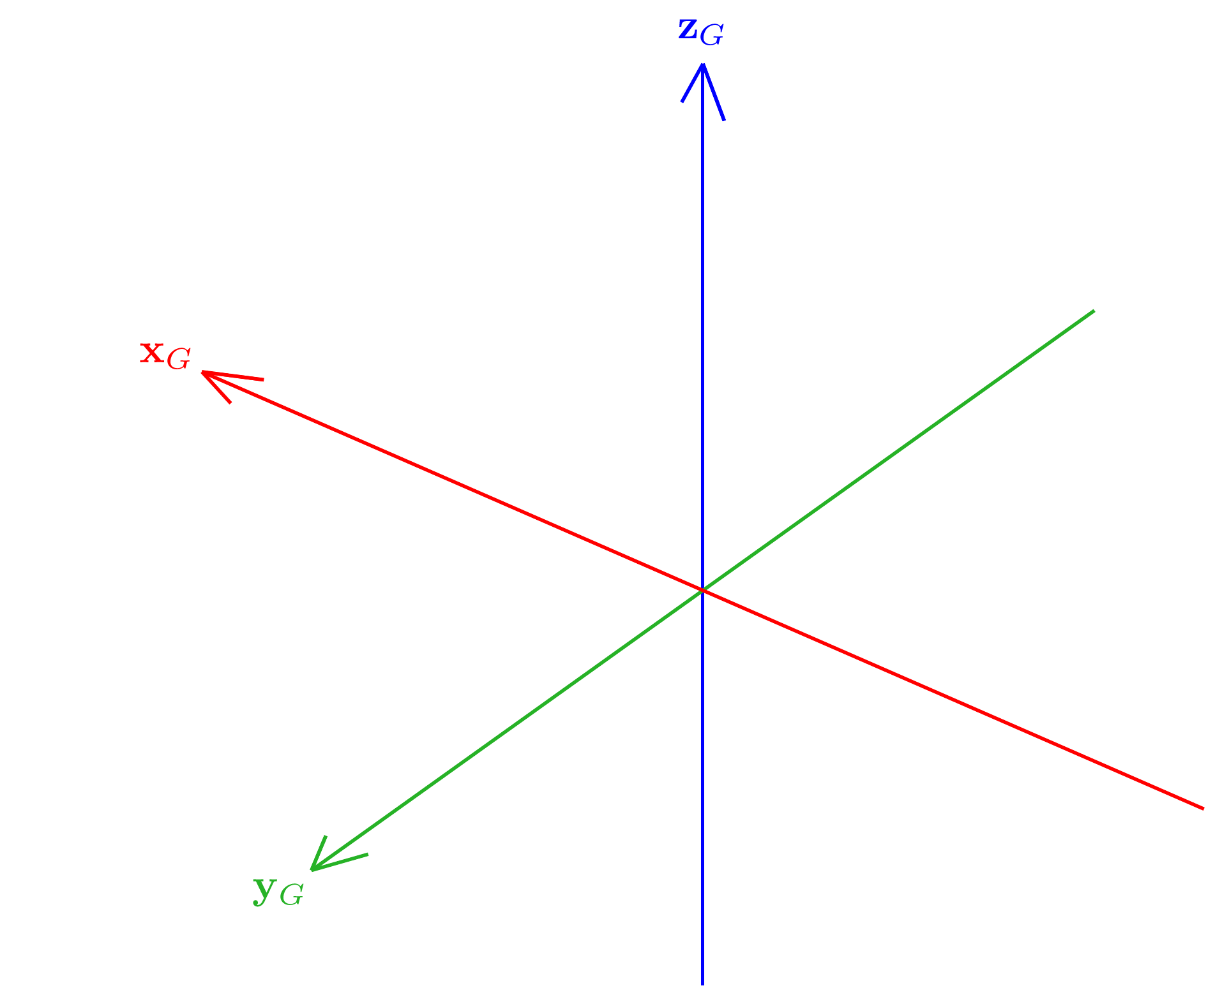
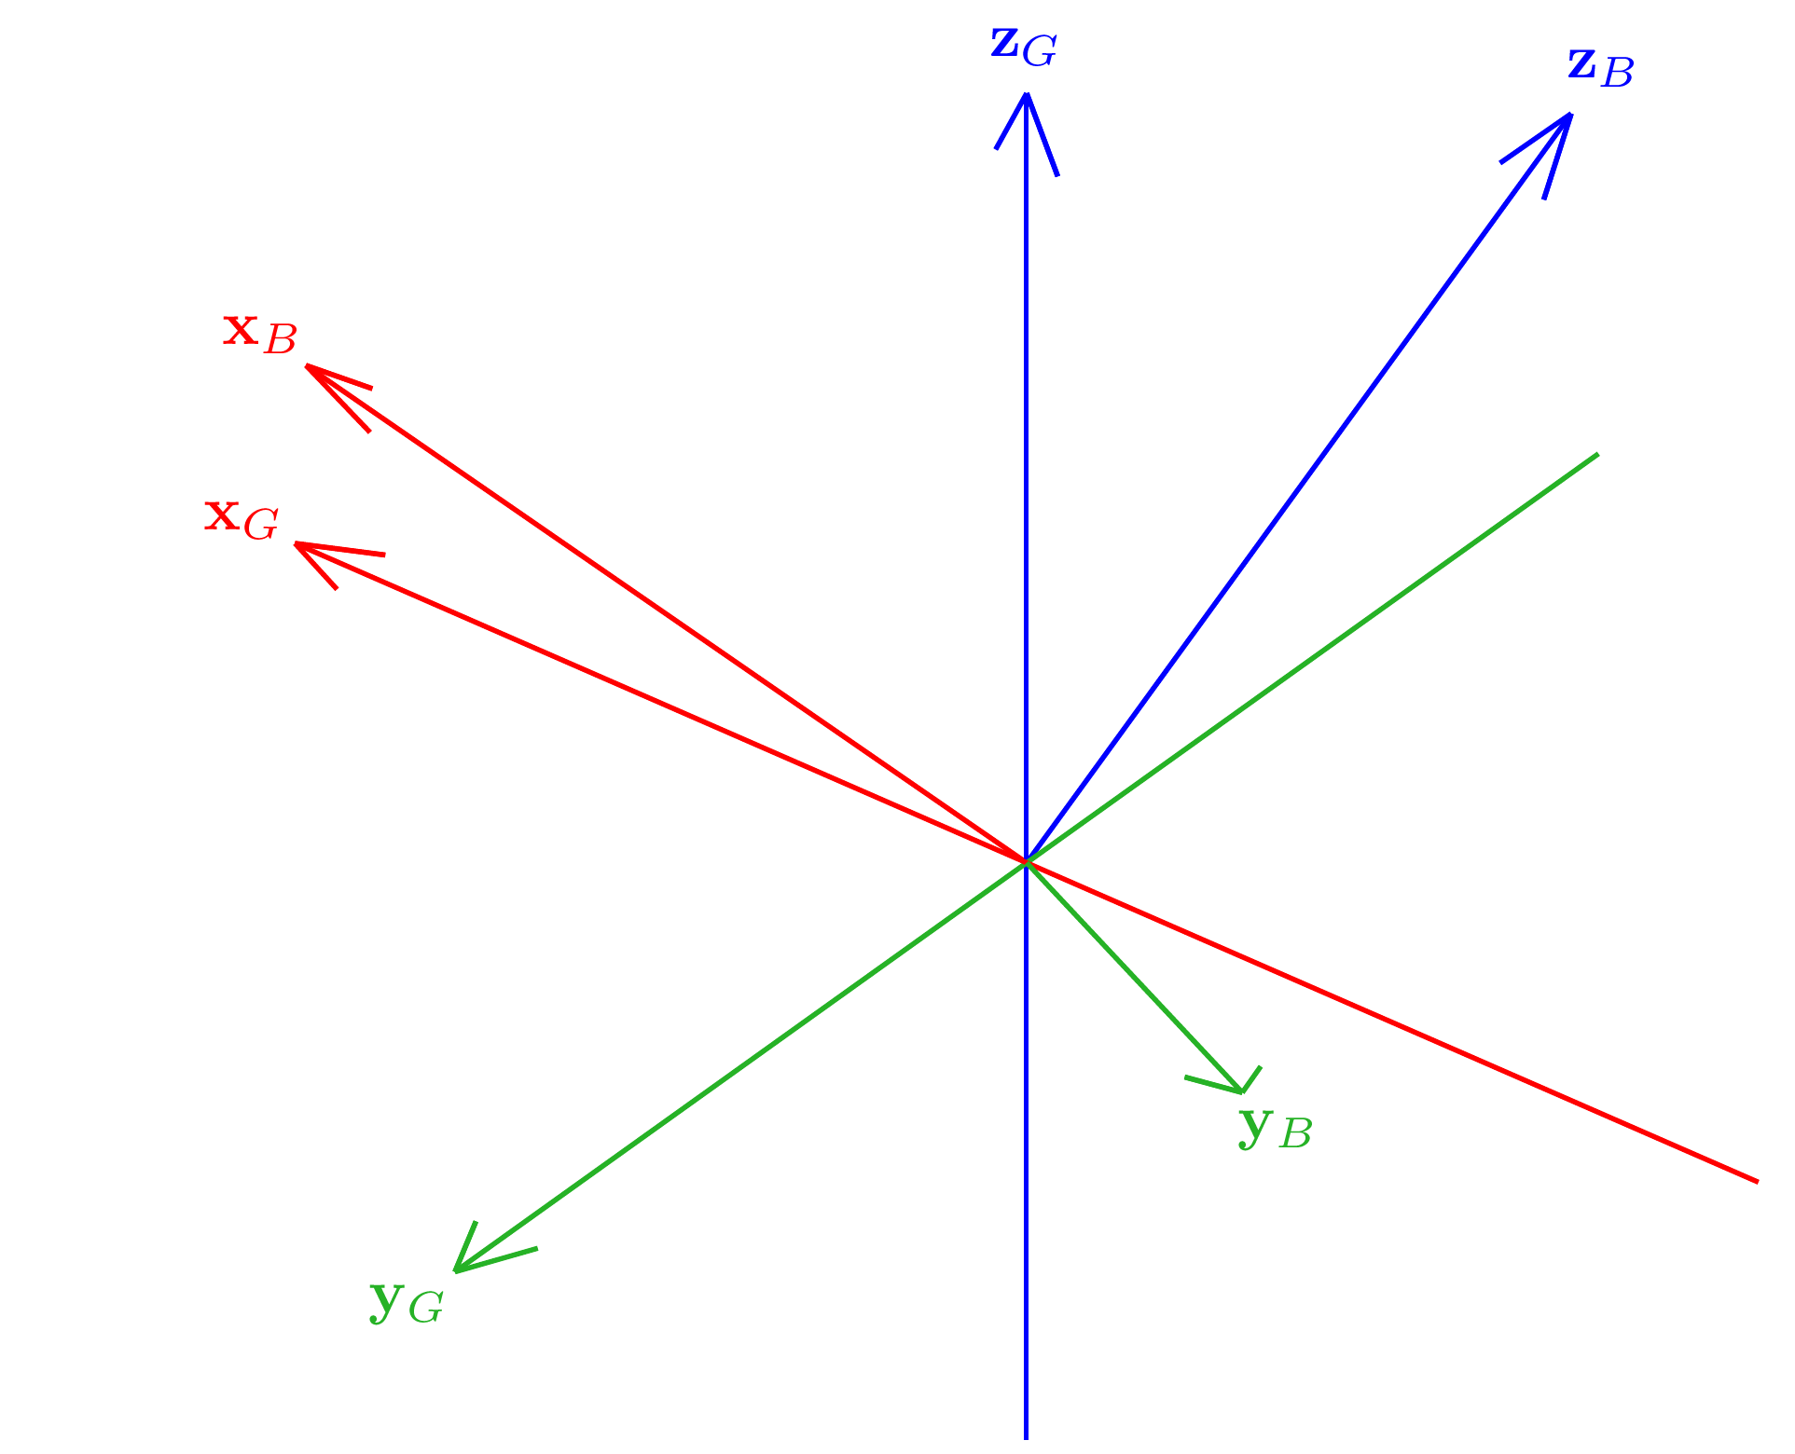
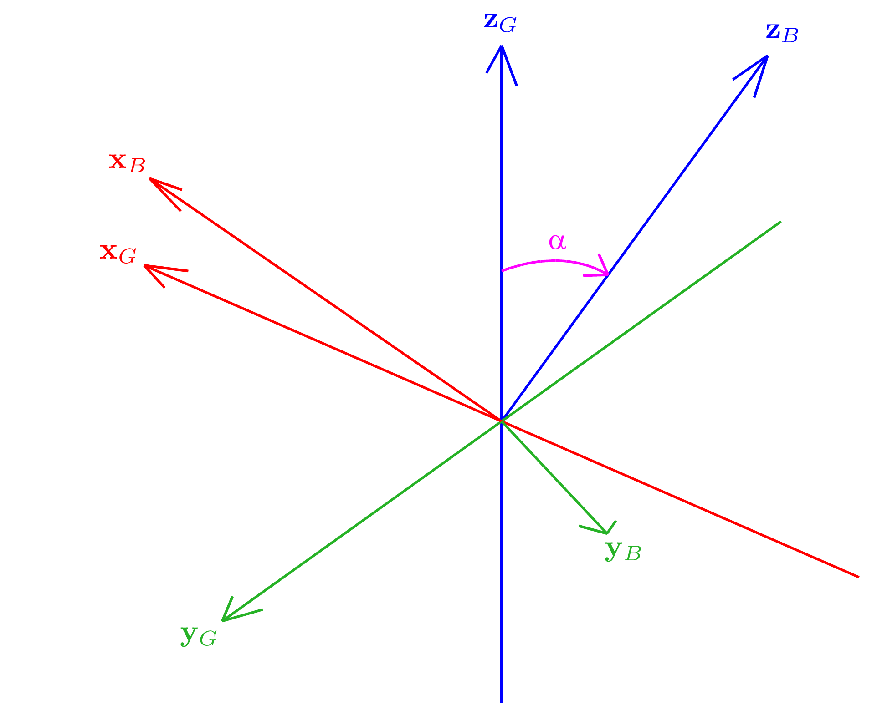
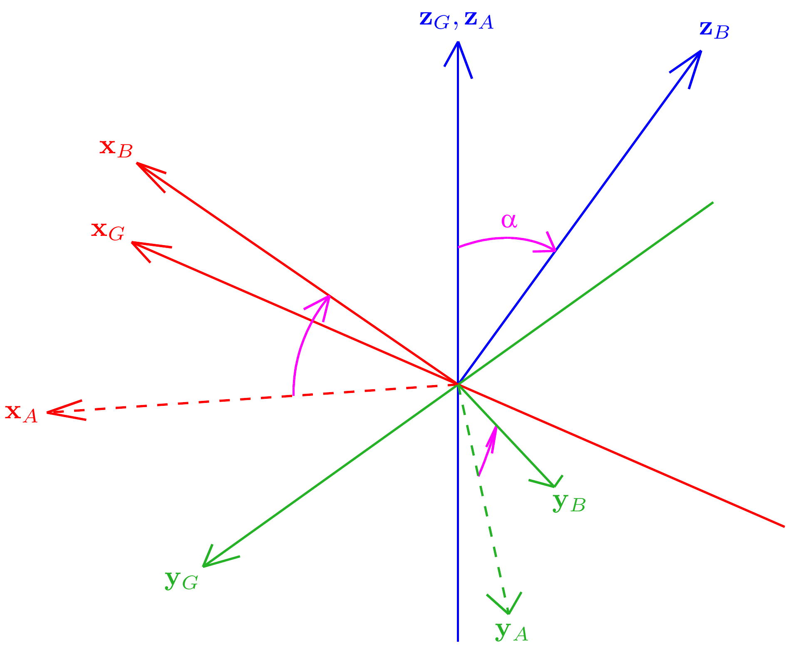
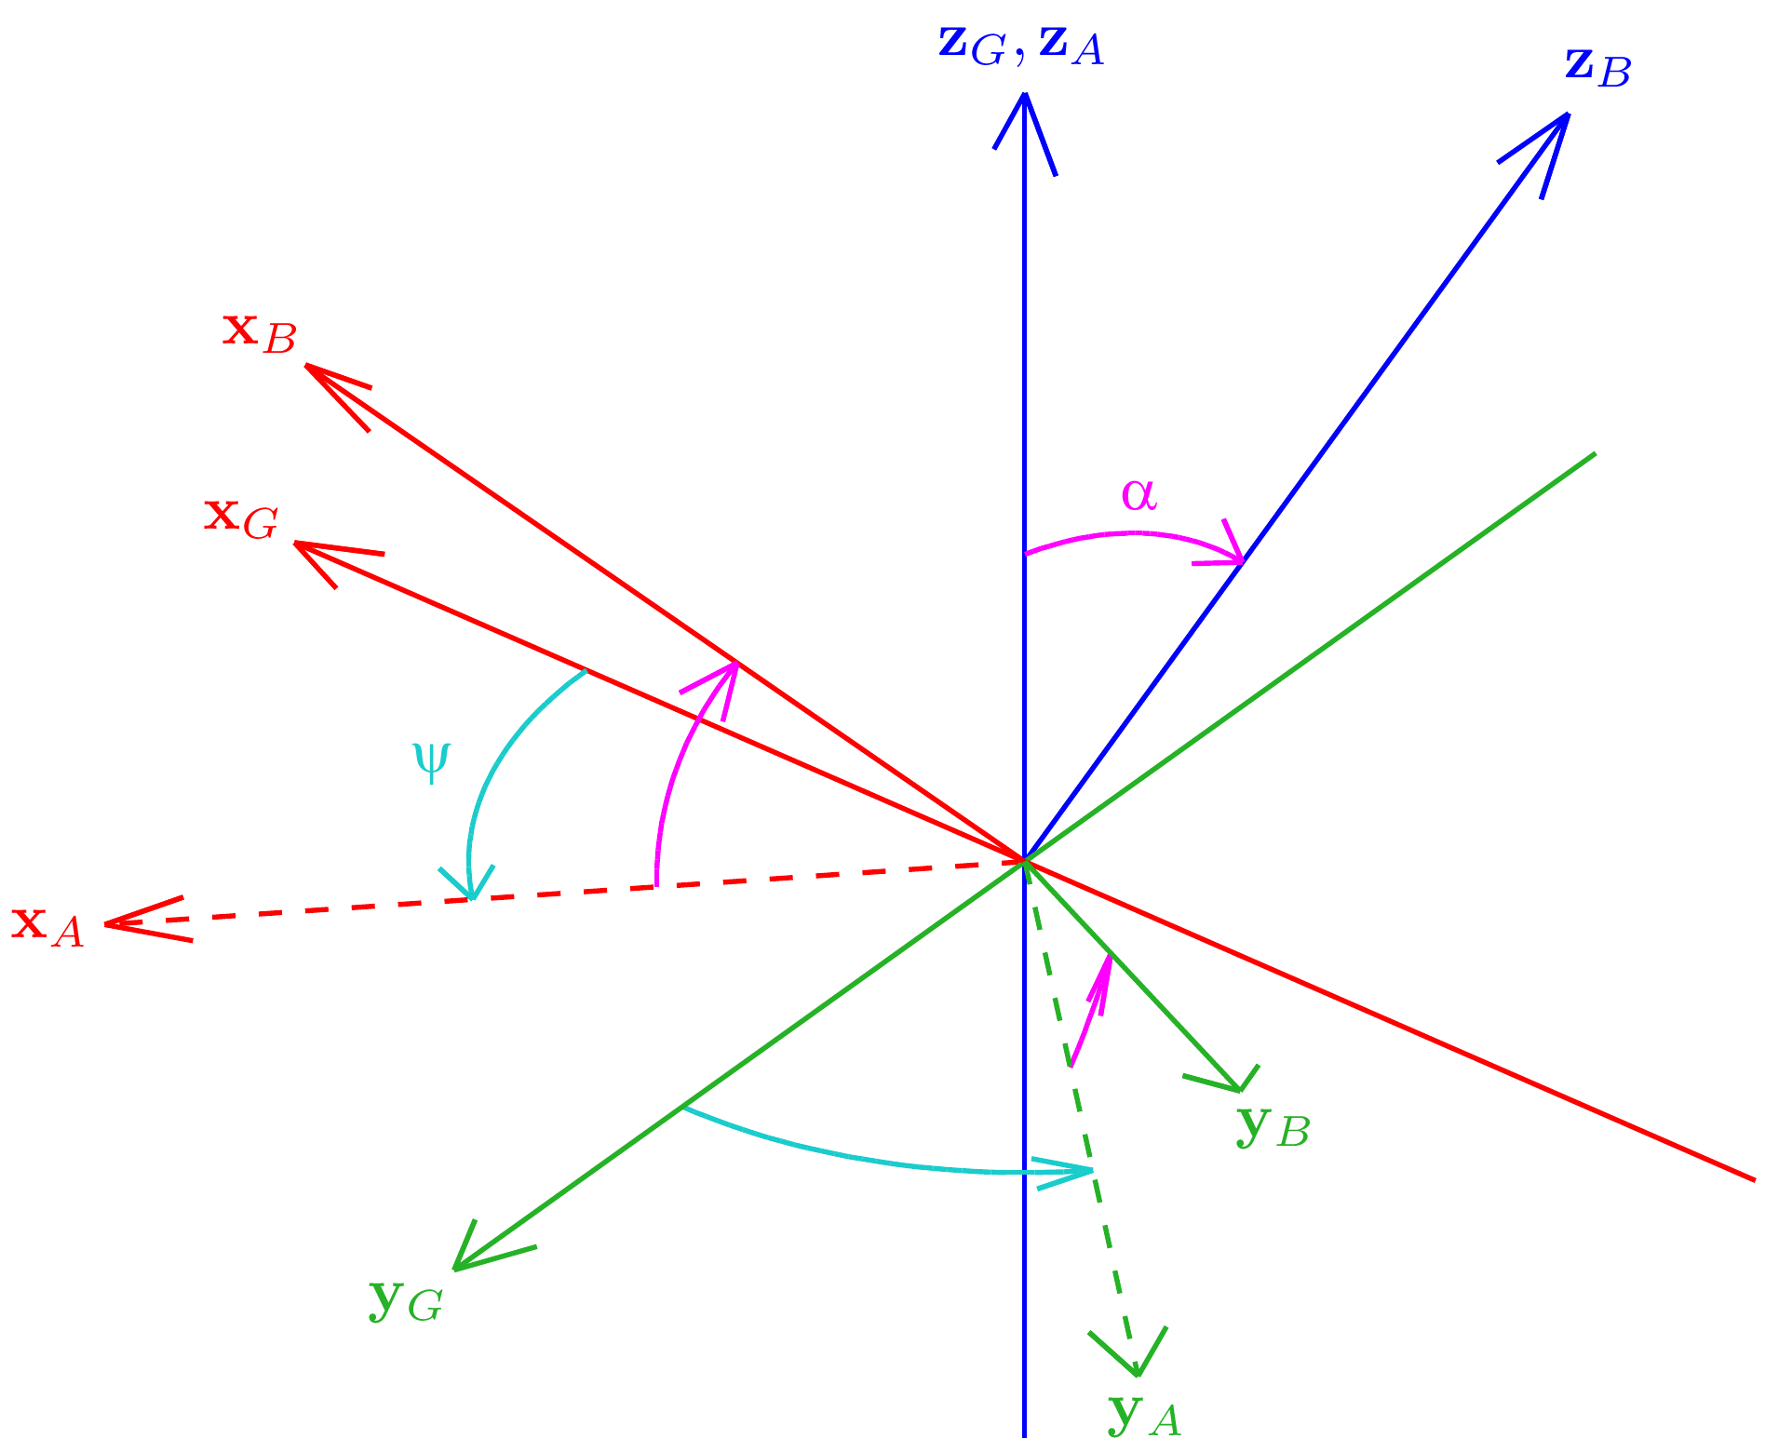
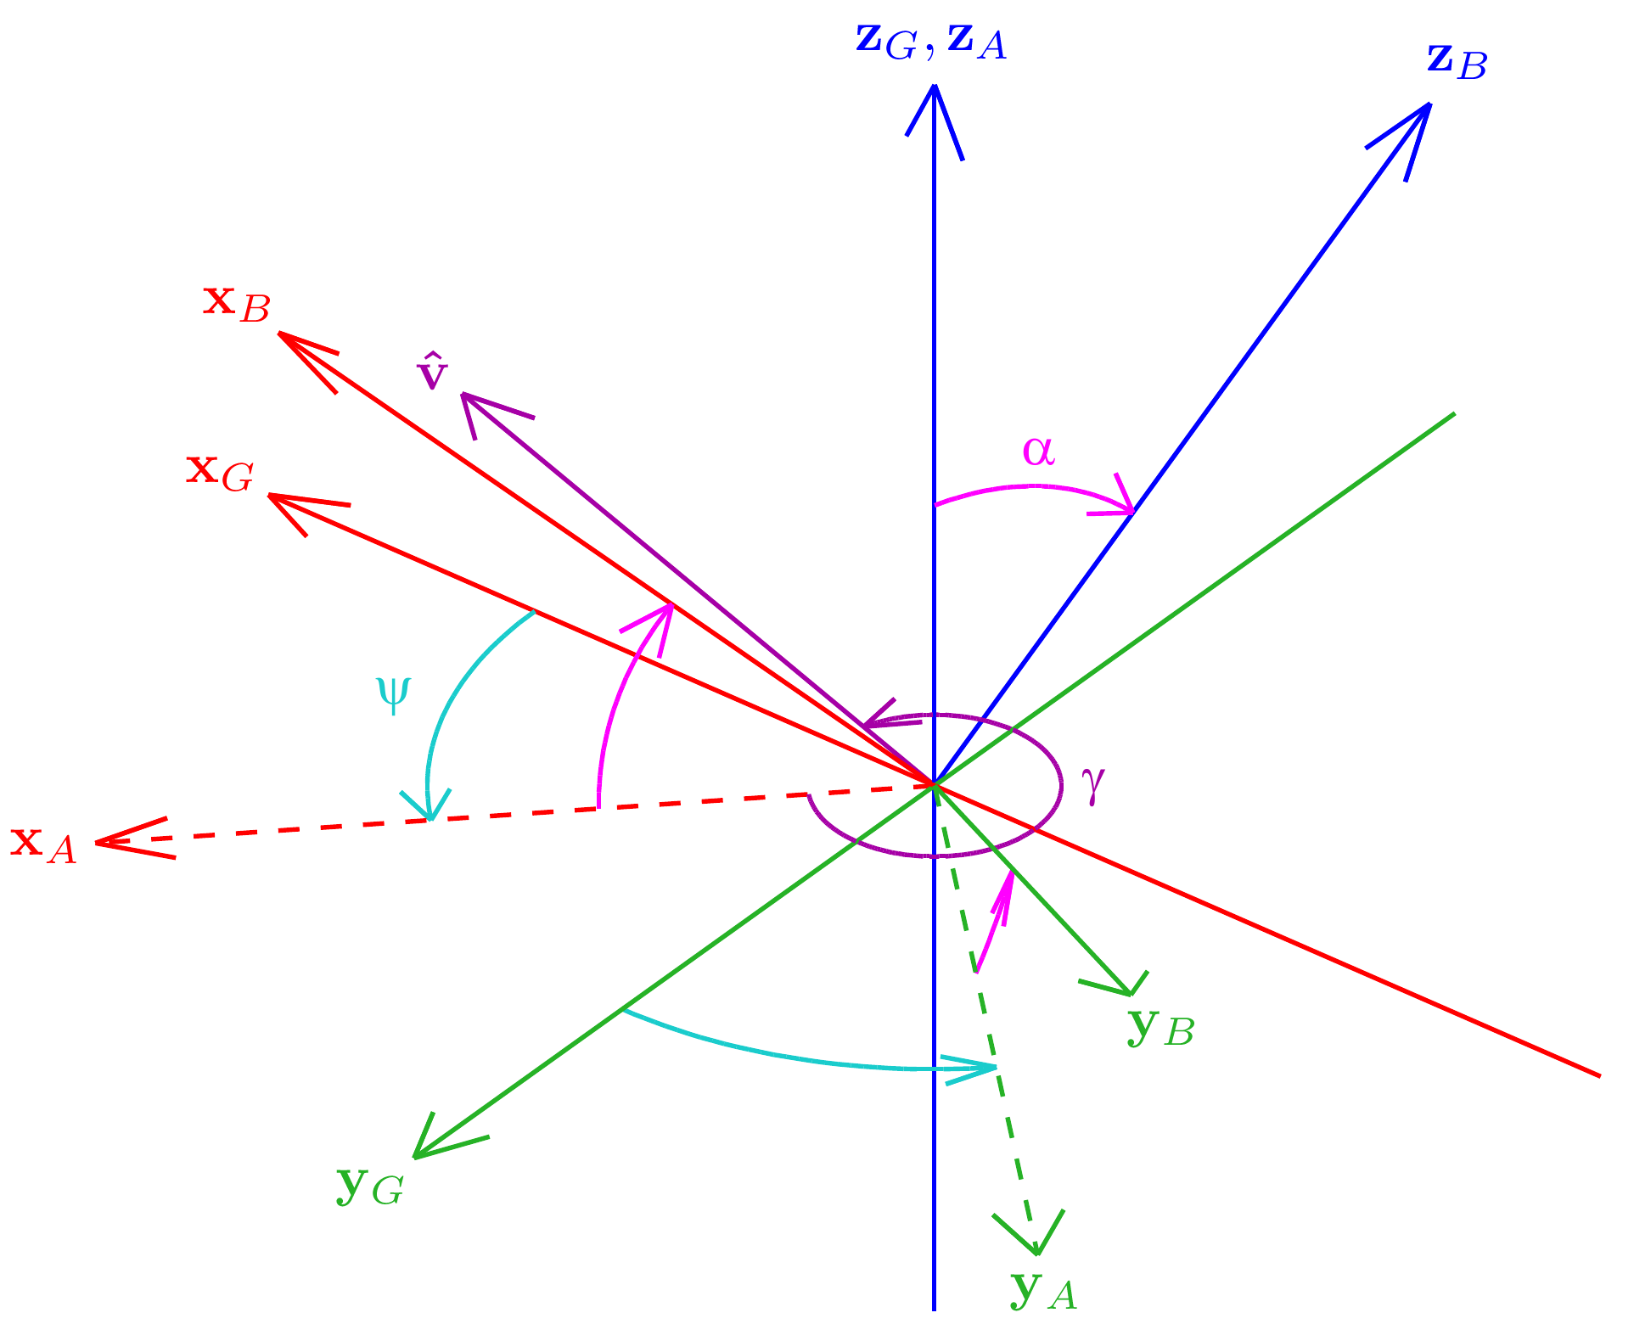
Tilt Angles
Rotation G to B
ψ = Fused yaw
γ = Tilt axis angle
α = Tilt angle

Slide 10
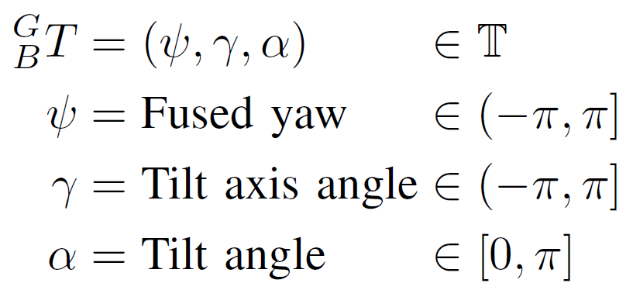
Tilt Angles
Features:
Geometrically and mathematically very relevant
Intuitive and axisymmetric definitions
Drawbacks:
γ parameter is unstable near the limits of α!

Slide 11
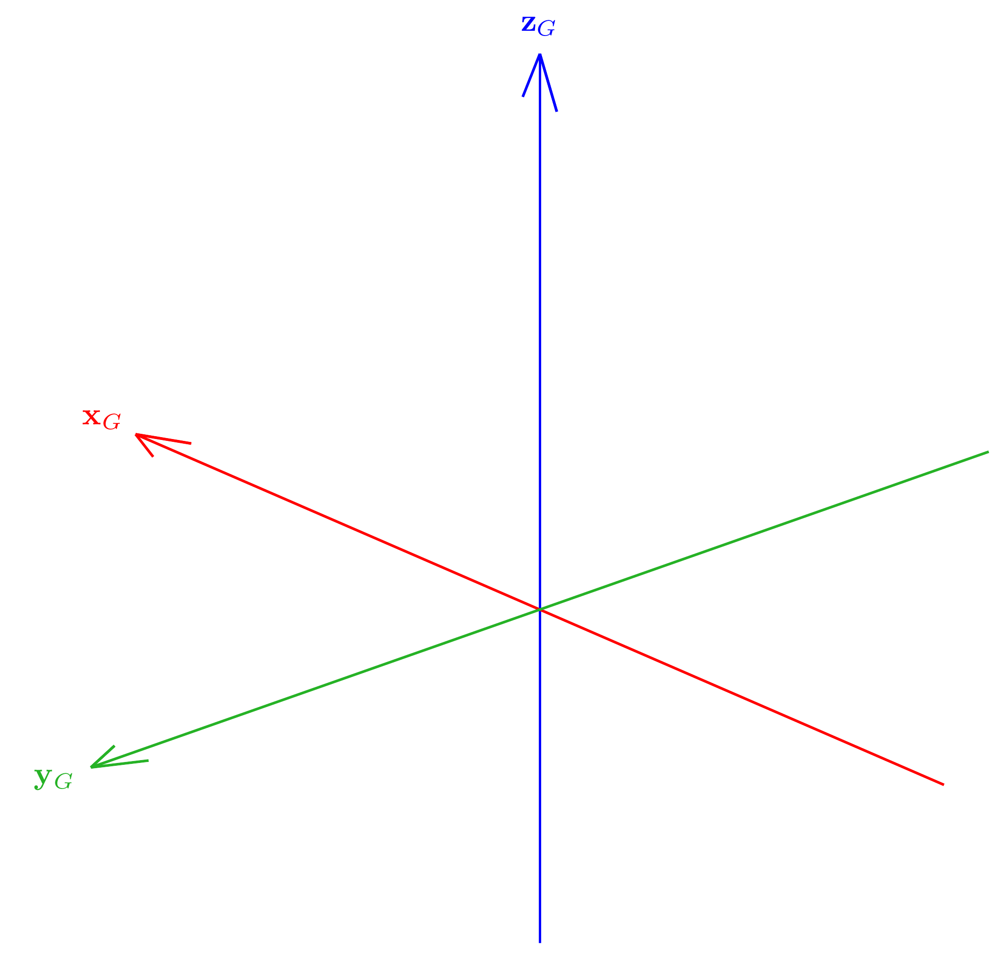
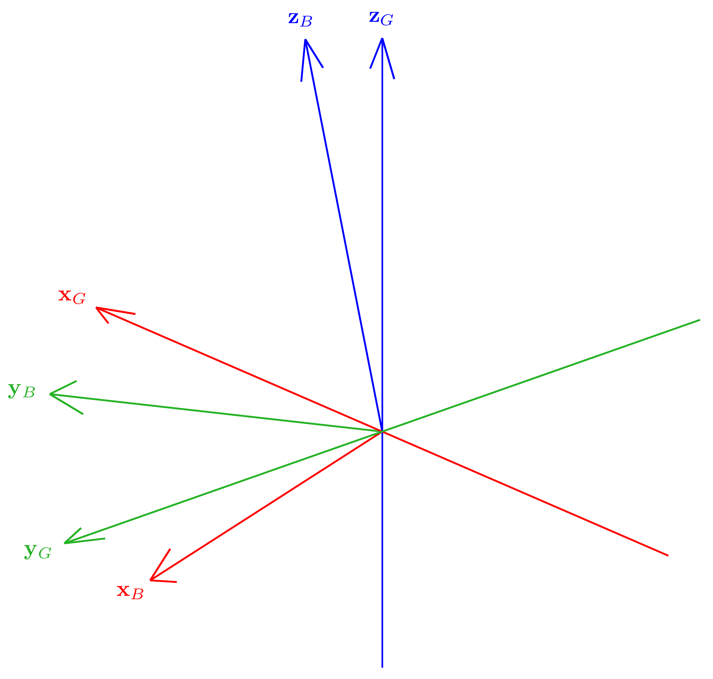
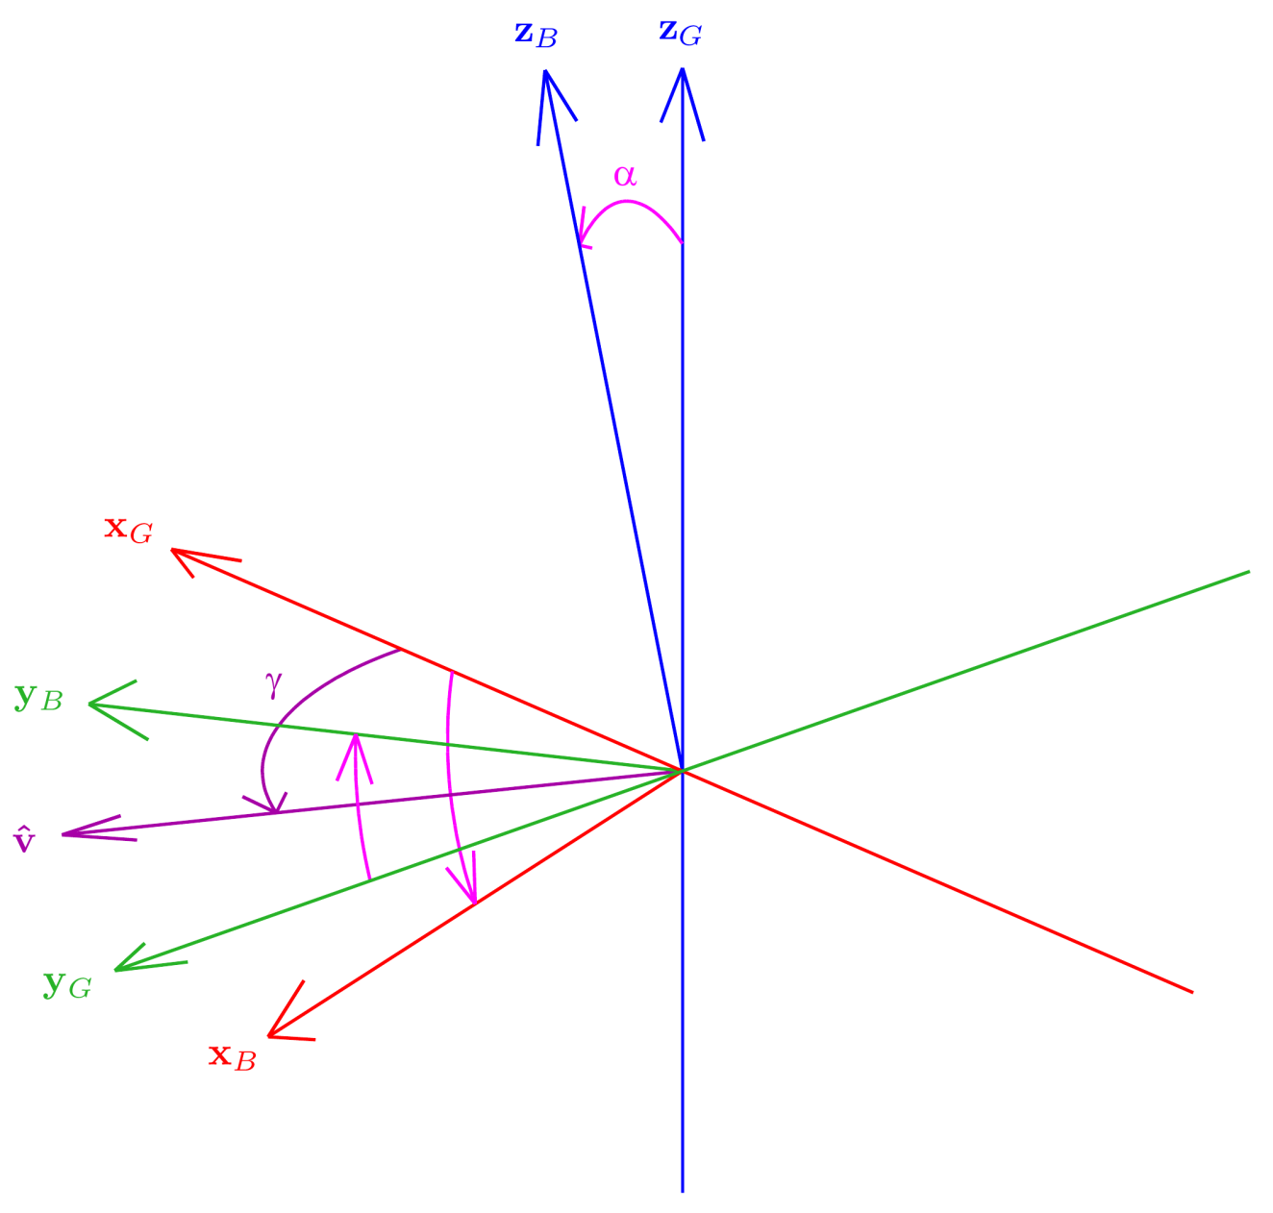
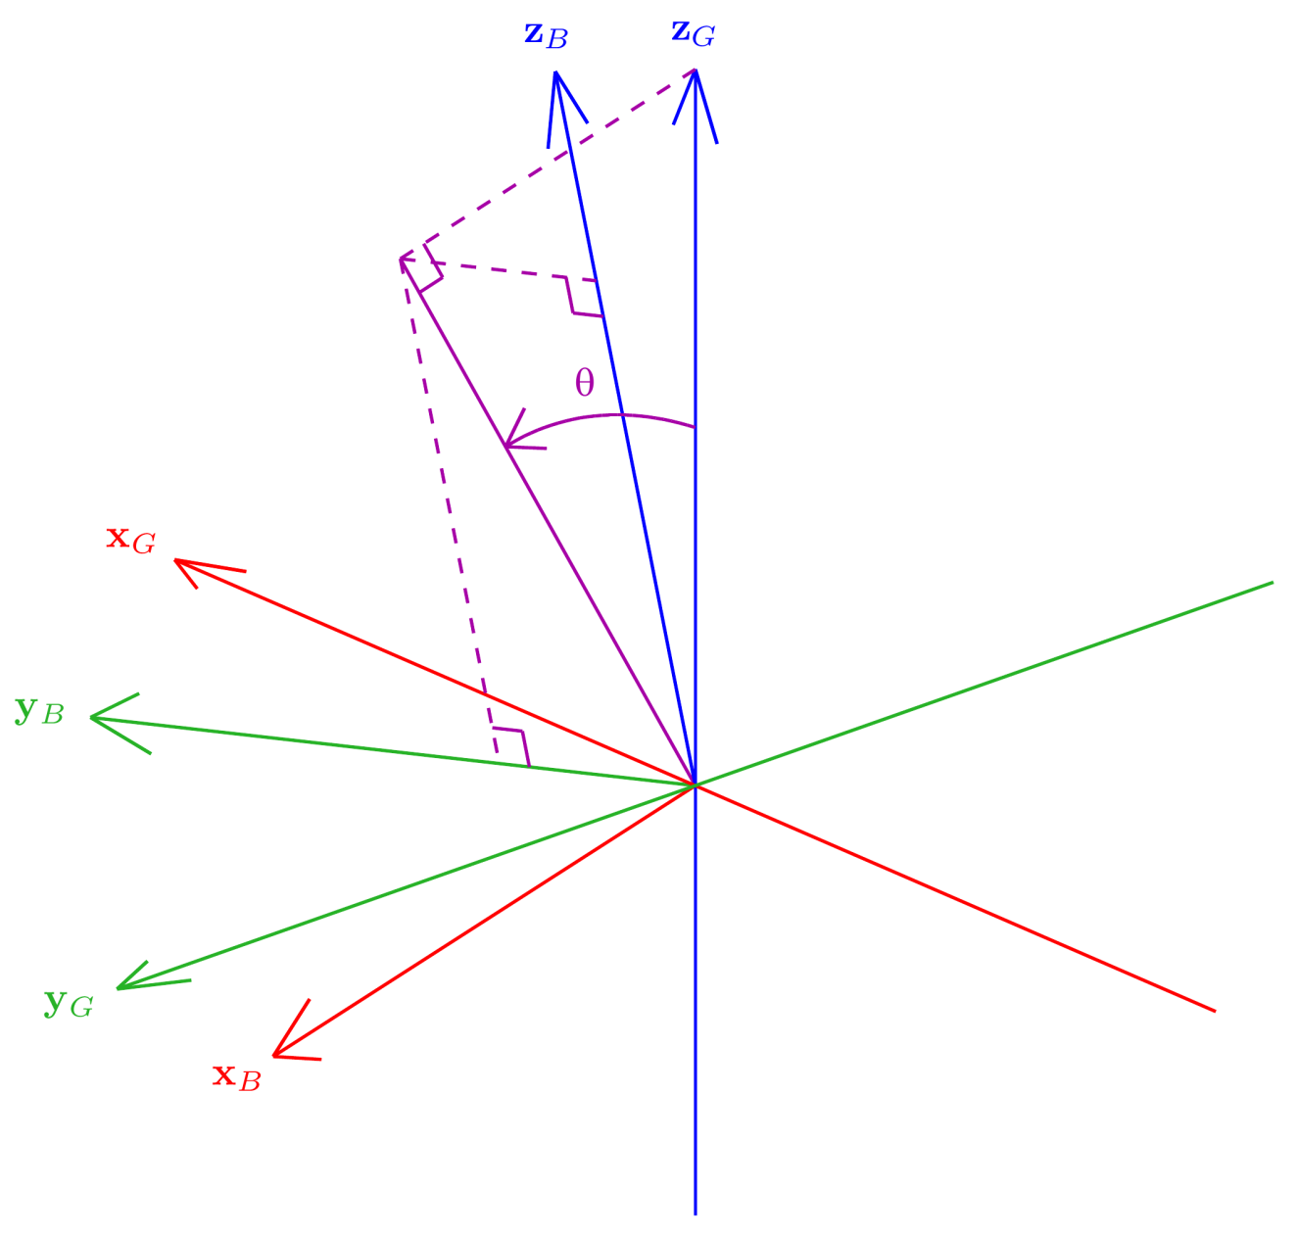
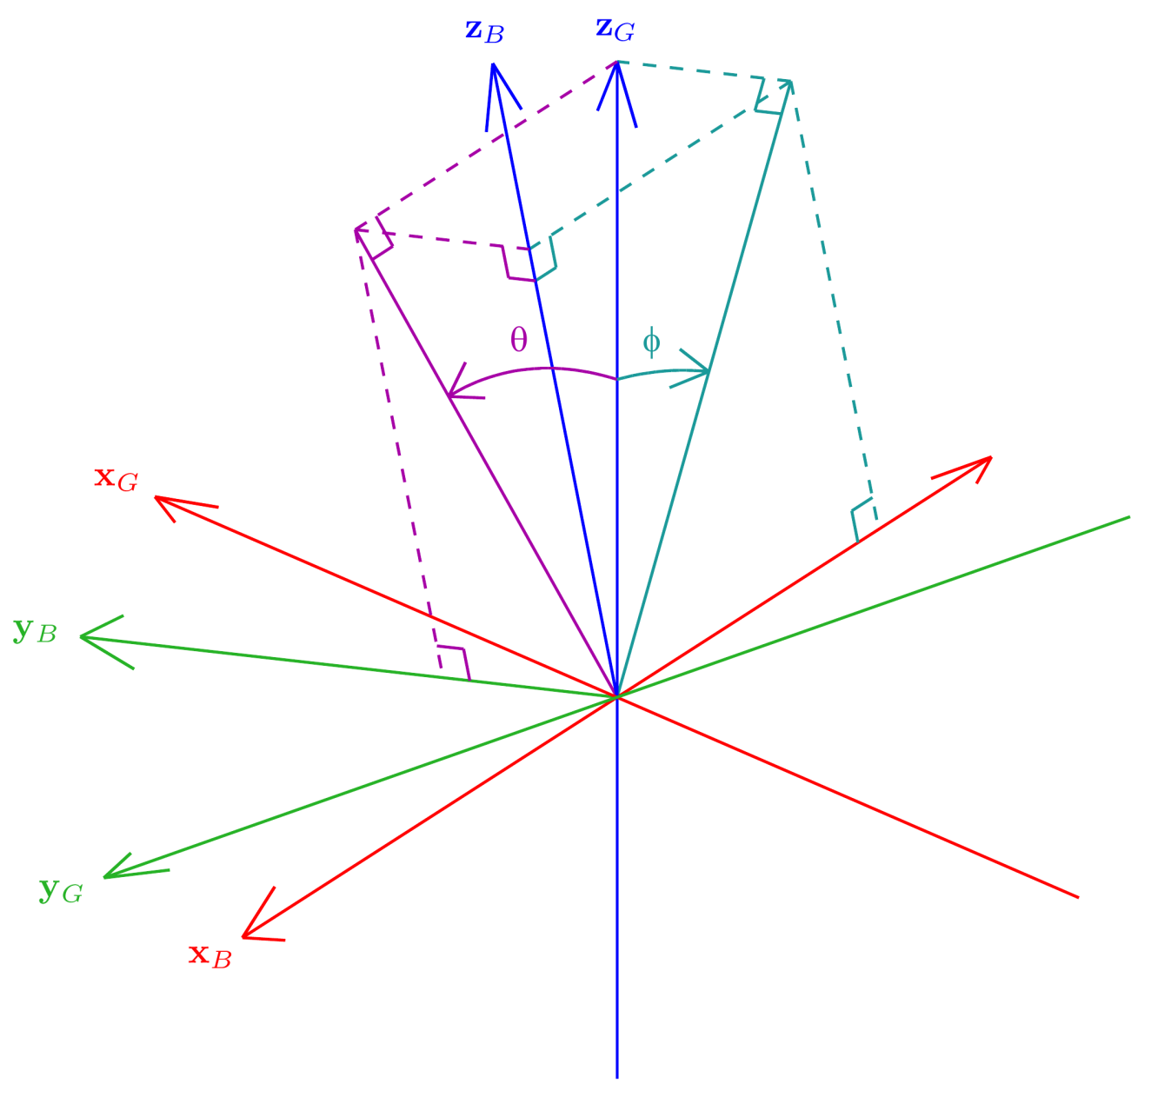
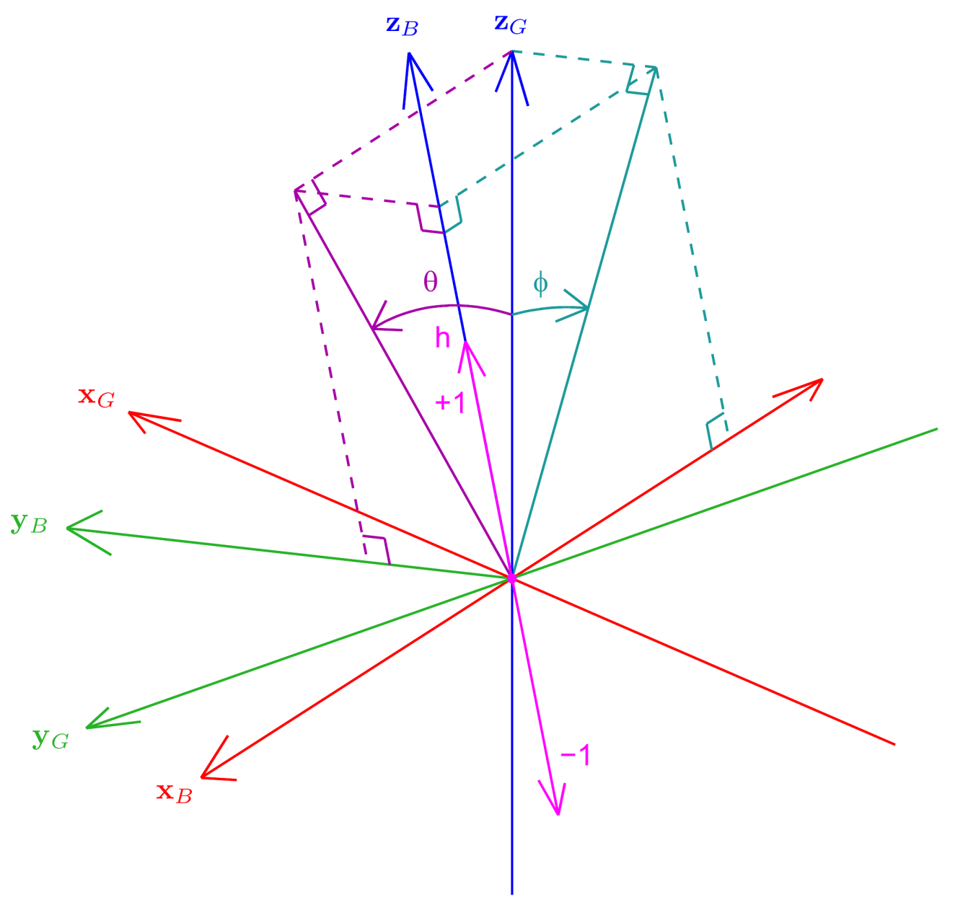
Fused Angles
Rotation G to B Pure tilt rotation!
θ = Fused pitch
φ = Fused roll
h = Hemisphere

Slide 12
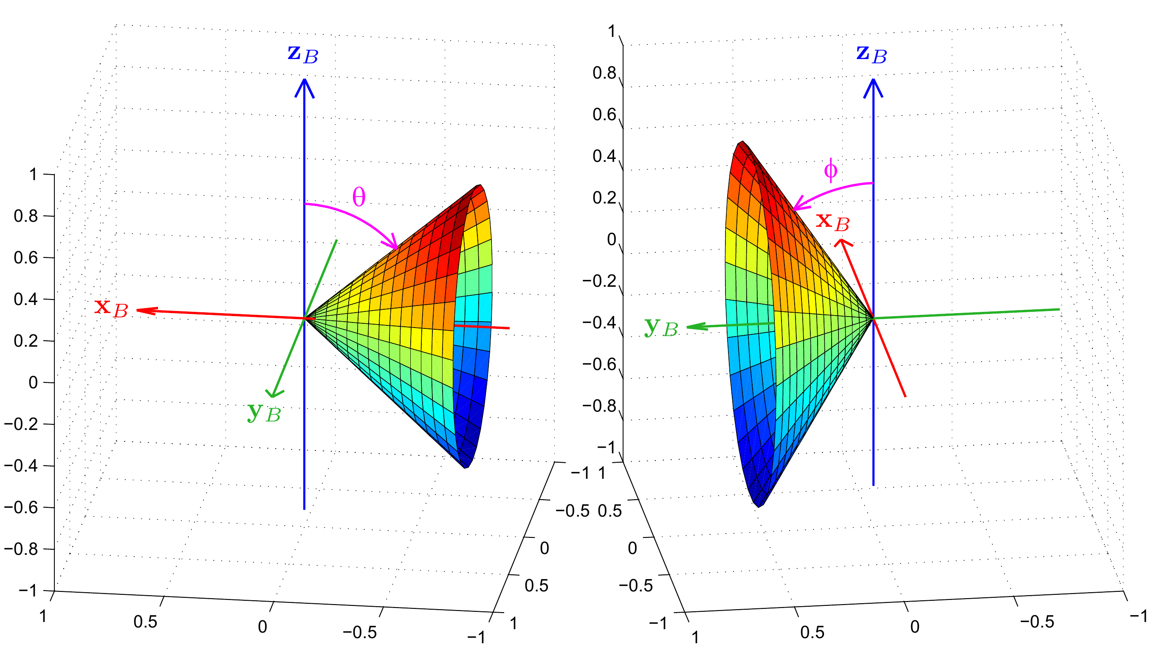
Fused Angle Level Sets

Slide 13
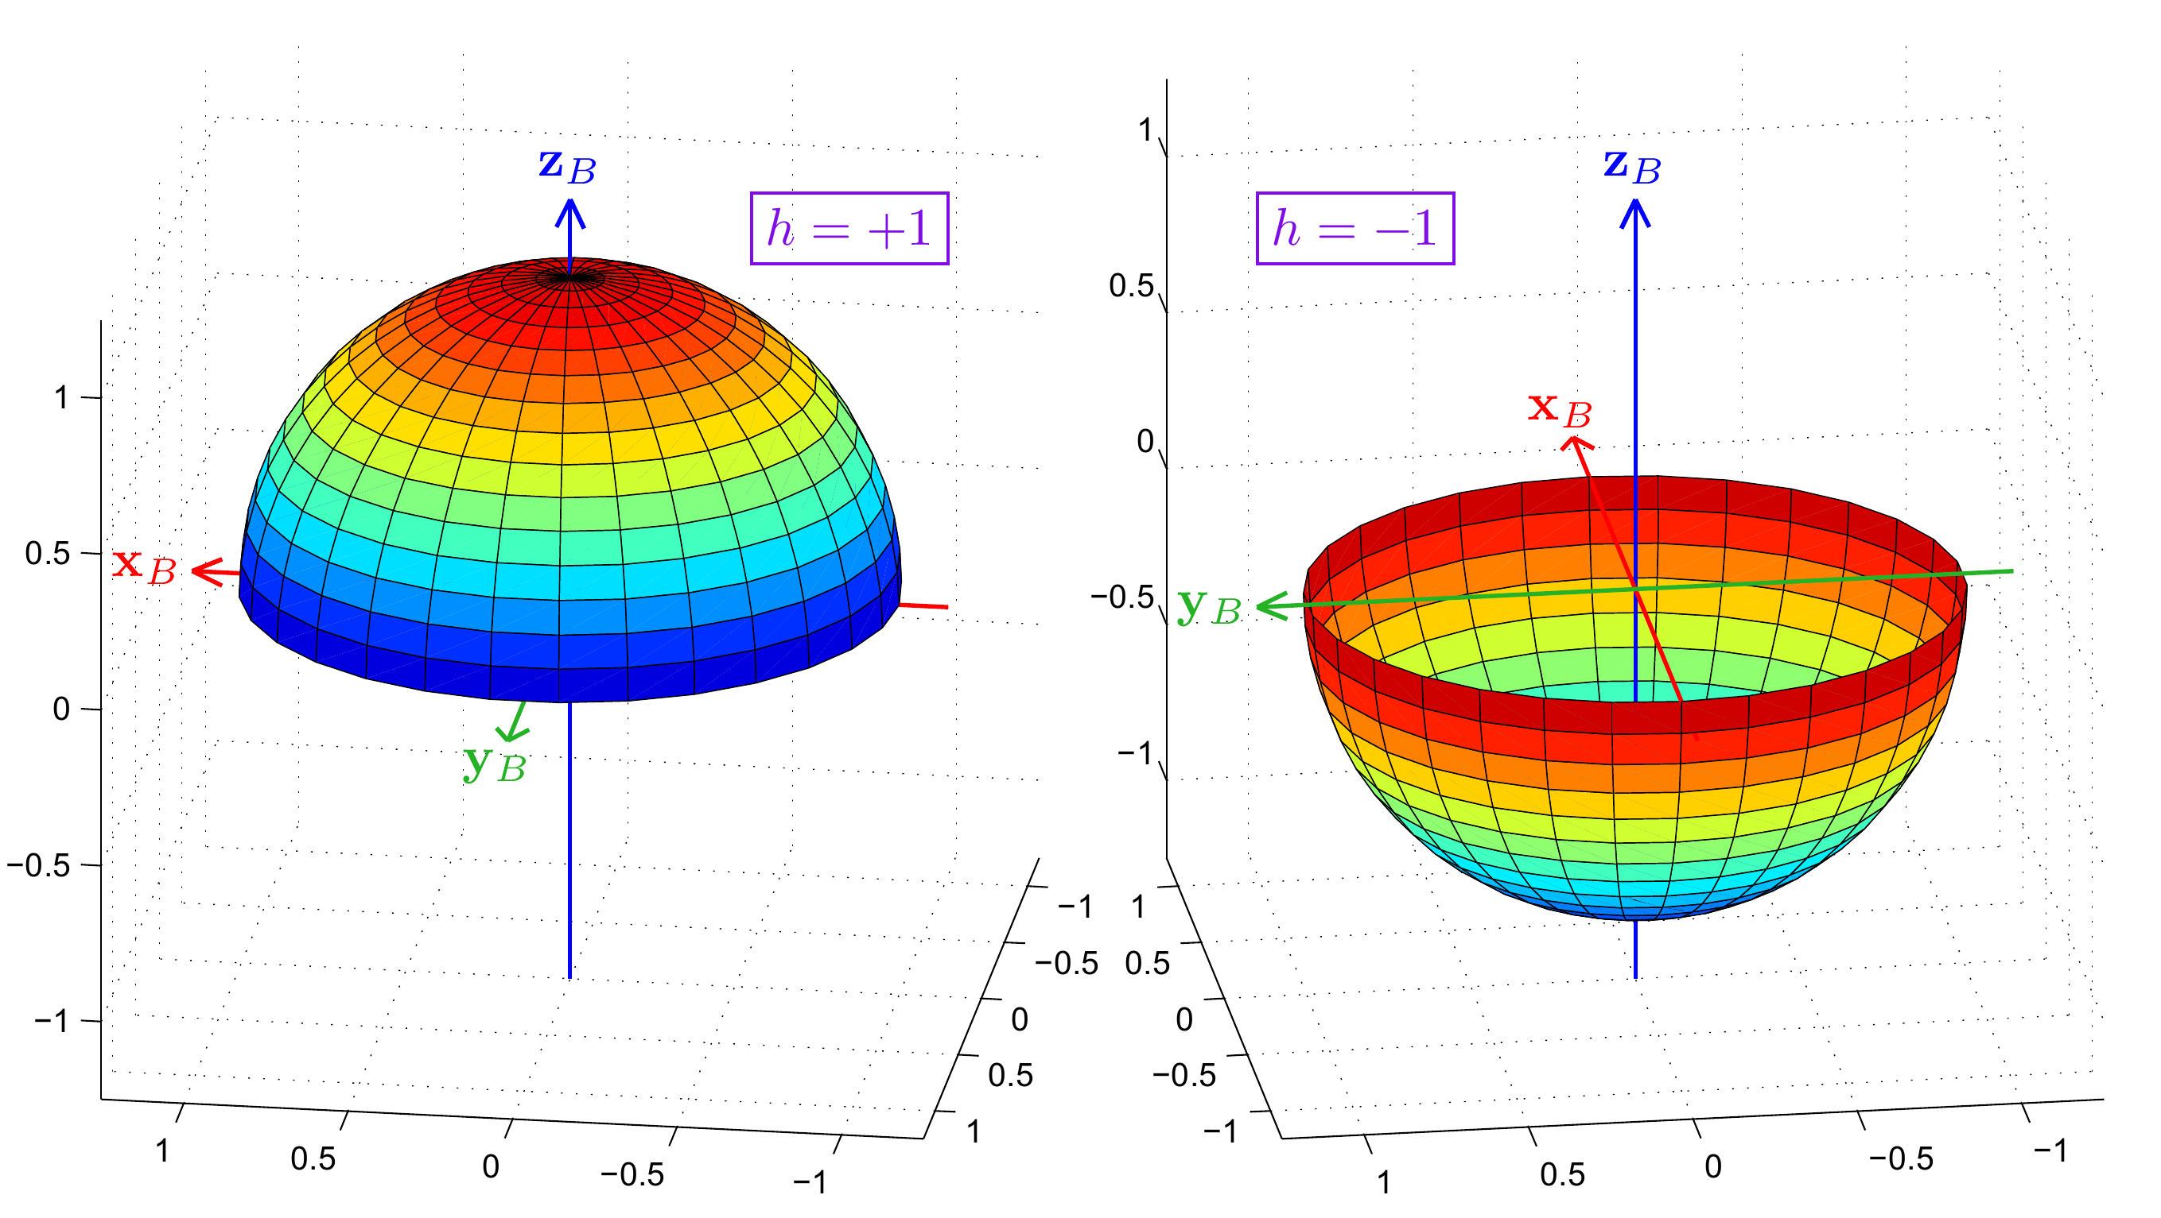
Fused Angle Level Sets

Slide 14
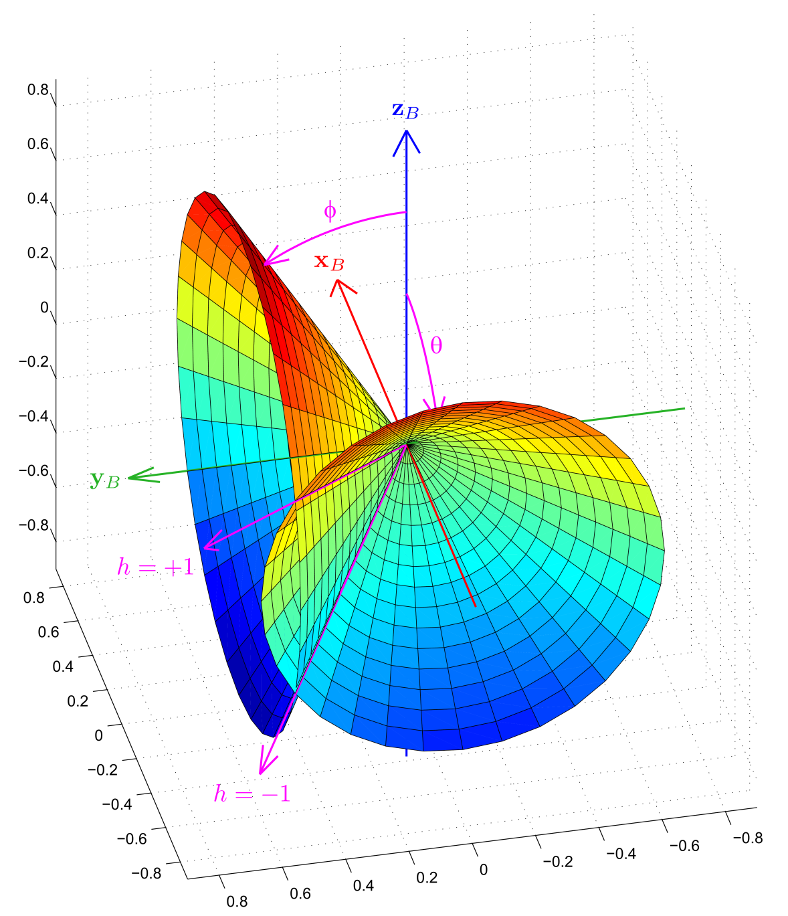
Intersection of Level Sets

Slide 15
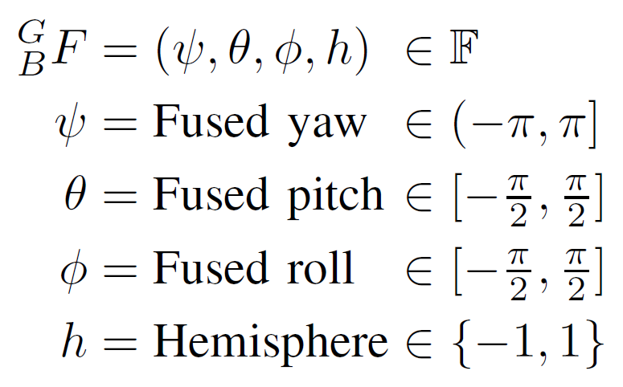
Fused Angles
Condition for validity:
Sine sum criterion
Set of all fused angles:

Slide 16
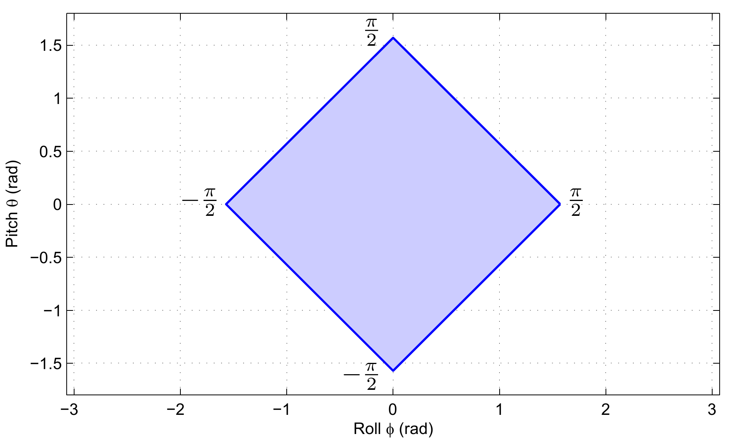
Sine Sum Criterion

Slide 17
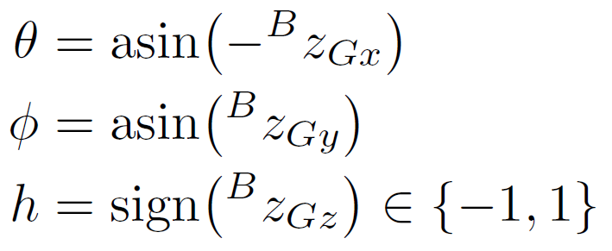
Mathematical Definitions
By analysis of the geometric definitions:

Slide 18
Representation Conversions
Refer to the paper
Fused angles ⇔ Tilt angles
Surprisingly fundamental conversions
Representations intricately linked
Fused angles ⇔ Rotation matrices, quaternions
Simple and robust conversions available
Tilt angles ⇔ Rotation matrices, quaternions
Robust and direct conversions available
Simpler definition of fused yaw arises

Slide 19
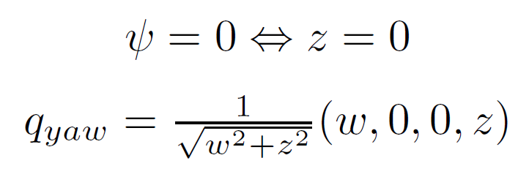
Properties
Tilt axis angle γ has singularities at α = 0, π
…but has increasingly little effect near α = 0
Fused yaw ψ has a singularity at α = π
Unavoidable due to the minimality of (ψ,θ,φ)
As ‘far away’ from the identity rotation as possible
Define ψ = 0 on this null set
Fused yaw and quaternions

Slide 20
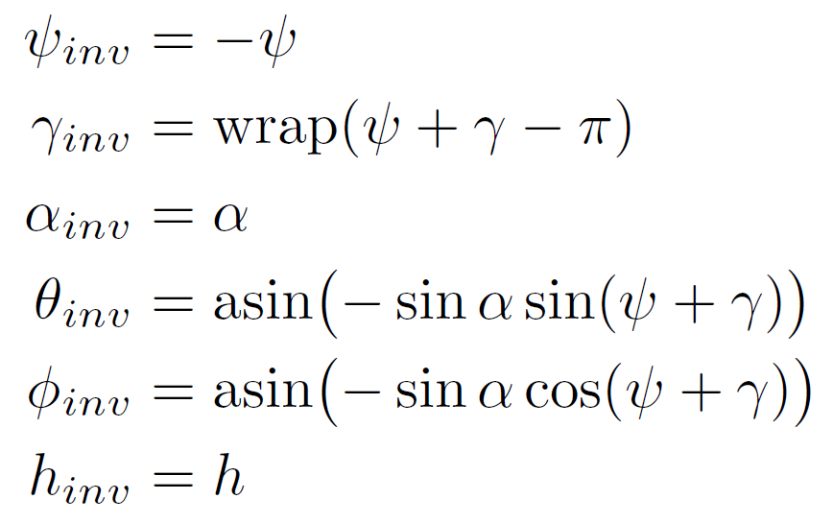
Properties
Inverse of a fused angles rotation
Special case of zero fused yaw

Slide 21
Thank you for your attention!
Matlab/Octave Rotations Library https://github.com/AIS-Bonn/matlab_octave_rotations_lib

Slide 22
References

Slide 23
Rotation Matrices
Containing set:
Parameters: 9 ⇒ Redundant
Constraints: Orthogonality (determinant +1)
Singularities: None
Features: Trivially exposes the basis vectors, computationally efficient for many tasks, numerical handling is difficult

Slide 24
Quaternions
Containing set:
Parameters: 4 ⇒ Redundant
Constraints: Unit norm
Singularities: None
Features: Dual representation of almost every rotation, computationally efficient for many tasks, unit norm constraint must be numerically enforced

