Slide 1
A ROS-based Software Framework for the NimbRo-OP Humanoid Open Platform
Philipp Allgeuer, Max Schwarz, Julio Pastrana
Sebastian Schueller, Marcell Missura, Sven Behnke
Institute for Computer Science VI
Autonomous Intelligent Systems

Slide 2
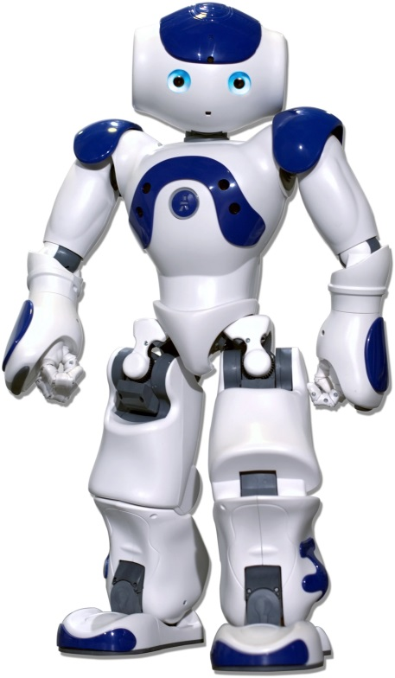
Motivation
Why do we want a framework?
Implement features in a structured environment
Provide out of the box capabilities
Why use ROS?
Open source, modular, easy code reuse
Hardware abstraction, low-level control
Other robots with ROS frameworks?
Willow Garage PR2, Cosero NimbRo
TurtleBot, Aldebaran Nao

Slide 3
Robot Operating System (ROS)
What is ROS?
Meta-operating system designed for robots
Community-based open source initiative
Open Source Robotics Foundation, Willow Garage
Pros and cons of ROS?
Modular, hardware portable, flexible
Provides abstraction layers and device drivers
Large ROS package repository, code sharing
System communications overhead

Slide 4
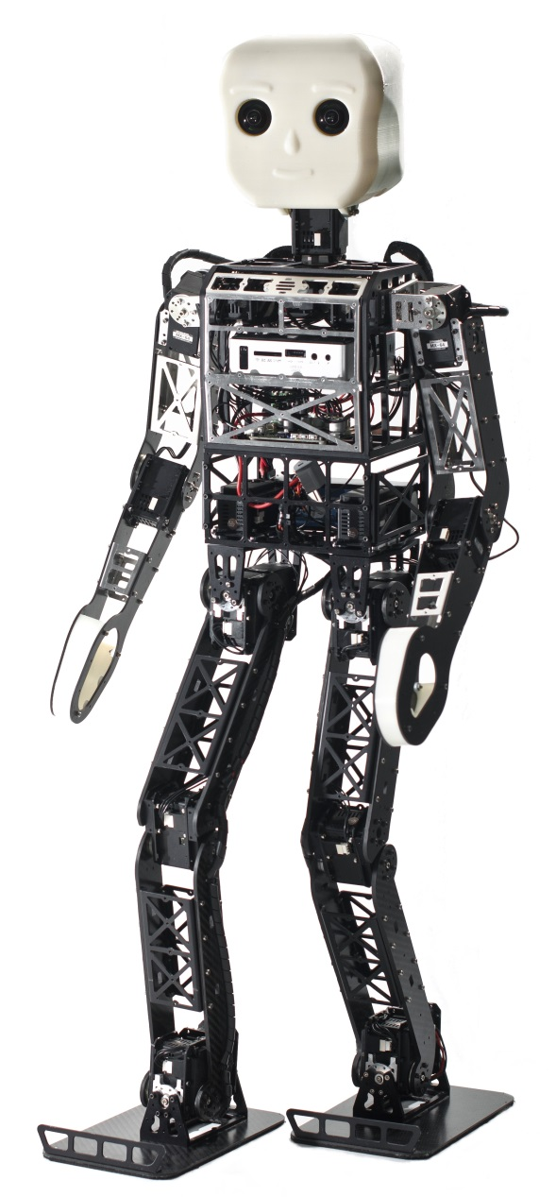
The NimbRo-OP Robot
Robotis Dynamixel MX Series Actuators
8 × MX-64: Shoulder, elbow, neck
12 × MX-106: Hip, knee, ankle
Materials
Carbon composite
Aluminium, ABS+
Dimensions
Height 95cm, 6.6kg
Battery
Lithium Polymer
14.8V, 3.6Ah
2
2
2
Battery
1
1
3
95cm
3
1
1
Open source hardware and software!
2
2

Slide 5
The NimbRo-OP Robot
WiFi Adapter
Standard: IEEE 802.11b/g/n
Wide-angle Camera with Fisheye Lens
Logitech C905
Zotac ZBox Nano XS
AMD E-450 1.65 GHz (dual core)
2 GB RAM, 64 GB SSD
USB 3.0, HDMI, Gigabit Ethernet
Memory card slot
CM730 Control Board
Servo communications
3-axis accelerometer
3-axis gyroscope
3-axis compass
WiFi Adapter
Camera
Processor
CM730
Discussion of Hardware

Slide 6
Software Architecture
Framework is split into processes called ROS nodes
Plugin schemes limit interprocess communication
Active Processes: Vision Nodelet Manager, Localization, Behavior Control, Robot Control
Passive Processes: Configuration Server, Game Controller, Joystick Driver
Tools: Calibration Tool, Vision GUI, Trajectory Editor, Visualization Tools
Active Processes: Vision Nodelet Manager, Localization, Behavior Control, Robot Control
Active Processes: Vision Nodelet Manager, Localization, Behavior Control, Robot Control
Active Processes: Vision Nodelet Manager, Localization, Behavior Control, Robot Control
Active Processes: Vision Nodelet Manager, Localization, Behavior Control, Robot Control
Passive Processes: Configuration Server, Game Controller, Joystick Driver

Slide 7
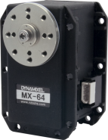
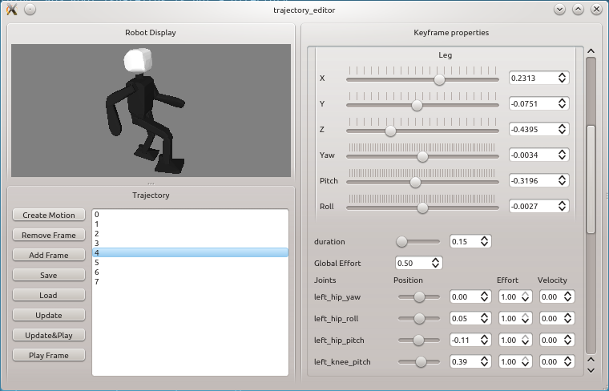
Robot Control Node
Low-level servo control and sensor management
Hardware abstraction via hardware interfaces:
Robot interface
Robot dummy interface
Extended via motion module plugins:
Gait
Head control
Fall protection
Motion player

Slide 8
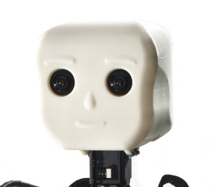
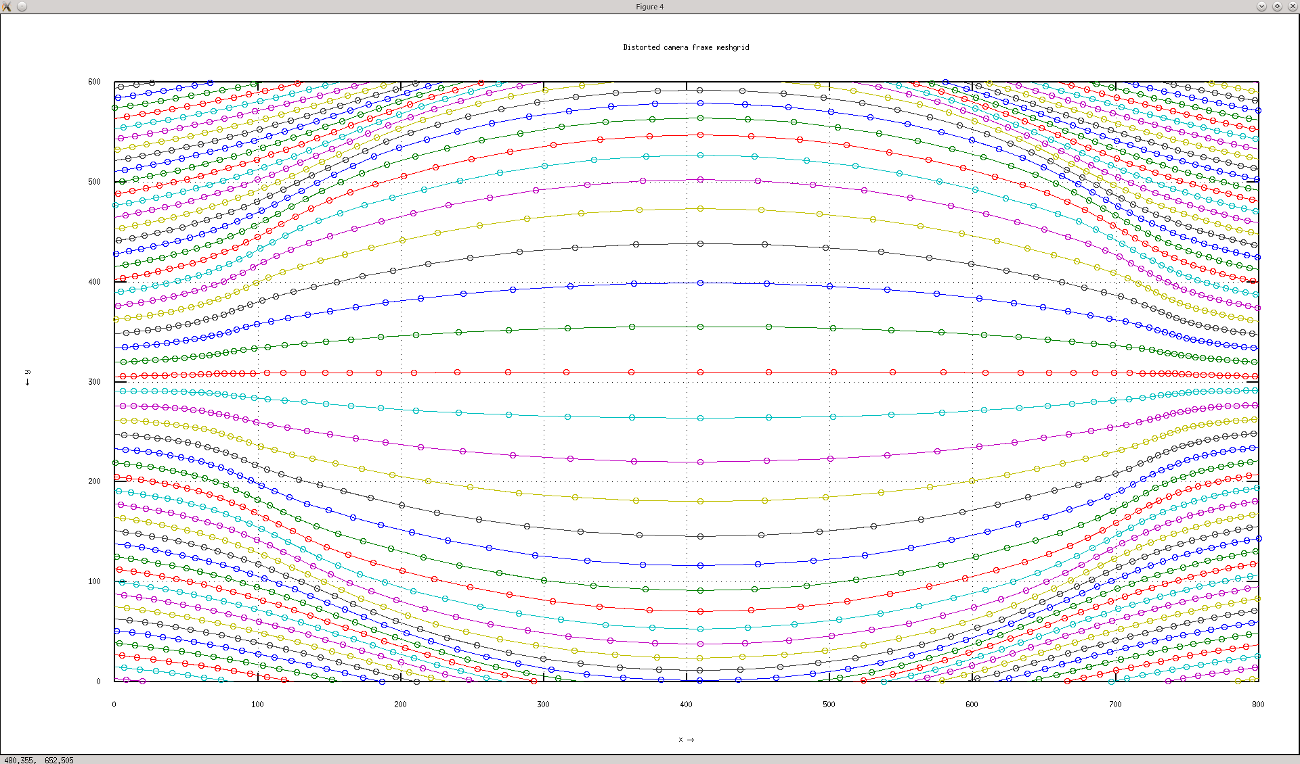
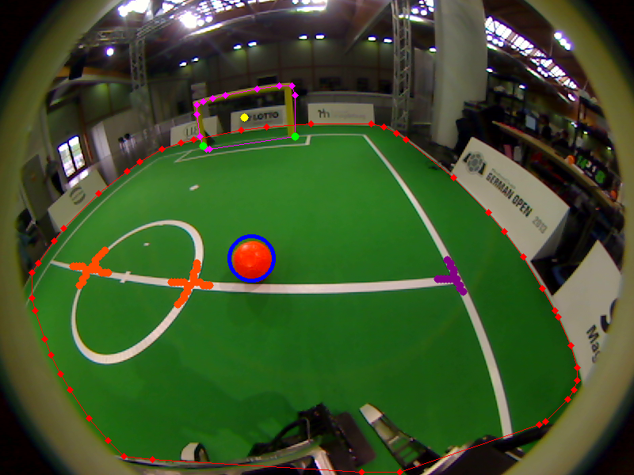
Vision System
Captures 800 × 600 YUYV images at 24Hz
Field of view ≈ 180° → Good visibility but high distortion

Slide 9
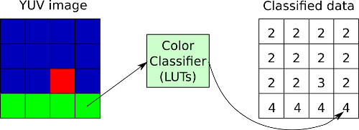
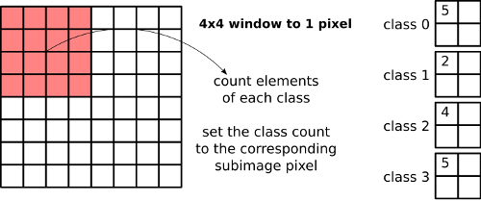
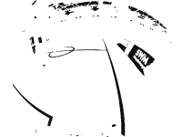
Vision System
Green
Yellow
Orange
White

Slide 10
Vision System

Slide 11
State Estimation
Local pose of the NimbRo-OP
Joint encoders → Forward kinematics
Torso attitude
3-axis accelerometer, 3-axis gyroscope
Angle estimation filter to get fused angle
Global pose of the NimbRo-OP
Localization using particle filter (beta)
Processes compass readings, white line crossings and goal post detections

Slide 12
Configuration Server
How to dynamically configure system parameters?
ROS parameter server?
ROS dynamic reconfigure package?
Configuration server?
Features:
Centralized manager and storage location for system parameters, with runtime reconfigurability
Parameters are shared globally across nodes
Can load and save entire parameter hierarchy
Configuration server

Slide 13
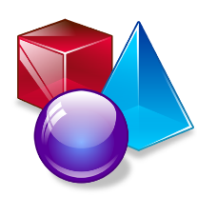
System Visualization

Slide 14
Behavior Control
Implemented using behavior control frameworks
Predominant architecture in use here is the BCF
Soccer behaviors have been implemented:
Search for the ball and walk behind it, while avoiding obstacles
Dribble and kick the ball towards the goal
State Controller Library (SCL)
Behavior Control Framework (BCF)
http://sourceforge.net/projects/statecontroller/
http://sourceforge.net/projects/behaviourcontrol/

Slide 15
Software Release
Link to ROS software release:
https://github.com/NimbRo/nimbro-op-ros
Last updated Oct 7, 2013
Future work
ROS framework is expected to be subject to further revisions and additions
e.g. Object tracking and filtering
Integration of physics-based simulator
More advanced soccer behaviors

Slide 16
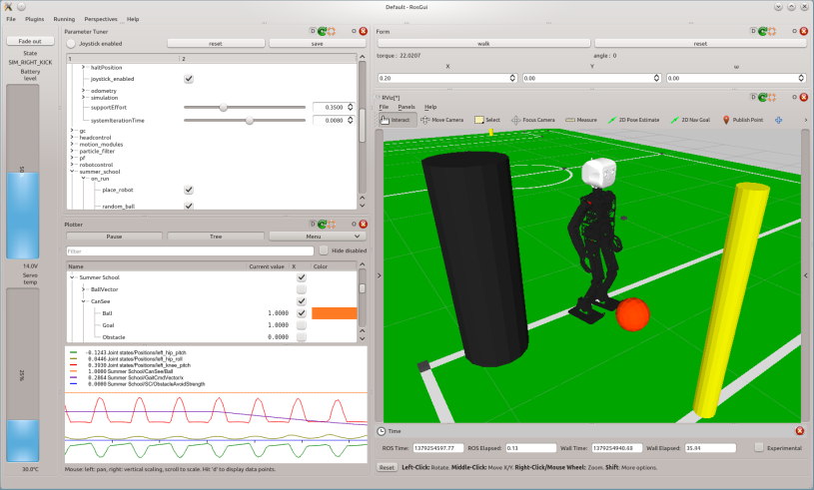
Thank you for your attention!

