Slide 1
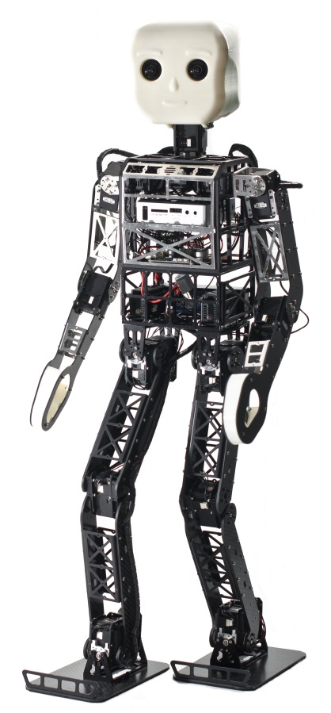
Hierarchical and State-based Architectures for Robot Behavior Planning and Control
Philipp Allgeuer and Sven Behnke
Institute for Computer Science VI
Autonomous Intelligent Systems

Slide 2
Motivation
What is a behavior?
An observable and coordinated pattern of activity of an agent
Why do we need behavior control?
Complete the required task, artificial intelligence
Respond to external stimuli
Formalize a plan of actions
How can we implement it?
Using a modular, efficient library or framework

Slide 3
Approaches
State Controller Library
State-based Architecture
Finite state machine
Hierarchical state machine
Behavior-based Architecture
Subsumption Architecture
Agent Network Architecture (ANA)
Behavior Languages
XABSL, The Behavior Language, Colbert
Configuration Description Language
Behavior Control Framework

Slide 4
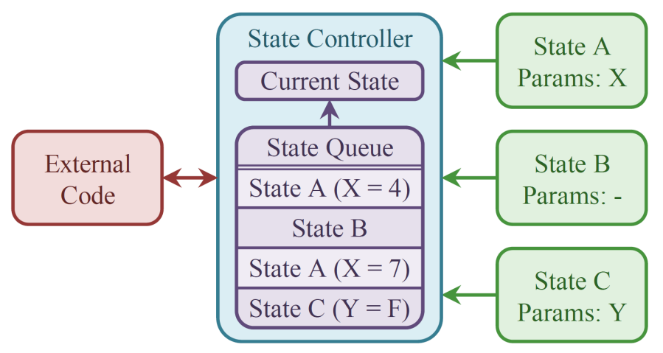
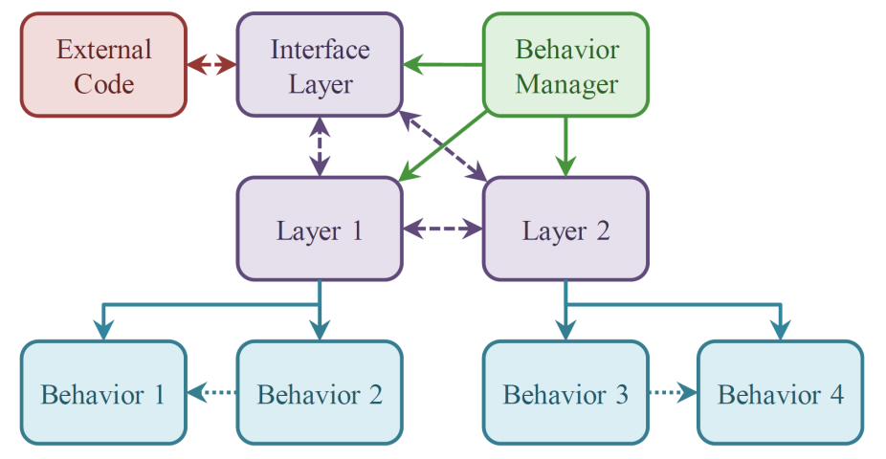
Overview of the Frameworks
State Controller Library
Behavior Control Framework
http://sourceforge.net/projects/statecontroller/
http://sourceforge.net/projects/behaviourcontrol/

Slide 5
State Controller Library (SCL)
Platform independent C++ framework
Can be used to implement:
Finite state machines
Hierarchical state machines
Multi-action planning generalizations thereof
Framework attributes:
Small, simple, resource efficient, modular
Suitable for small to medium applications
Designed with usability in mind

Slide 6
Components of the SCL
State Controller
Class/object that encapsulates and manages one instance of an entire state machine
State
A possible state type of the controller (class in C++)
State Instance
An instance of a State (instance of the C++ class)
State Queue
An ordered list of desired future state instances

Slide 7
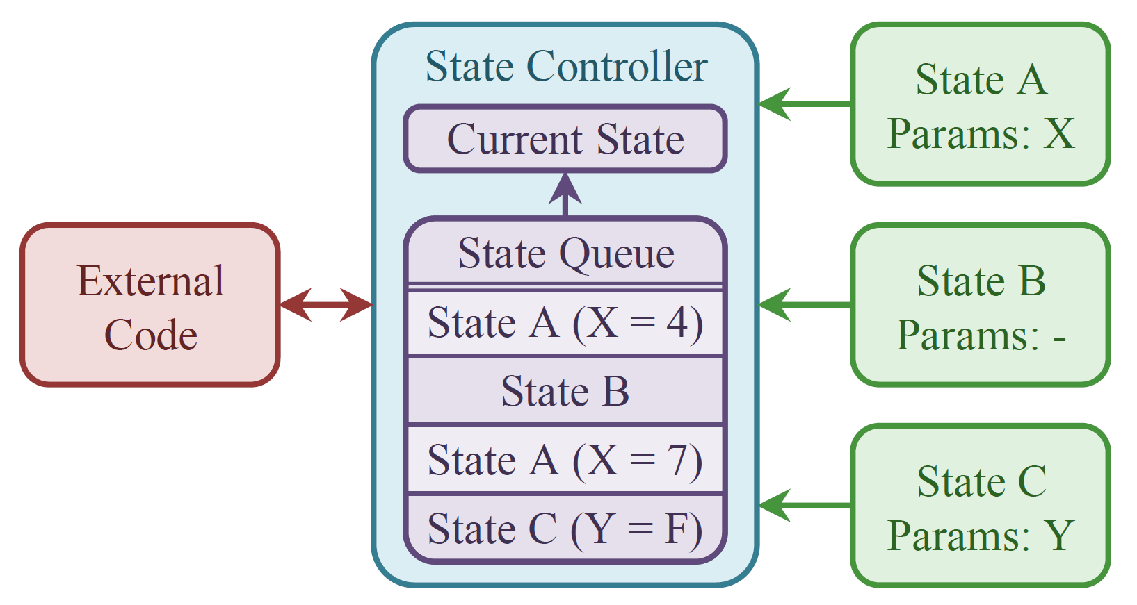
Components of the SCL
A state instance may specialize a state with the use of state parameters.

Slide 8
Executing the SCL
Qn: Did the current state set the finished flag in the last step?
No: Execute the current state again
Yes: Deactivate current state
Pop the next state from the state queue and set it as the current state
Activate the new state
Execute the new state
Timed Loop
while(true)
{
...
SCL->step();
...
}

Slide 9
Executing the SCL
Callbacks are implemented by each state to perform the required activation, execution and deactivation.
States make plans and set their successor state by modifying the state queue and setting the finished flag.
Plans can be altered by clearing or modifying the queue.
Hierarchical state machines are implemented by nesting state controller objects within each other.

Slide 10
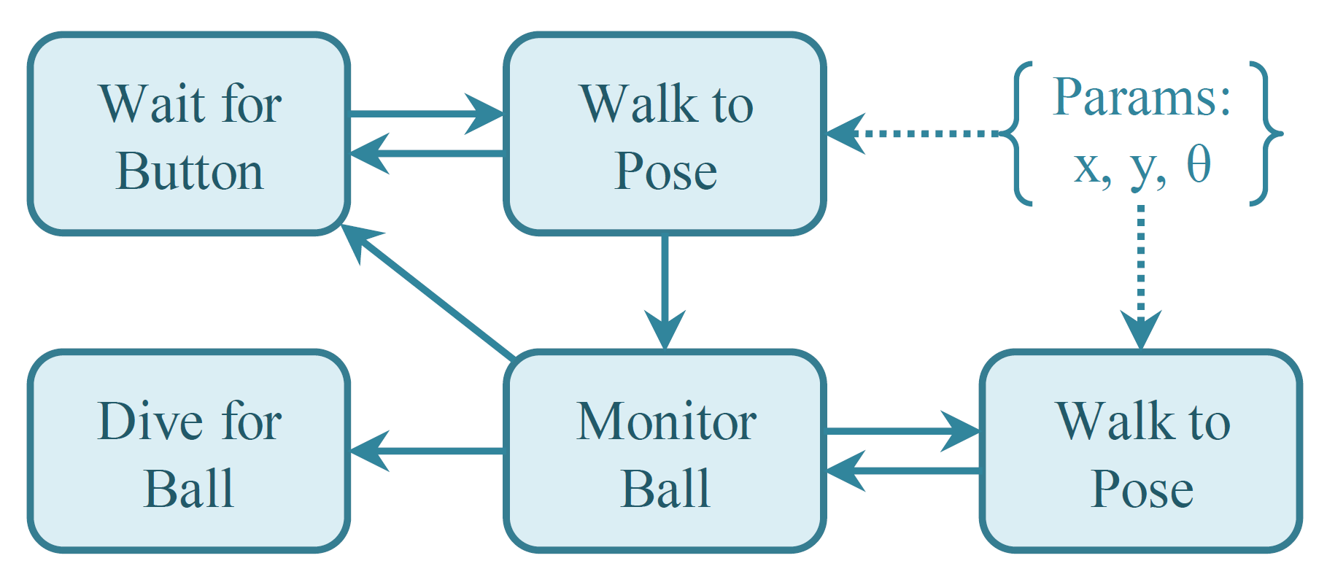
Example of SCL
Simple Soccer Goalie Behavior

Slide 11
Behavior Control Framework (BCF)
Platform independent C++ framework
Can be used to implement:
A hierarchical behavior architecture that utilizes the concept of inhibitions to allow for dynamic transitioning between multiple running behaviors
Framework attributes:
Lightweight, resource efficient, modular
Suitable for medium to large applications
Designed with usability in mind

Slide 12
Components of the BCF
Behavior Manager
Class/object that encapsulates and manages one instance of an entire BCF architecture
Behavior Layer
A bundle of behaviors that can inhibit each other
Behavior
A class that implements a certain action/ability
Actuators and Sensors
Internal writers and readers used to share data

Slide 13
Components of the BCF
Object hierarchy
Data exchange
Inhibitions

Slide 14
Behavior Inhibitions
Behavior 1
Behavior 1
1.0
1.0
1.0
Behavior 4
0.0
1.0
0.0
Transitive
Behavior 2
Chaining inhibition
Non-chaining inhibition
0.0
0.5
0.0
Inhibition tree:
Behavior 3
0.0
1.0
0.0
Behavior 5
Behavior 5
0.7
0.7
0.7
Intransitive!
Topological ordering: 1 → 2 → 4 → 3 → 5
Inhibition resolution:
Activation levels are returned by each behavior
Refactored in the topological order to get true activation levels
Beh. 1 = 1.0, Beh. 2 = 0.5 True Beh. 2 = (1 – 1.0) × 0.5 = 0.0
Behaviors with non-zero activation level are executed

Slide 15
Actuator Aggregation
Partial activation if activation level is between 0 and 1
Multiple writes to an actuator are weighted by the respective true activation levels of the behaviors
Behavior 1
1.0
Behavior 2
0.5
GC = 2.0
GC = 5.0
Gait Command
1.0 × 2.0 + 0.5 × 5.0
True GC = = 3.0
1.0 + 0.5

Slide 16
Data Interfaces
Communication between layers
Write data to virtual actuators
Read data from virtual sensors
Sensors are statically bound to actuators by name
Single sender multiple receiver network of data
Only single data copy operation is required
Communication to external code
Global interface layers (no child behaviors)
e.g. Can be used to read/write from ROS topics

Slide 17
Example of BCF
Higher Level Behavior Layer
Behavior Layer
Sample Sensors
Vector to Ball
Vision Detections
Kick Ball
Go Behind Ball
Search for Ball
Head Control
Sample Actuators
Gait Command
Gaze Target
Lower Level Behavior Layer

Slide 18
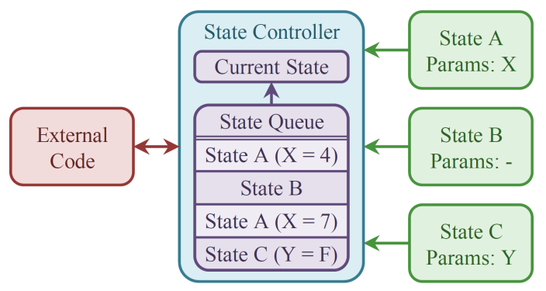
Using the Frameworks Together
e.g. Walking Behavior
Kicking Behavior
Grasping Behavior
…
BCF
SCL

Slide 19
Framework Performance
State Controller Library
Executing a single state: 43ns / 23.0MHz
Always transitioning: 320ns / 3.1MHz
Enqueueing 2 items at a time: 292ns / 3.4MHz
Enqueueing 5 items at a time: 307ns / 3.3MHz
Enqueueing 10 items at a time: 343ns / 2.9MHz
Behavior Control Framework
Executing 3 layers, 2 behaviors: 282ns / 3.6MHz
Tested on a single core of an Intel Xeon X5650 Processor (2.67GHz)

Slide 20
Thank you for your attention!
State Controller Library
Behavior Control Framework
http://sourceforge.net/projects/statecontroller/
http://sourceforge.net/projects/behaviourcontrol/

