Slide 1
Fused Angles and the Deficiencies of Euler Angles
Philipp Allgeuer
Sven Behnke
Institute for Computer Science VI
Autonomous Intelligent Systems
University of Bonn
Fused angles
Euler angles

Slide 2
Motivation
Yaw
Pitch
Roll
(Z)
(Y)
(X)
Should be angles: Units of radians or degrees
Bigger values ≈ bigger rotations

Slide 3
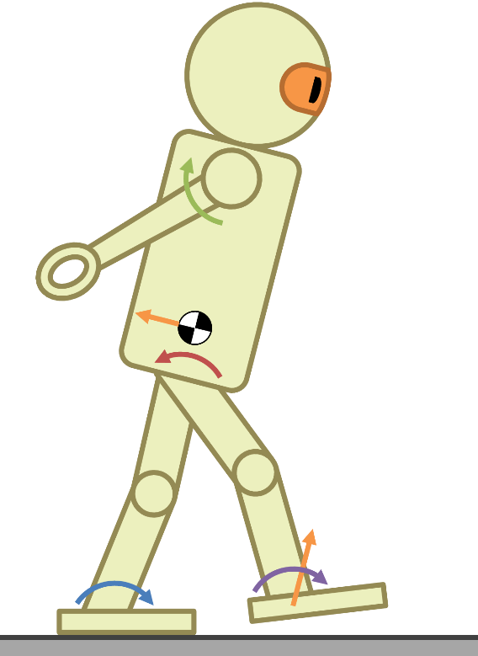
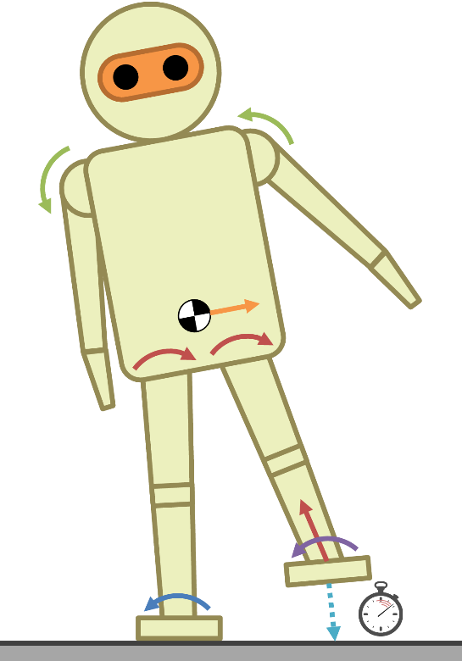
Bipedal Walking
Pitch
Roll
Yaw

Slide 4
Standard Representations
Quaternions
Rotation matrices
Euler angles
Axis-angle
Rotation vectors
Vectorial parameterisations
Yaw
Pitch
Roll
(Z)
(Y)
(X)

Slide 5
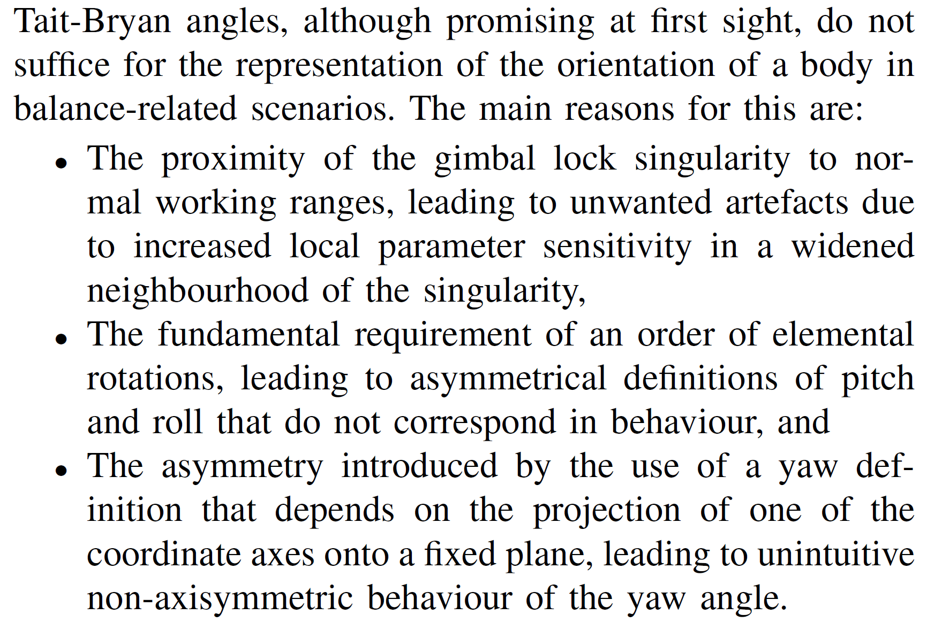
Fused Angles
Fused yaw
Fused pitch
Fused roll
First introduced at IROS 2015:
Fused Angles: A Representation of Body Orientation for Balance
“
Just trust me!
”

Slide 6
Fused Angles and the
Deficiencies of Euler Angles
Full analysis of Euler angles and fused angles
Demonstrates in detail what the differences are, and why these are important
Next time…
Thank you!
Come talk to me in the interactive part
of the session for more information and insights!

Slide 7
Fused Angles vs. Euler Angles

Slide 8
Euler Angles

Slide 9
Fused Angles
Fused yaw ψ
Fused pitch θ
Fused roll φ

Slide 10
Main Deficiencies of Euler Angles
The proximity of the gimbal lock singularity to normal working ranges, leading to unwanted artefacts due to increased local parameter sensitivities in a widened neighbourhood of the singularity
The interdependence of the Euler parameters, leading to an unclear attribution of which parameter encapsulates which major plane of rotation
The asymmetry introduced by the use of a definition of yaw that depends on projection, leading to unintuitive non-axisymmetric behaviour of the yaw angle
The fundamental requirement of an order of elemental rotations, leading to non-axisymmetric definitions of pitch and roll that do not correspond in behaviour.

Slide 11
A. Singularities and Local Parameter Sensitivities
Global 3-param parameterisations topologically must have a singularity
Fused angles have single singularity in single parameter,
Euler angles have two singularities in two parameters
Fused angles have no singularity in pitch/roll (defines local state of balance),
Euler angles have singularity in roll (part of balance state)
Fused yaw singularity is ‘maximally far’ from the identity rotation,
Euler angles singularities are 90° away (thus, close to or in working ranges)
Increased parameter sensitivity near gimbal lock has noticeable effects even for tilt rotations of only 65°. Sudden sensitive changes in Euler yaw and roll occur even when the tilt rotation is actually only a few degrees from being pure pitch
The Euler yaw of a rotation cannot in general be meaningfully removed, as for even moderate tilts this can lead to large z-rotations occurring in the rotation that remains

Slide 12
B. Mutual Independence of Rotation Parameters
Individual parameters should be as mutually independent as possible, and correspond intuitively to the x, y and z-components of rotation.
Interdependence of yaw and roll: Euler roll contributes to ‘yaw’ in the intuitive sense (rotation component about z-axis). Part of the total ‘yaw’ of a rotation is always quantified by the Euler roll parameter instead of Euler yaw, meaning that neither parameter cleanly represents the component of rotation that it ideally should.
Interdependence of pitch and roll: As the Euler pitch elemental rotation precedes the Euler roll one, the axis of rotation of the latter is a function of the former. This creates a dependency of Euler roll on pitch, which results in Euler roll not completely capturing the intuitive sense of ‘roll’ independently by itself. Euler pitch + roll has z-axis component!
Purity of axis of rotation: Fused yaw is zero iff the component of the axis of rotation in the z-direction is zero—not the case for Euler yaw. Axis of rotation e_{x}, e_{y} are both mixed expressions of pitch and roll for Euler angles, not so for fused angles.

Slide 13
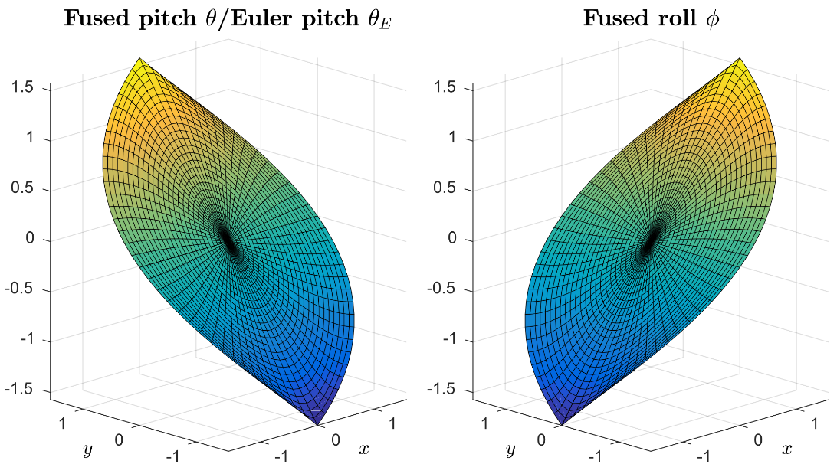
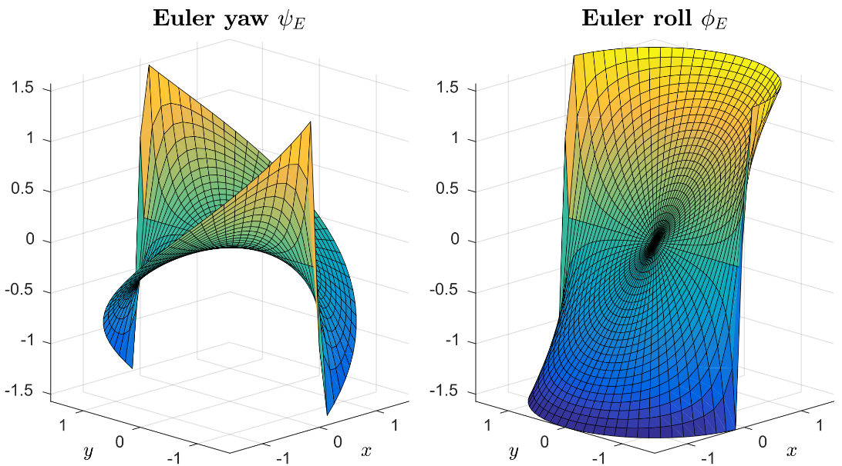
B. Mutual Independence of Rotation Parameters
Rotation inverses: Fused yaw has negation through rotation inversion property, so inverse of a zero fused yaw rotation has zero fused yaw. These are natural properties to expect, but neither property holds for Euler yaw. The various inverse expressions for Euler angles all have mixed terms in them, unlike fused angles.

Slide 14
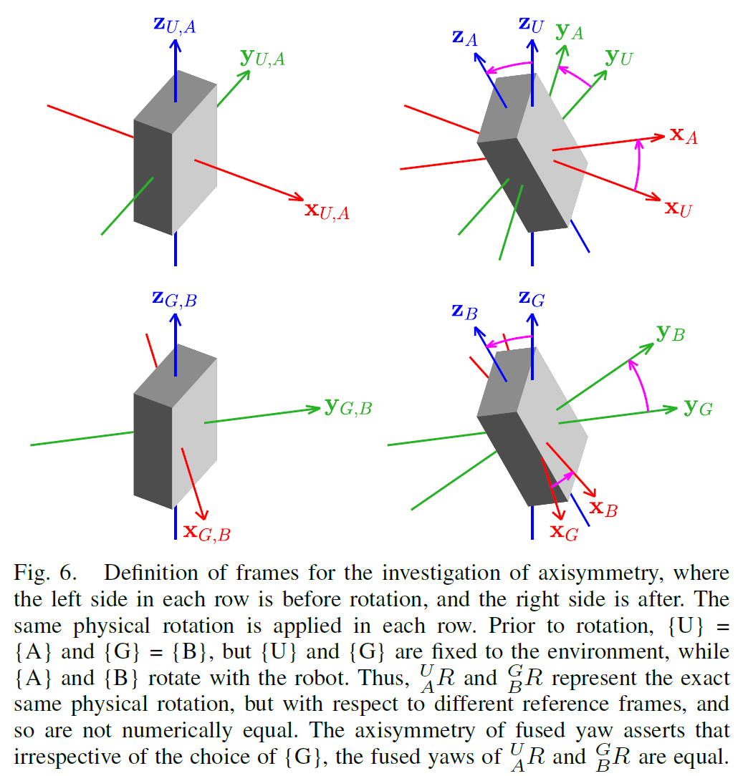
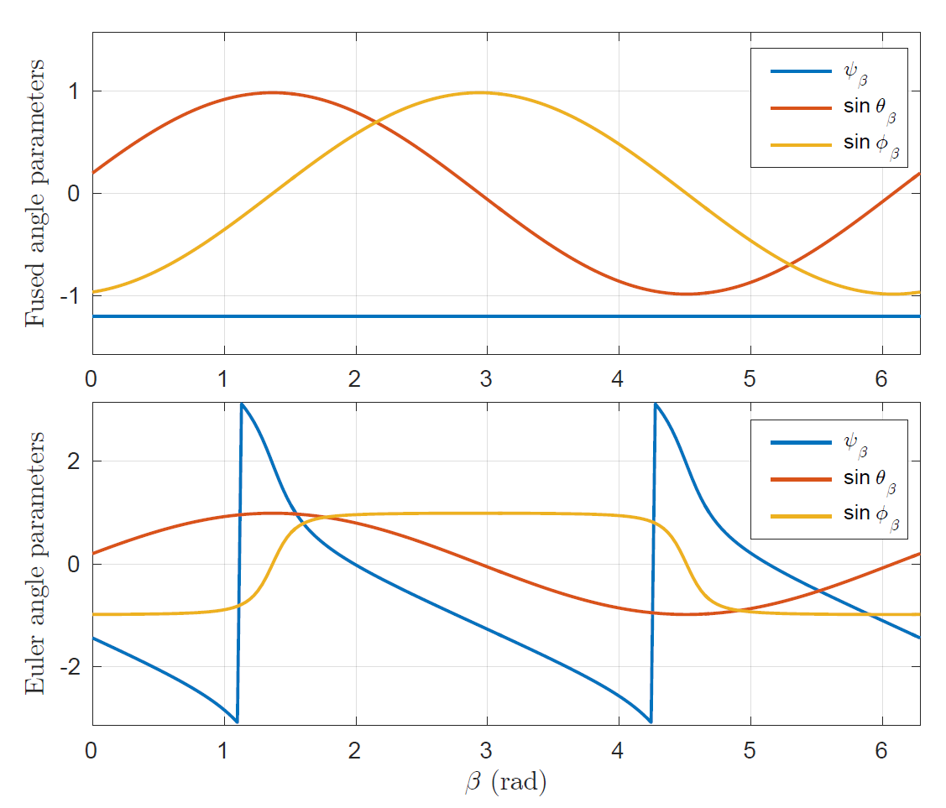
C. Axisymmetry of Yaw
Fused yaw is invariant to the choice of global x and y-axis, thus self-consistent! Euler yaw is NOT.

Slide 15
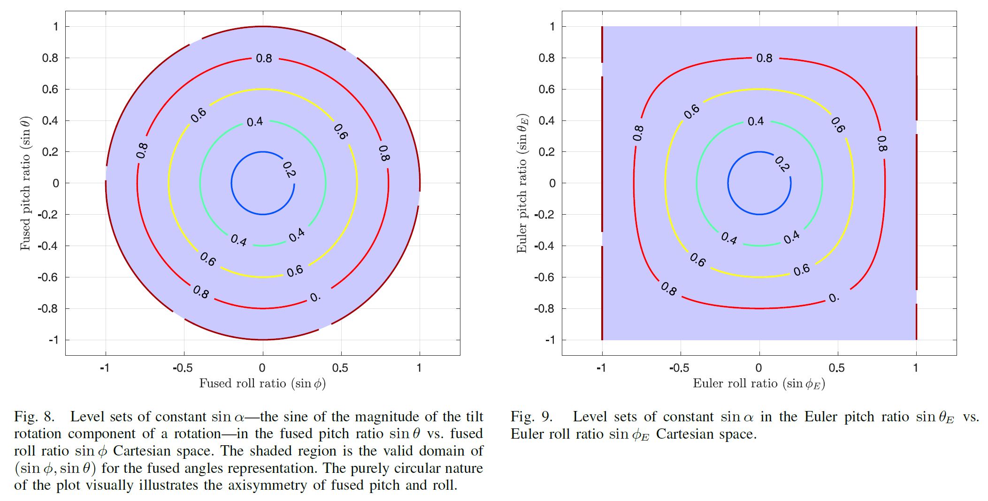
D. Axisymmetry of Pitch and Roll

Slide 16
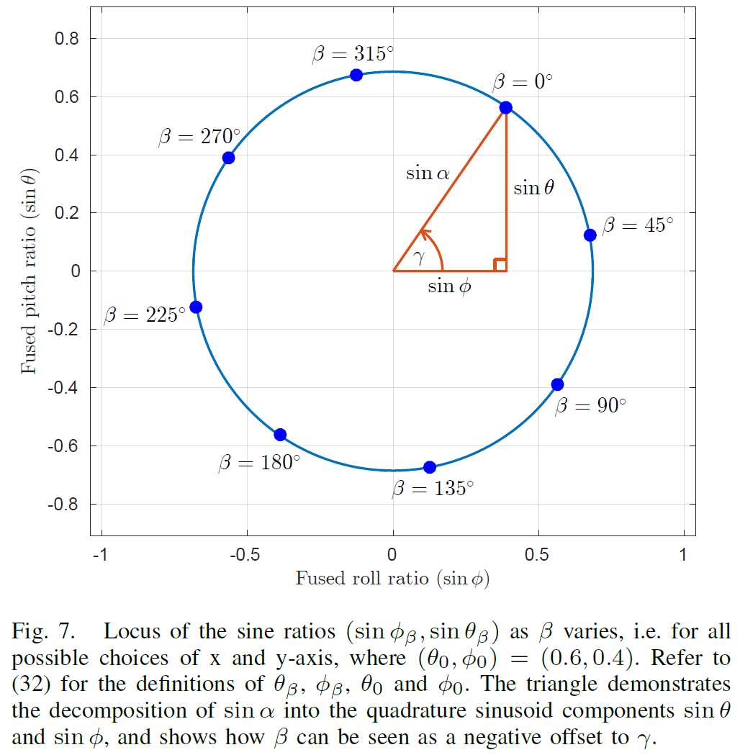
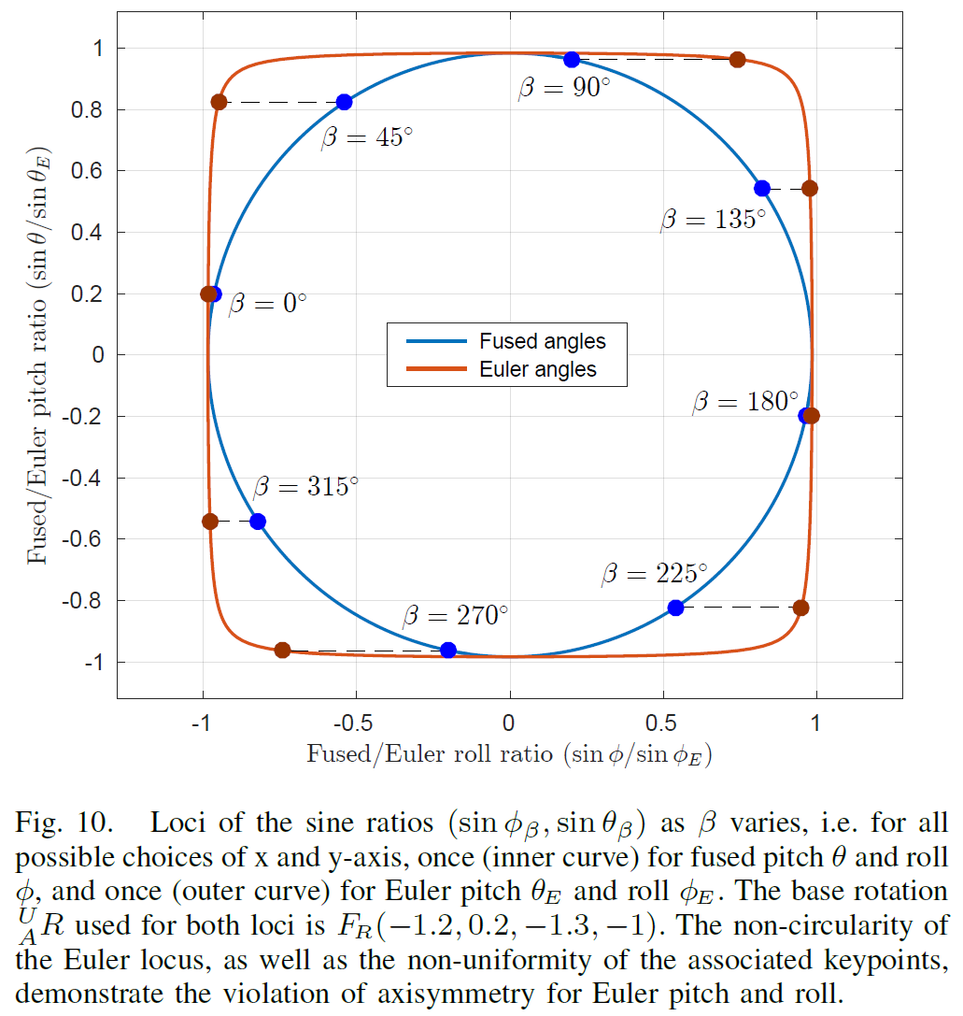
D. Axisymmetry of Pitch and Roll

