Slide 1
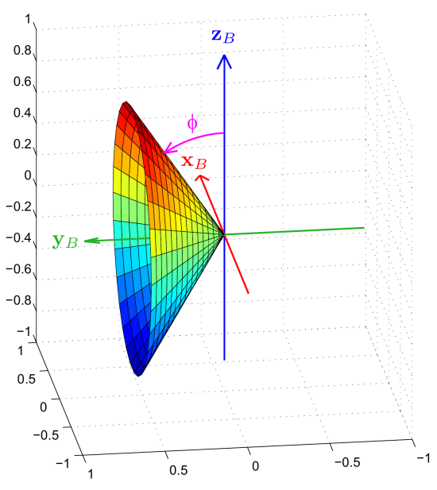
Fused Angles: A Representation of Body Orientation for Balance
Philipp Allgeuer and Sven Behnke
Institute for Computer Science VI
Autonomous Intelligent Systems
University of Bonn

Slide 2
Motivation
Why develop a new representation?
Desired for the analysis and control of balancing bodies in 3D (e.g. a biped robot)
How rotated is the robot in the sagittal direction?
How rotated is the robot in the lateral direction?
What is the heading of the robot?

Slide 3
Problem Definition
Find a representation that describes the state of balance in an intuitive and problem-relevant way, and yields information about the components of the rotation in the three major planes (xy, yz, xz)

Slide 4
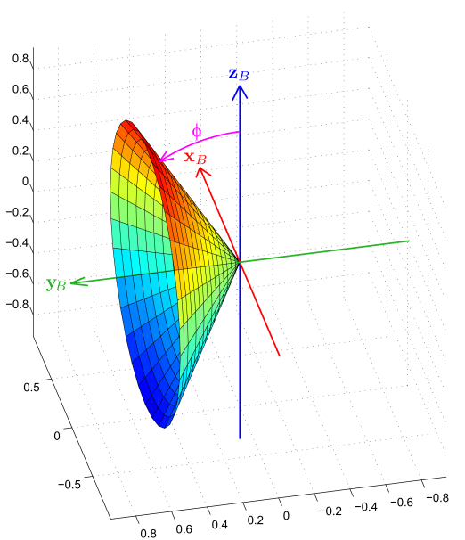
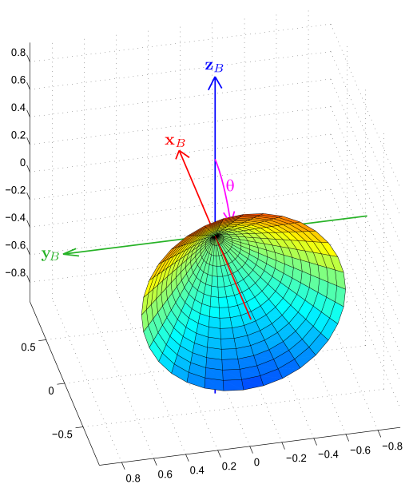
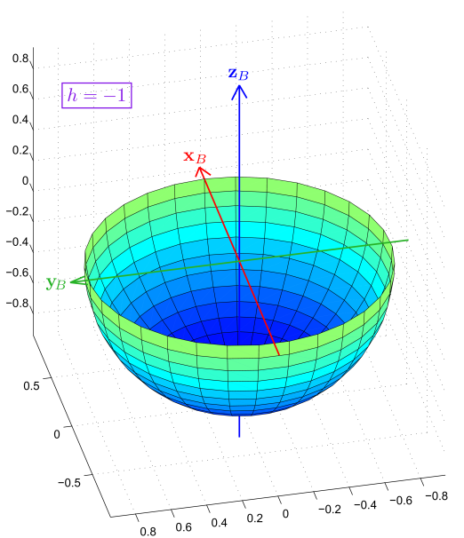
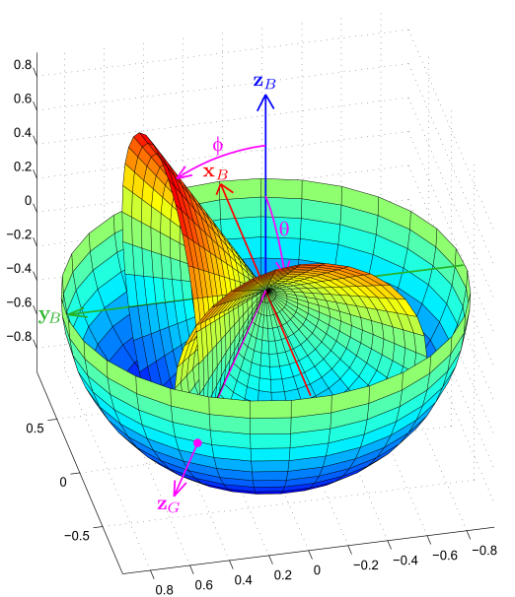
Problem Definition
Fused angles
(and the intermediate tilt angles representation)

Slide 5
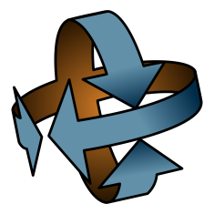
Uses of Fused Angles to Date
Attitude Estimator ^{[1]}
Internally based on the concept of fused angles for orientation resolution
igus Humanoid Open Platform ROS Software ^{[2]}
Fused angles are used for state estimation, the walking engine and balance feedback.
Matlab/Octave Rotations Library ^{[3]}
Library for 3D rotation computations and algorithm development, including support for both fused angles and tilt angles.

Slide 6
Existing Representations
Rotation matrices
Quaternions
Euler angles
Axis-angle
Rotation vectors
Vectorial parameterisations

Slide 7
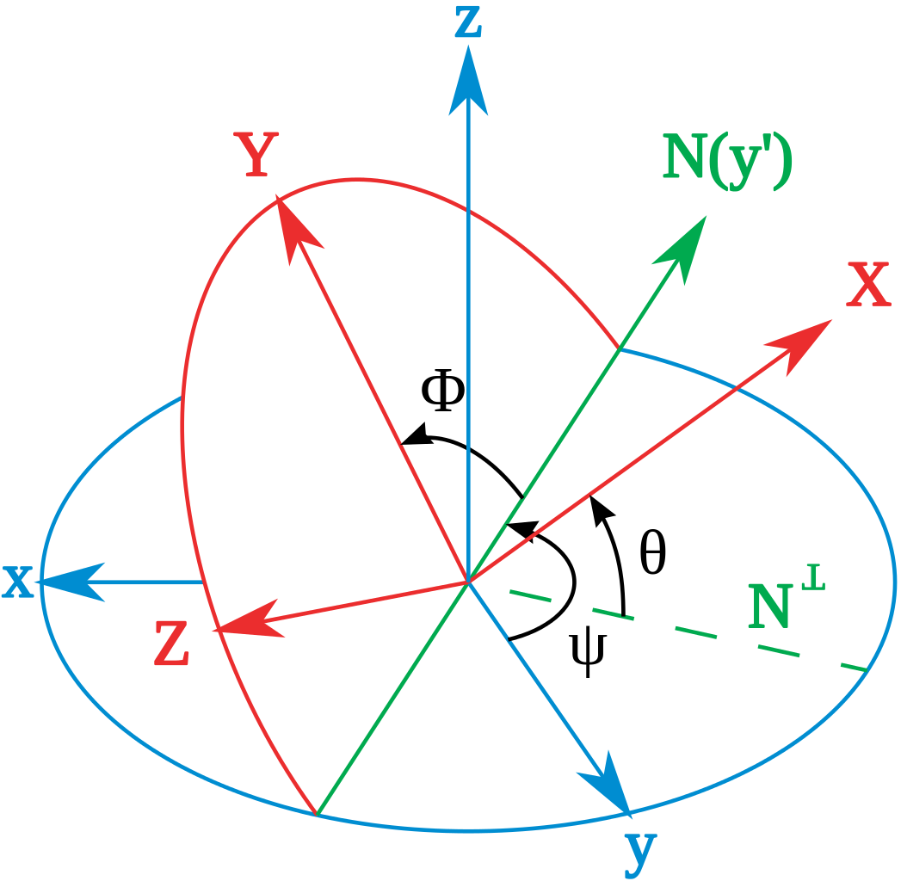
Intrinsic ZYX Euler Angles
Features:
Splits rotation into a sequence of three elemental rotations
Gimbal lock at the limits of θ
Numerically problematic near the singularities
Computationally inefficient

Slide 8
Intrinsic ZYX Euler Angles
Relevant feature:
Quantifies the amount of rotation about the x, y and z axes ≈ in the three major planes
Problems:
Proximity of both gimbal lock singularities to normal working ranges, high local sensitivity
Requirement of an order of elemental rotations, leading to asymmetrical definitions of pitch/roll
Unintuitive non-axisymmetric behaviour of the yaw angle due to the reliance on axis projection

Slide 9
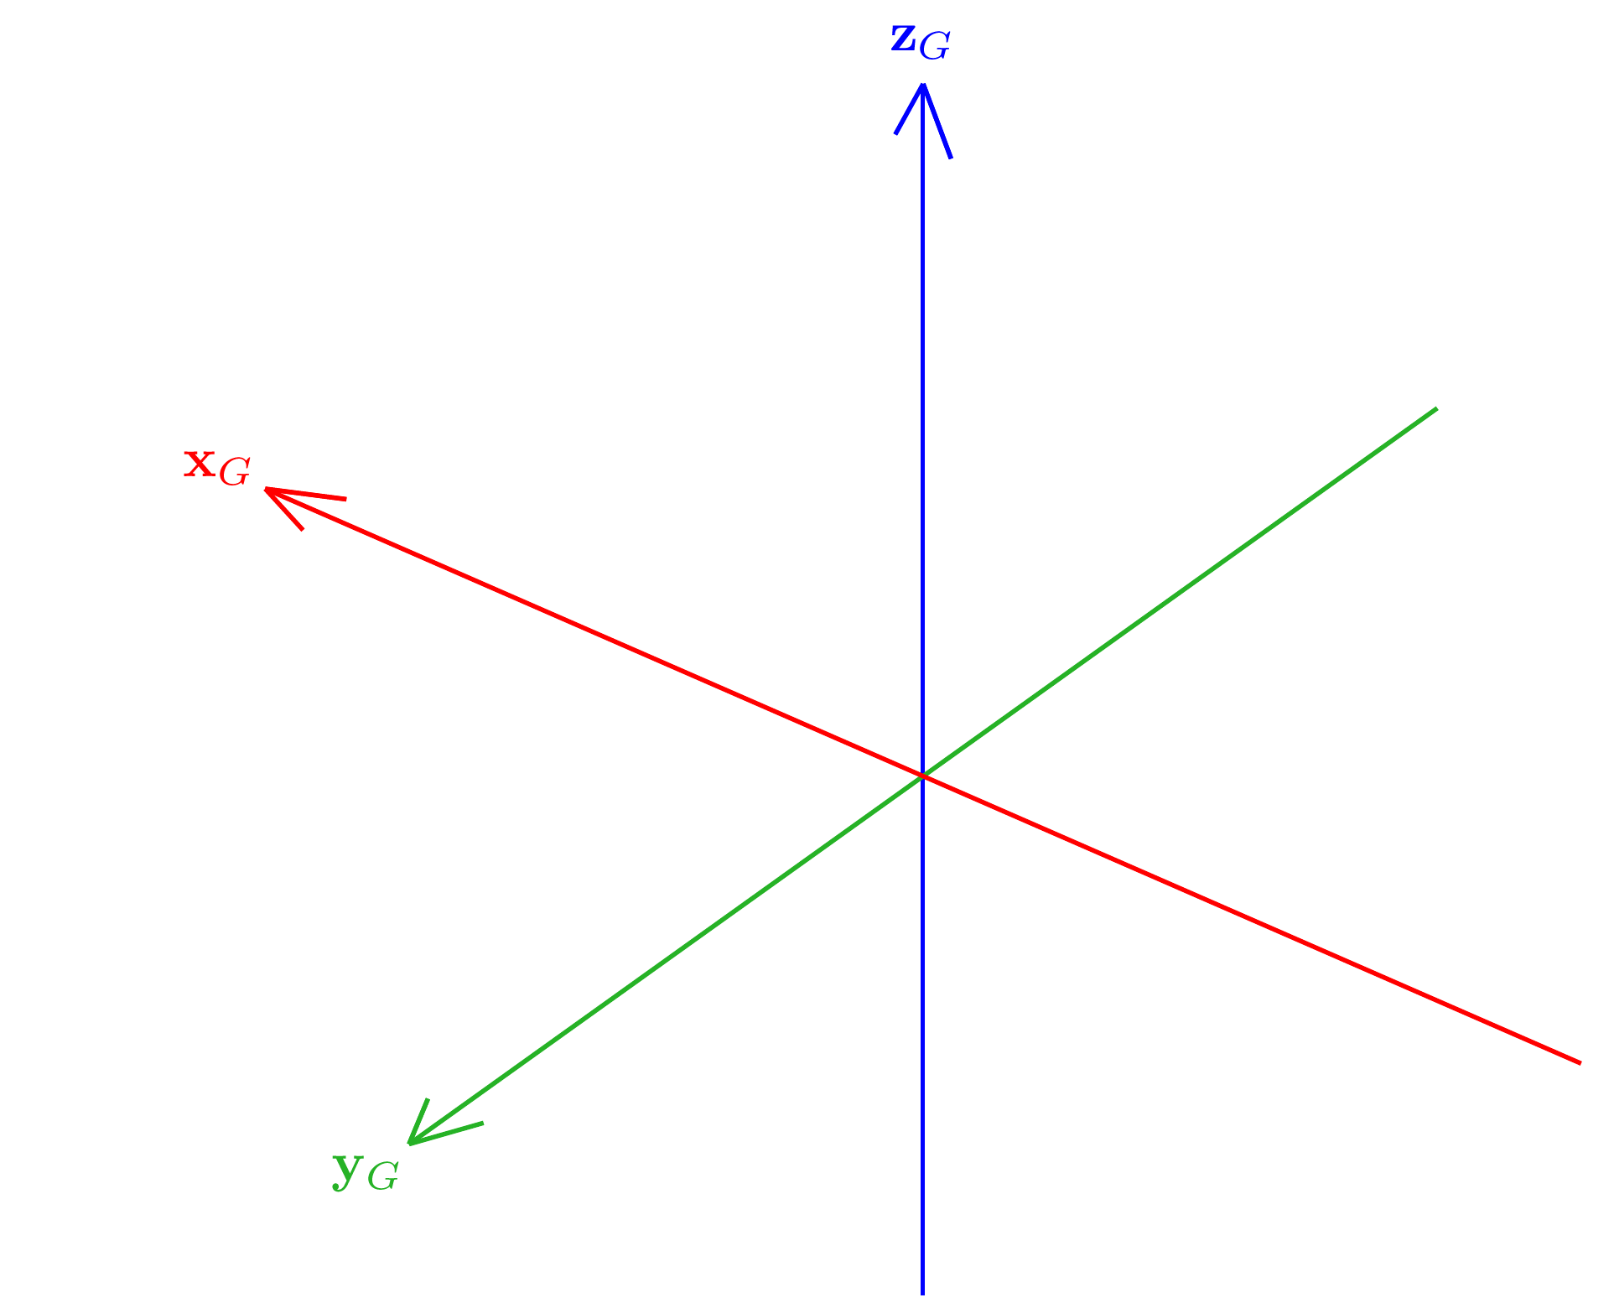
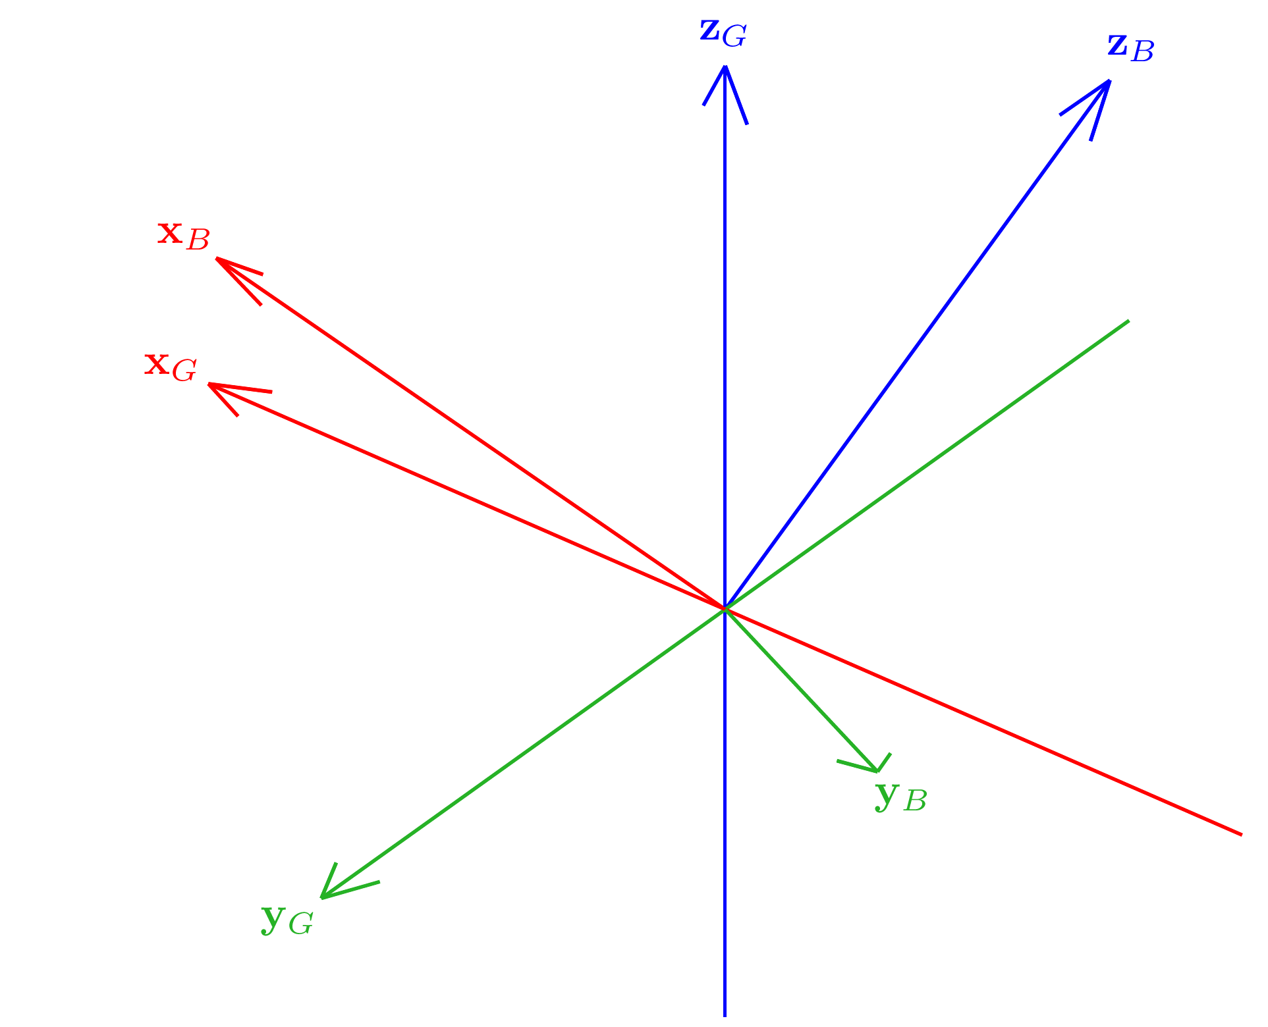
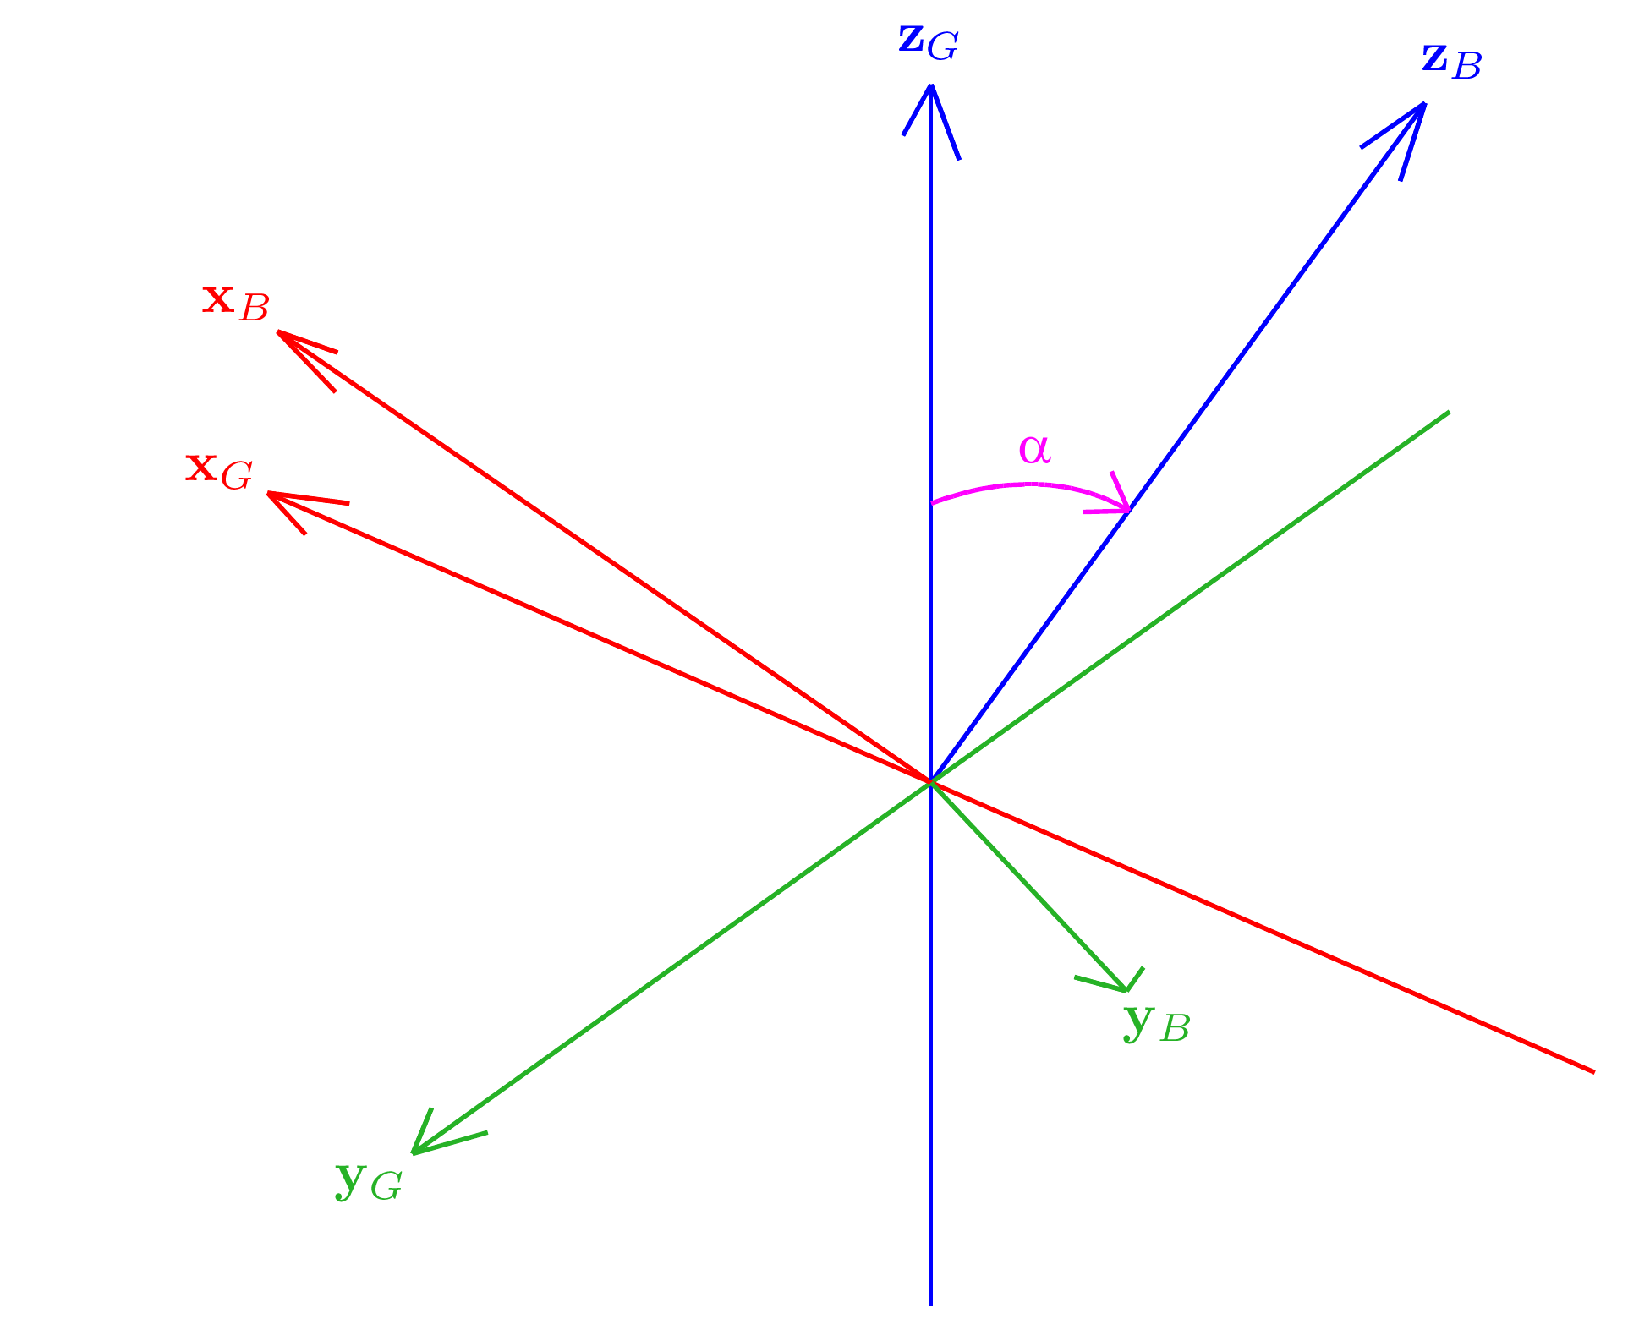
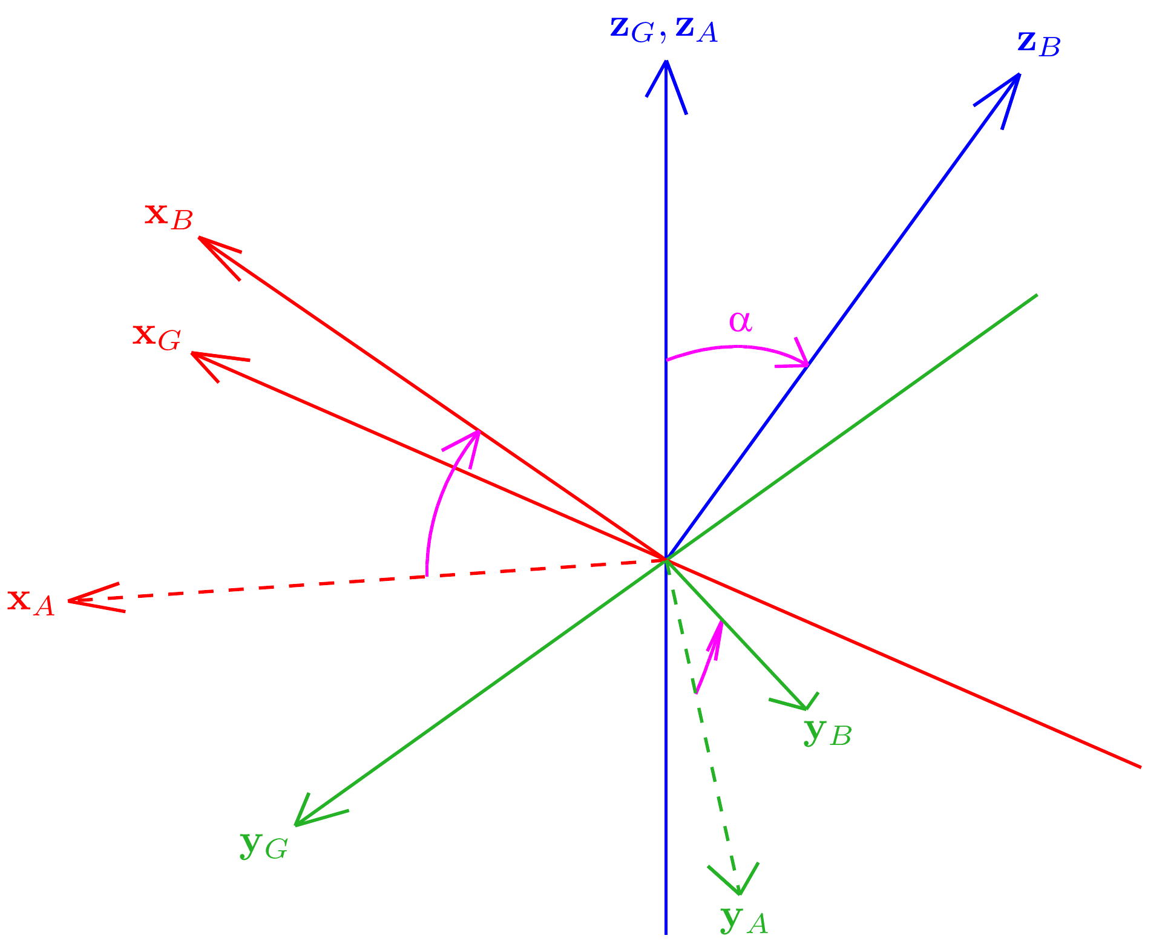
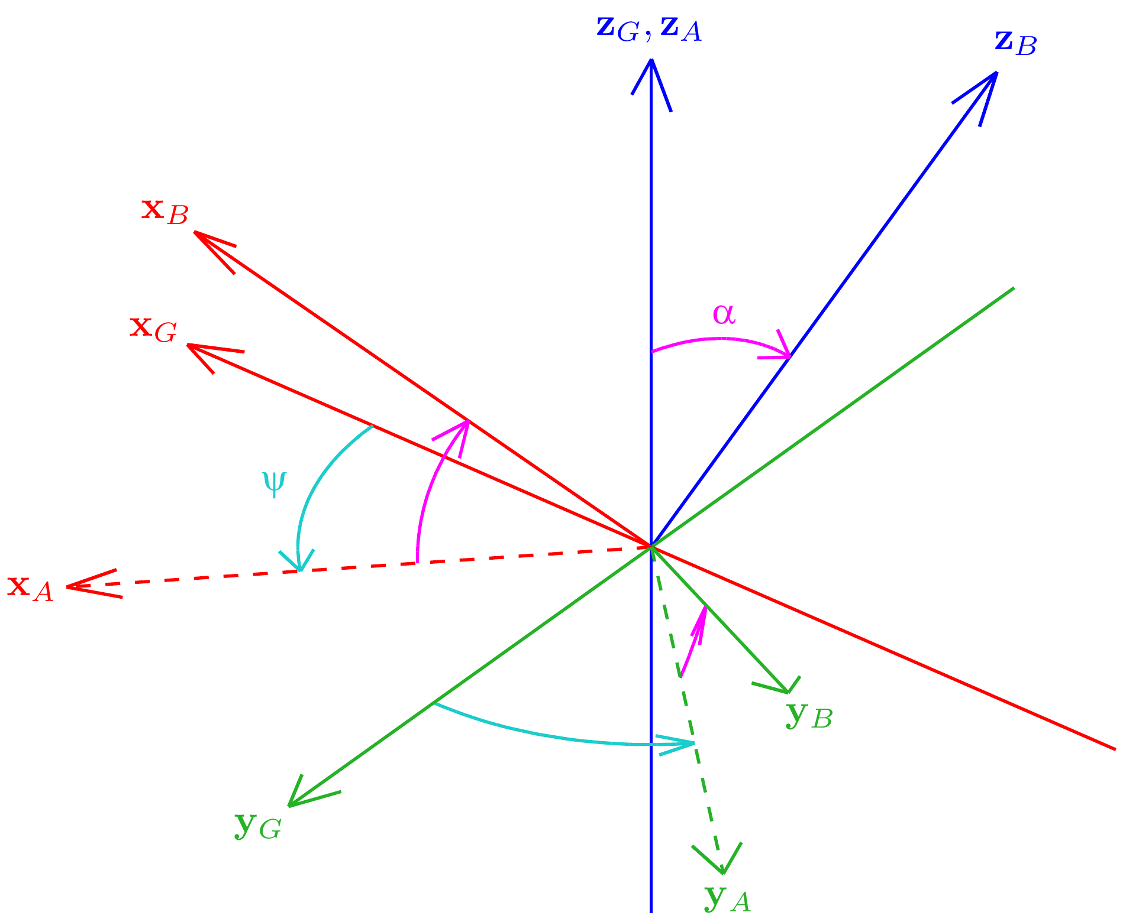
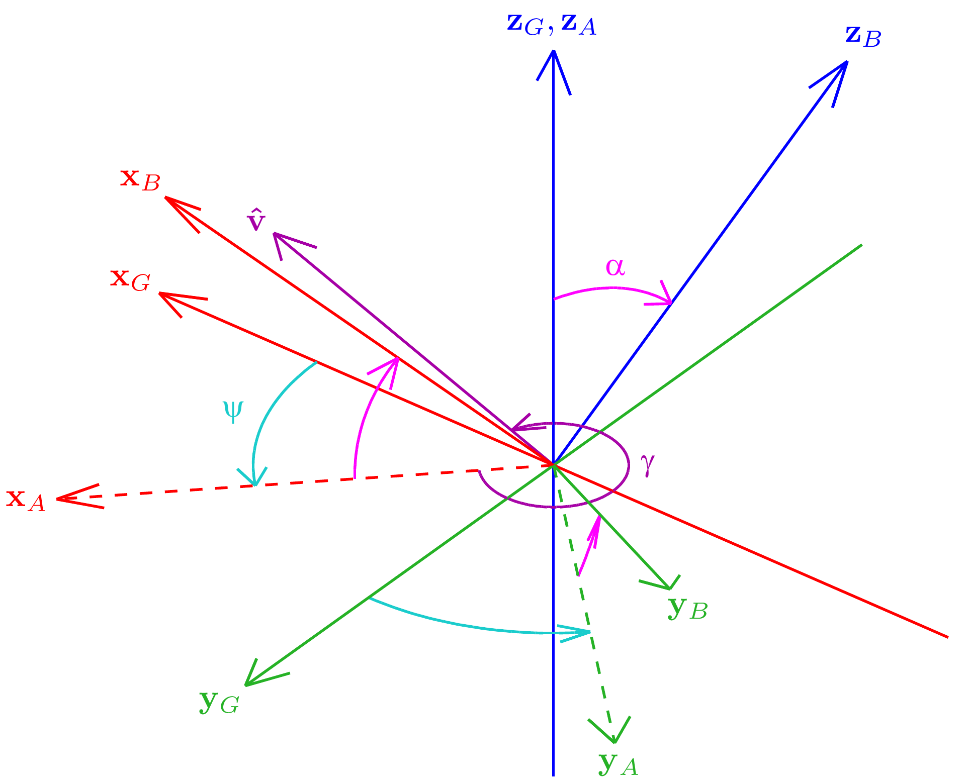
Tilt Angles
Rotation G to B
ψ = Fused yaw
γ = Tilt axis angle
α = Tilt angle

Slide 10
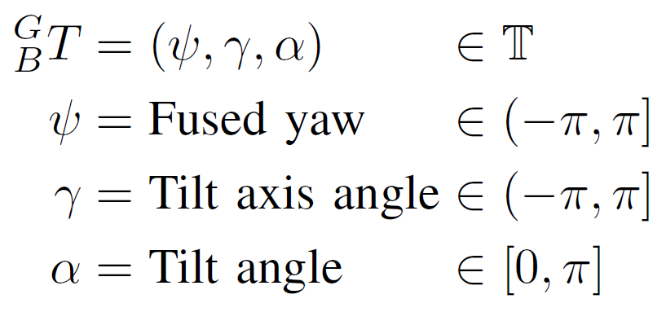
Tilt Angles
Features:
Geometrically and mathematically very relevant
Intuitive and axisymmetric definitions
Drawbacks:
γ parameter is unstable near the limits of α!

Slide 11
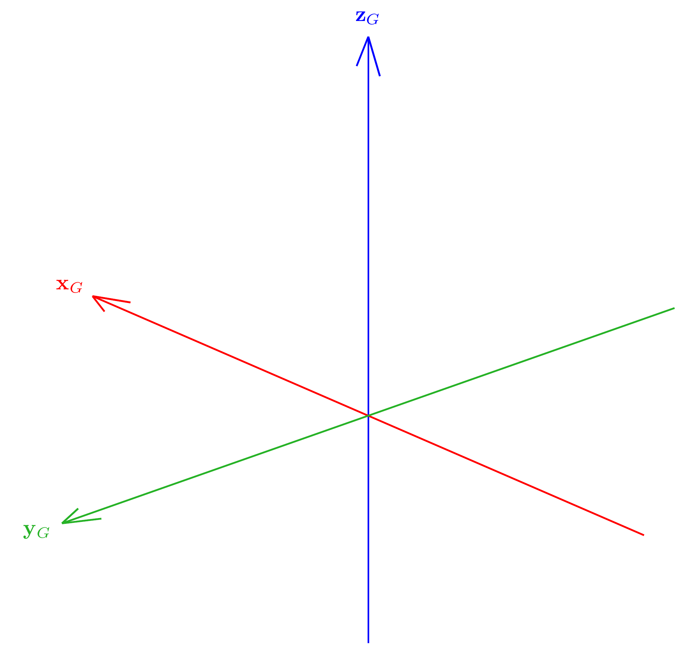
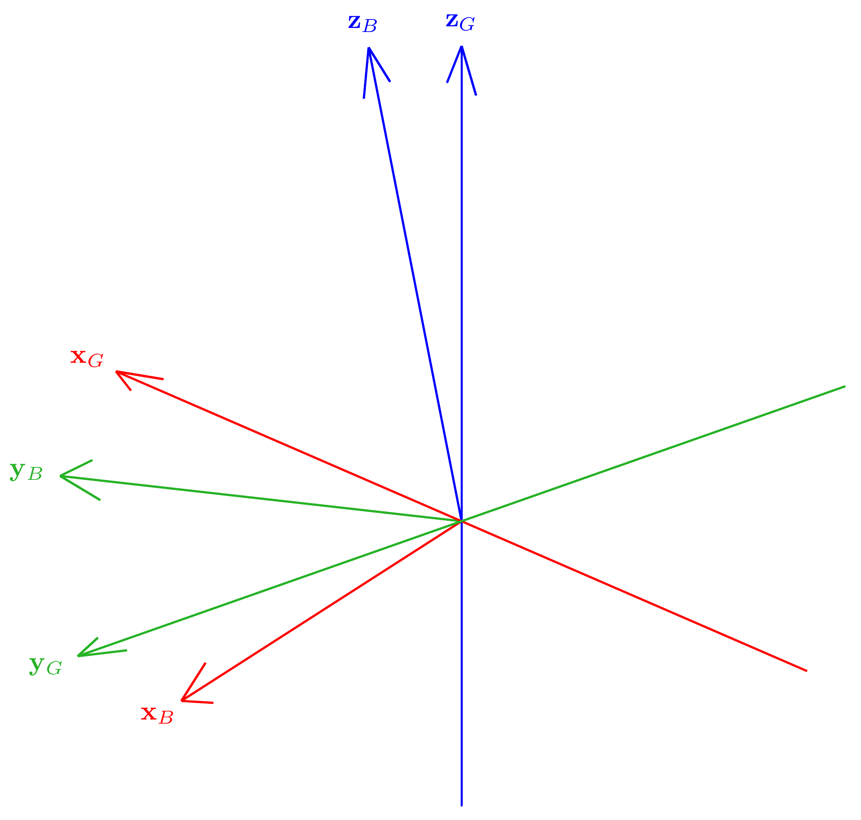
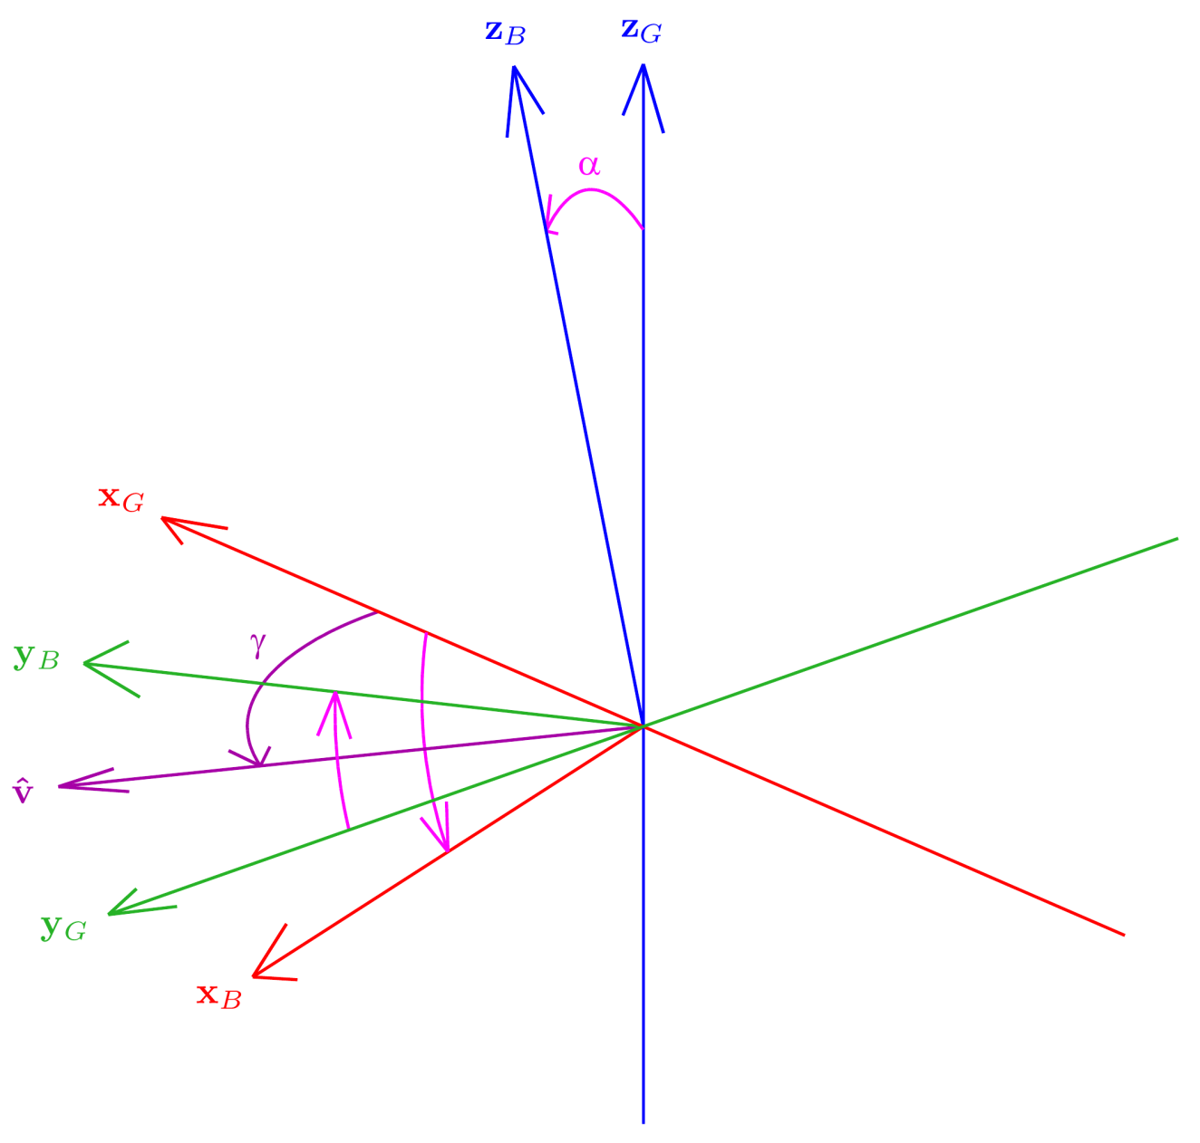
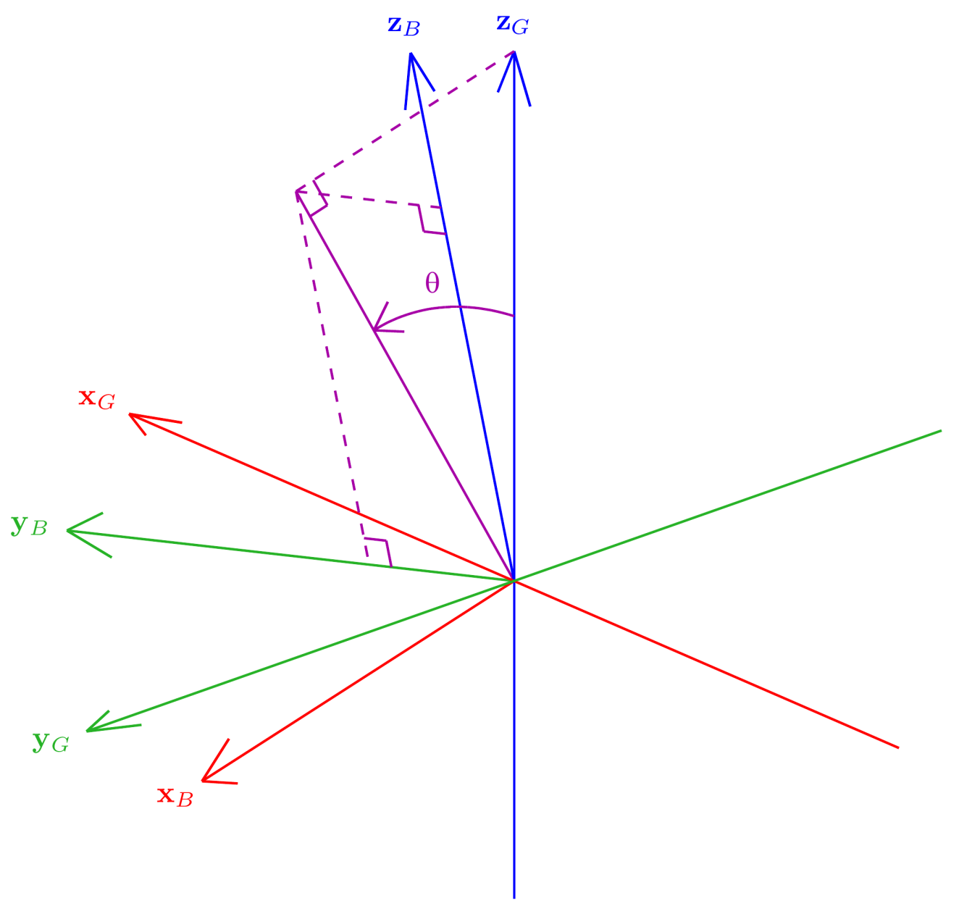
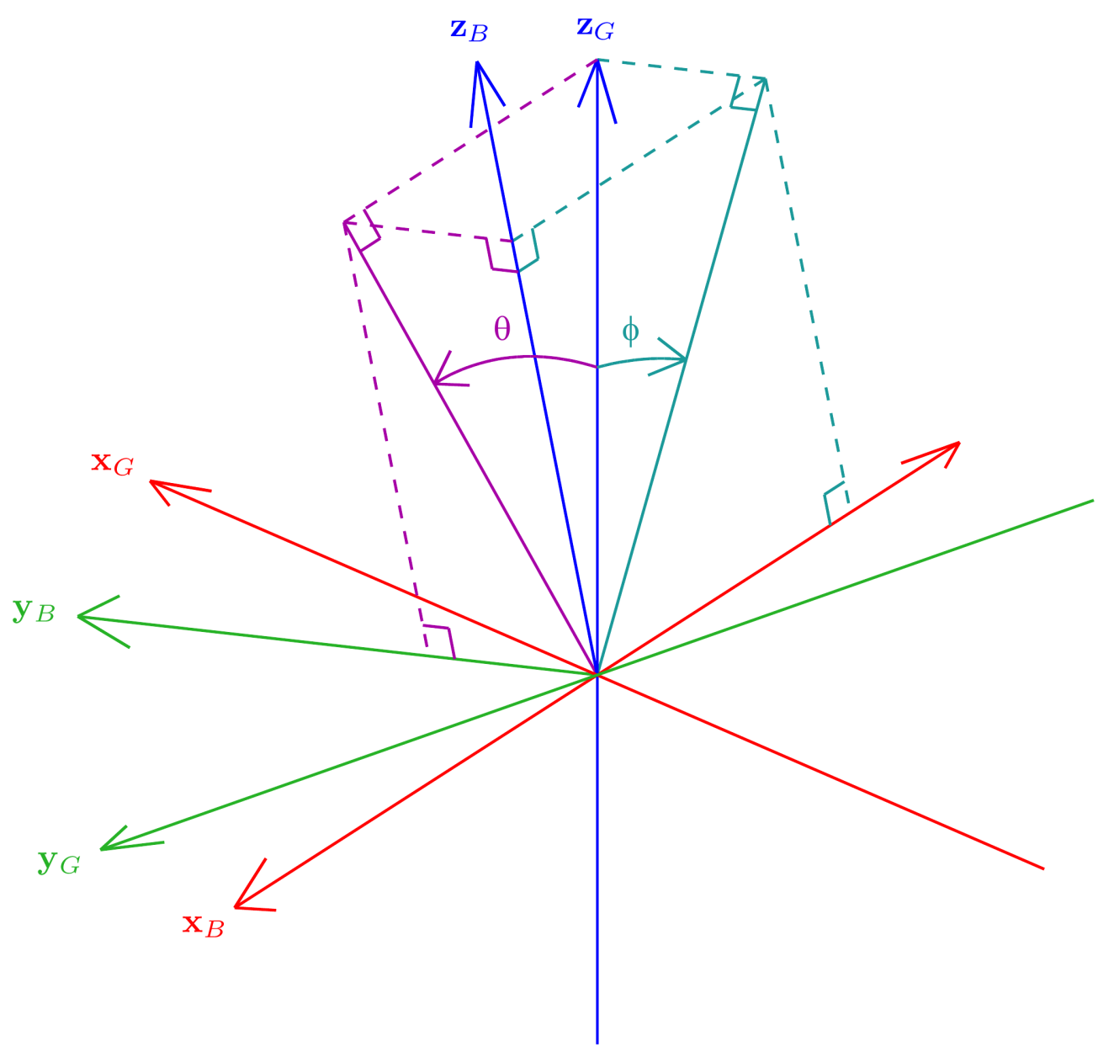
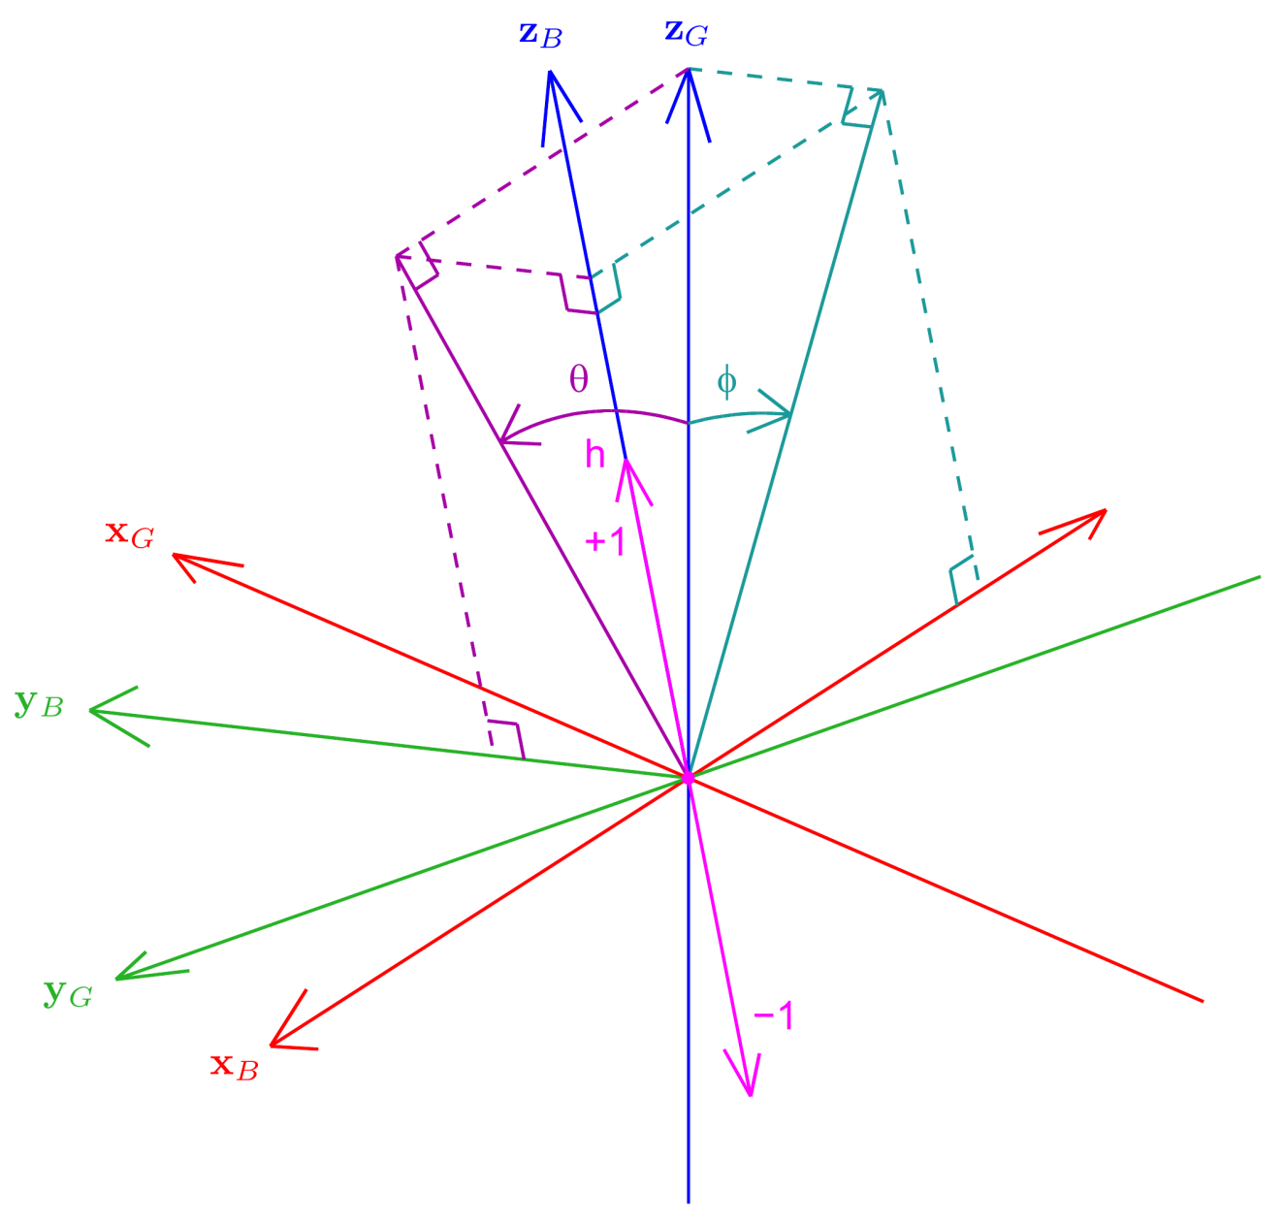
Fused Angles
Rotation G to B Pure tilt rotation!
θ = Fused pitch
φ = Fused roll
h = Hemisphere

Slide 12
Fused Angle Level Sets
Fused Pitch θ
Fused Roll φ

Slide 13
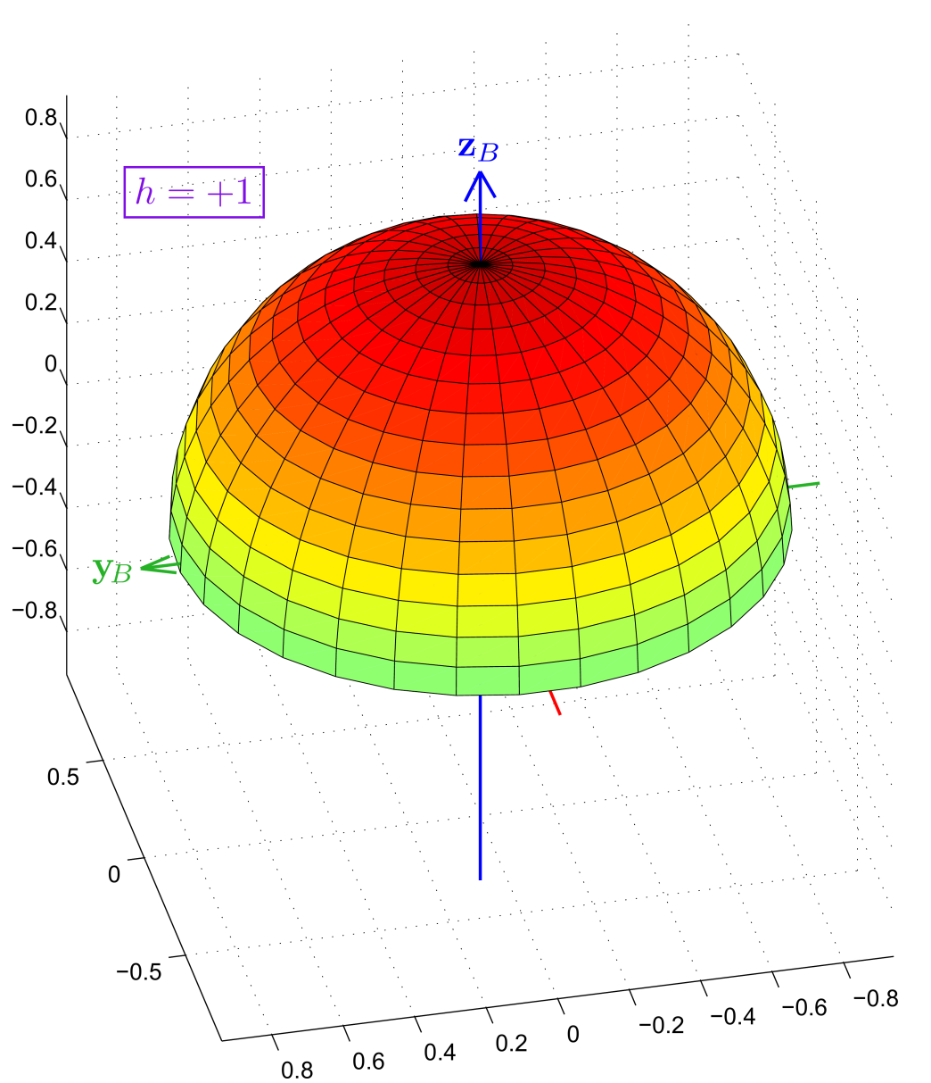
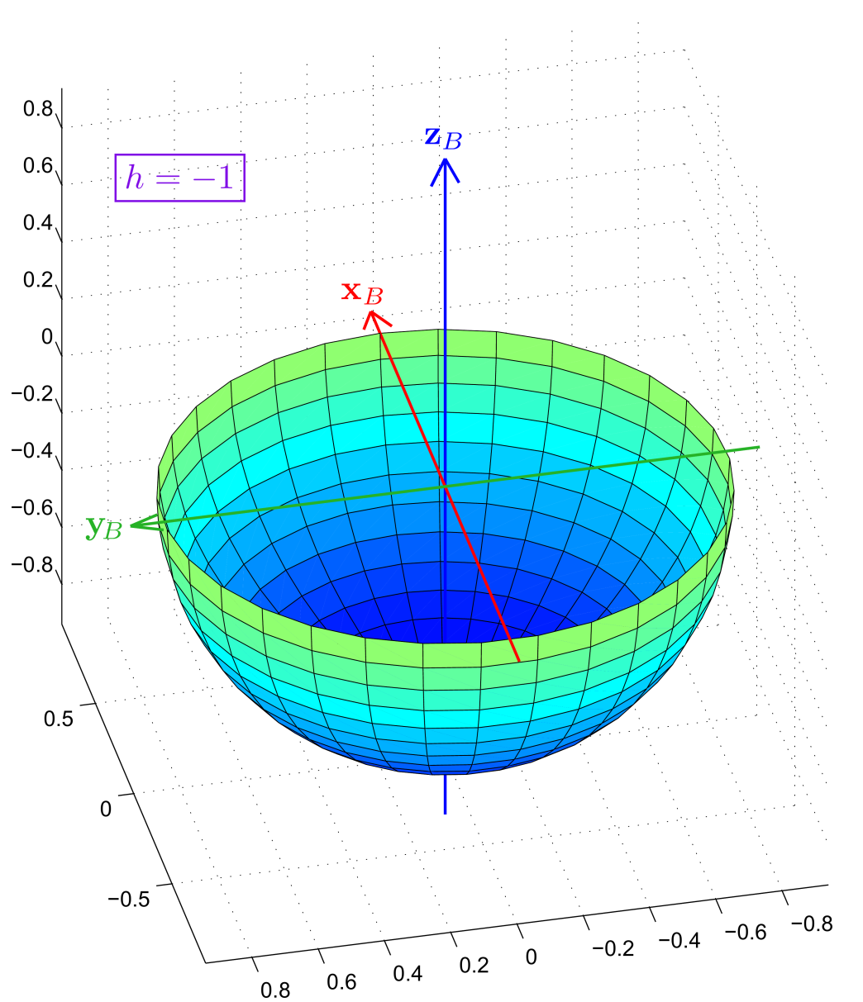
Fused Angle Level Sets
Hemisphere h

Slide 14
Intersection of Level Sets
Uniquely resolved z_{G}

Slide 15
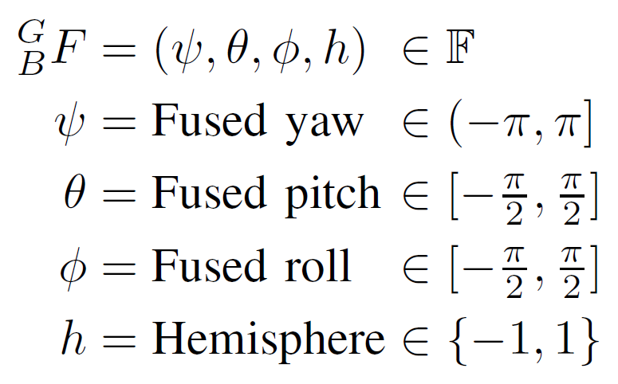
Fused Angles
Condition for validity:
Sine sum criterion

Slide 16
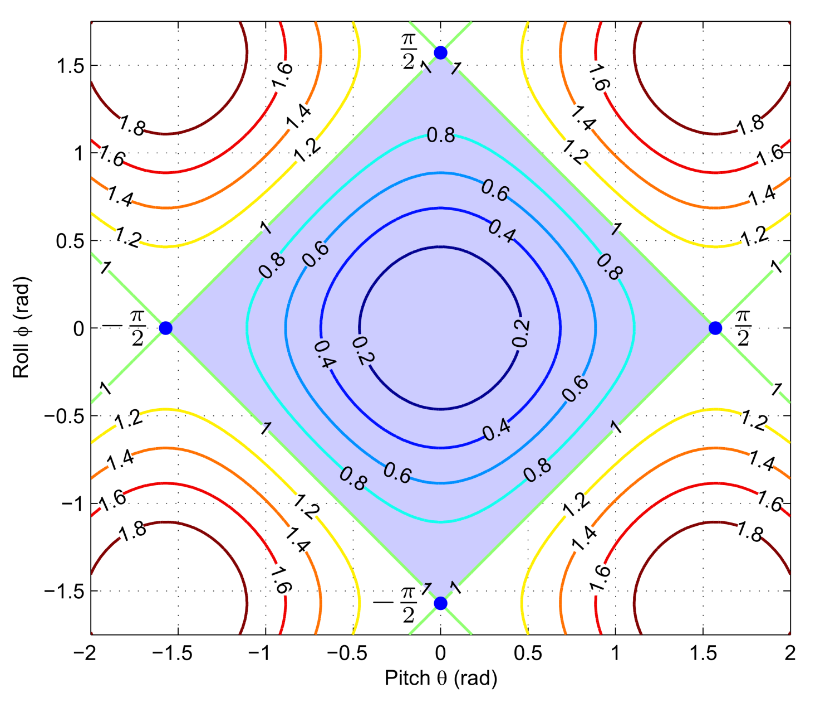
Sine Sum Criterion

Slide 17
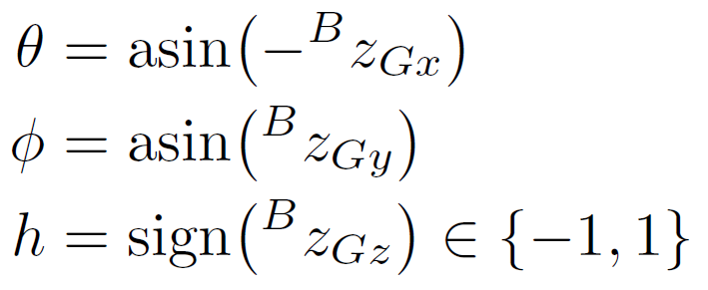
Mathematical Definitions
Tilt angles:
Fused angles:

Slide 18
Representation Conversions
Refer to the paper
Fused angles ⇔ Tilt angles
Surprisingly fundamental conversions
Representations intricately linked
Fused angles ⇔ Rotation matrices, quaternions
Simple and robust conversions available
Tilt angles ⇔ Rotation matrices, quaternions
Robust and direct conversions available
Simpler definition of fused yaw arises

Slide 19
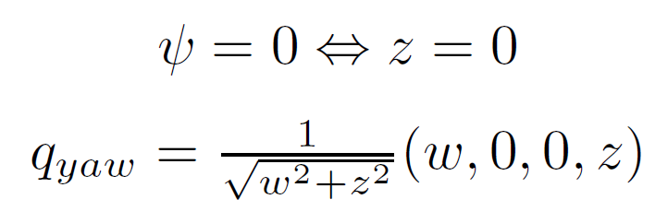
Properties
Tilt axis angle γ has singularities at α = 0, π
…but has increasingly little effect near α = 0
Fused yaw ψ has a singularity at α = π
Unavoidable due to the minimality of (ψ,θ,φ)
As ‘far away’ from the identity rotation as possible
Define ψ = 0 on this null set
Fused yaw and quaternions

Slide 20
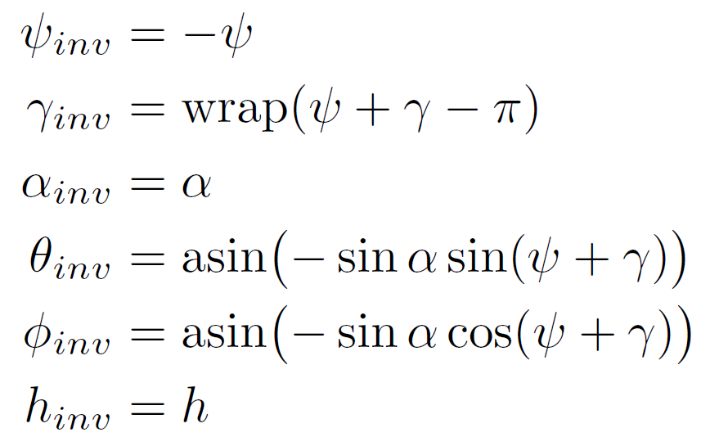
Properties
Inverse of a fused angles rotation
Special case of zero fused yaw

Slide 21
More in the Paper…
Further results and properties of fused angles
Detailed discussion of the shortcomings of Euler angles
The relationship between tilt rotations and accelerometer measurements
Precise mathematical and geometric definitions of fused angles and tilt angles, and the level sets
Rigorous singularity analysis of the representations
Metrics over fused angles
Refer to the paper

Slide 22
Thank you for your attention!
Matlab/Octave Rotations Library https://github.com/AIS-Bonn/matlab_octave_rotations_lib

Slide 23
References

Slide 24
Intrinsic ZYX Euler Angles
Containing set:
Parameters: 3 ⇒ Minimal
Constraints: None
Singularities: Gimbal lock at the limits of θ
Features: Splits rotation into a sequence of elemental rotations, numerically problematic near the singularities, computationally inefficient

Slide 25
Rotation Matrices
Containing set:
Parameters: 9 ⇒ Redundant
Constraints: Orthogonality (determinant +1)
Singularities: None
Features: Trivially exposes the basis vectors, computationally efficient for many tasks, numerical handling is difficult

Slide 26
Quaternions
Containing set:
Parameters: 4 ⇒ Redundant
Constraints: Unit norm
Singularities: None
Features: Dual representation of almost every rotation, computationally efficient for many tasks, unit norm constraint must be numerically enforced

