Slide 1
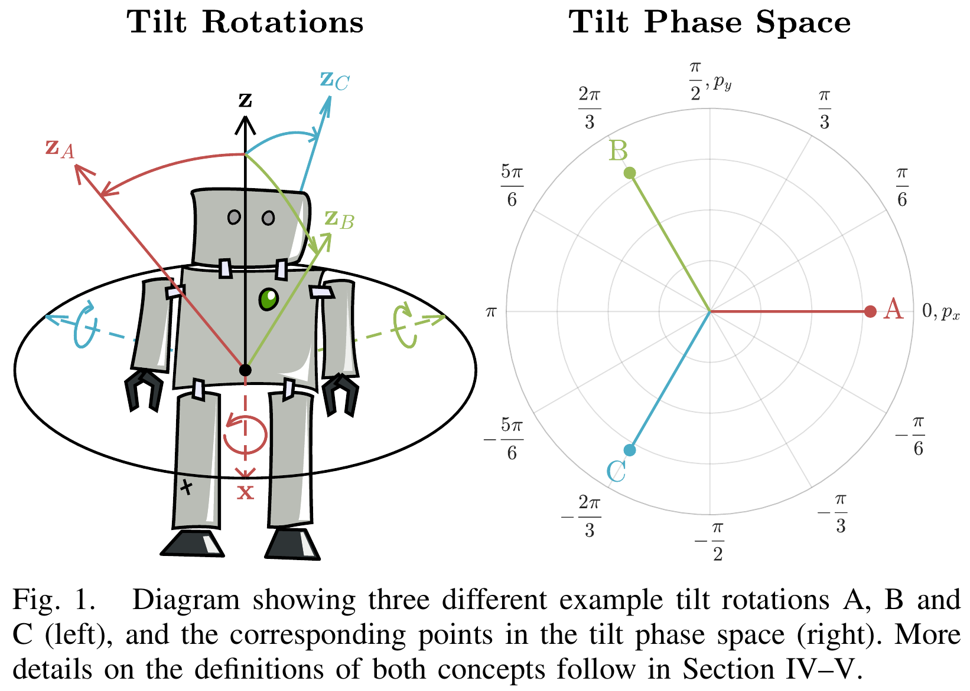
Tilt Rotations and the Tilt Phase Space
Philipp Allgeuer and Sven Behnke
The intuitive idea of tilt is formalised into the rigorous concept of tilt rotations
Introduces the tilt phase space, which is closely related to fused angles
For the analysis and control of balancing bodies in 3D

Slide 2
Motivation

Slide 3
Tilt Angle / Fused Angles

Slide 4
Tilt Phase Space

Slide 5
Important Properties of the Tilt Phase Space
Correspond to different major planes of rotation
Mutual parameter independence
Axisymmetry of all three parameters
Magnitude axisymmetry (equal angle magnitude rotations in any tilt direction have equal norms in the 2D tilt phase space)

Slide 6
Link Between Fused Angles and Tilt Phase Space

Slide 7
Topics Explored in the Paper
Referenced rotations
Four existing parameterisations of tilt rotations
The novel tilt phase space
Tilt vector addition + interpretation thereof
Tilt rotations as a vector space
Spherical linear interpolation between tilt rotations
Relation between fused angles and the tilt phase space
Rotational velocities and conversions
Rotation decomposition into yaw and tilt
Rotation composition from yaw and tilt
Rotation composition from mismatched yaw and tilt
Application examples

