Slide 1
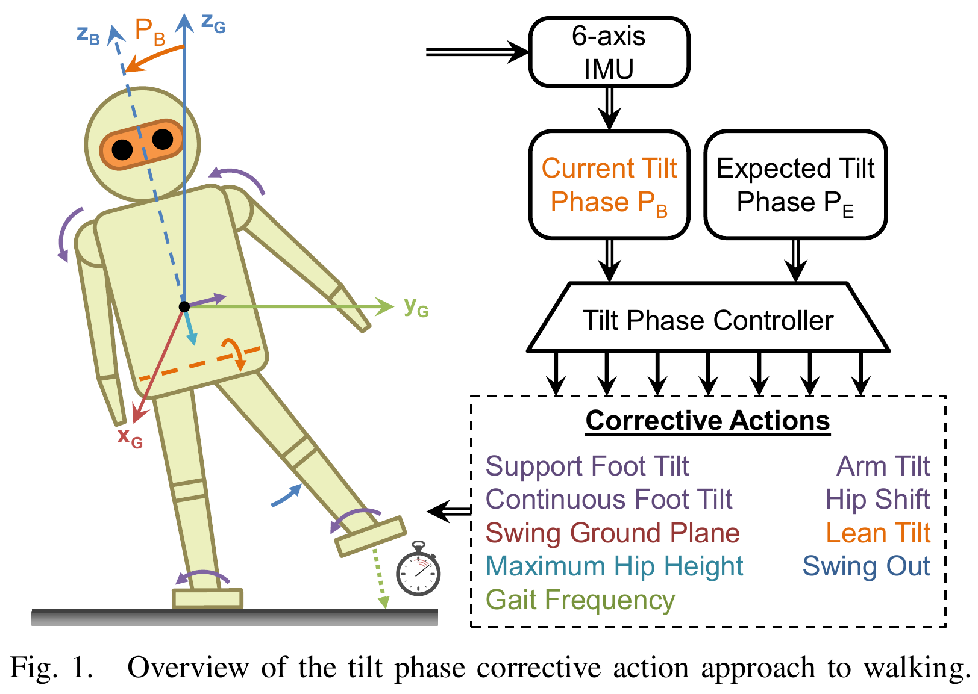
Bipedal Walking with Corrective Actions in the Tilt Phase Space
Philipp Allgeuer and Sven Behnke
Multifaceted feedback controller that uses corrective actions to stabilise a core gait
No physical model of the robot required
Only sensor is single 6-axis IMU
Constructs feedback in the tilt phase space

Slide 2
Gait Architecture (3 layers)
Actuator control scheme: Joint targets, joint efforts and support coefficients commanded by the middle layer are converted into raw actuator commands and stiffnesses.
Keypoint gait generator: Generates the required joint trajectories based on corrective action activation commands from the top layer. Essentially constitutes an underlying open loop gait.
Higher level controller: More specifically, the tilt phase controller, computes activations of the corrective actions based on sensory feedback that robustly stabilise the walking robot

Slide 3
Corrective Actions

Slide 4
Tilt Phase Space

Slide 5
Tilt Phase Controller

Slide 6
Experimental Results

Slide 7
Experimental Results
Walking 4m with 1m run-up
45.7cm/s average achieved
30.5cm/s average achieved by previous work

