Slide 1
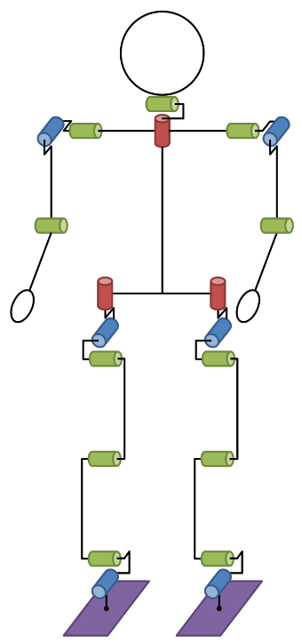
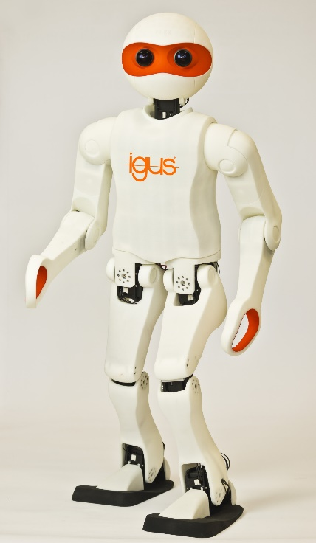
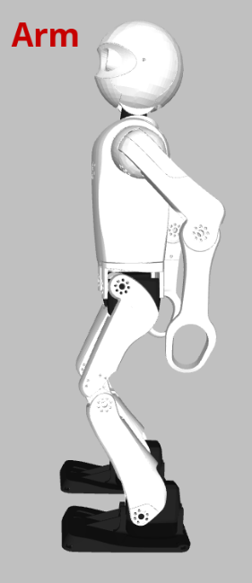
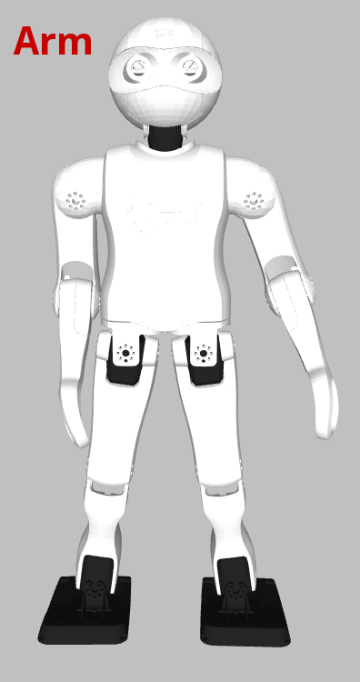
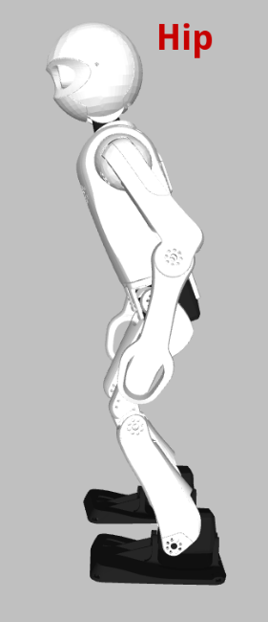
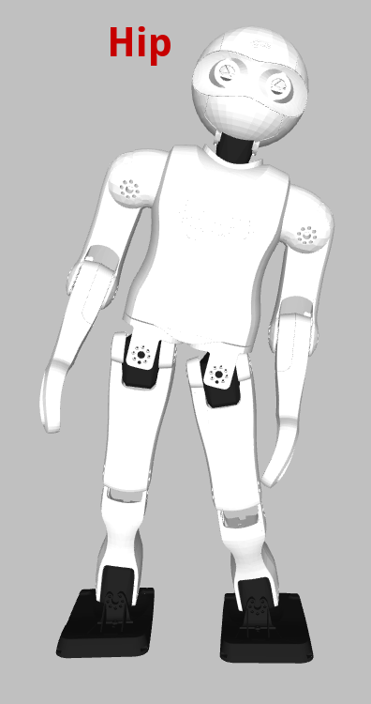
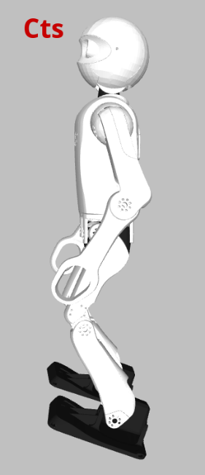
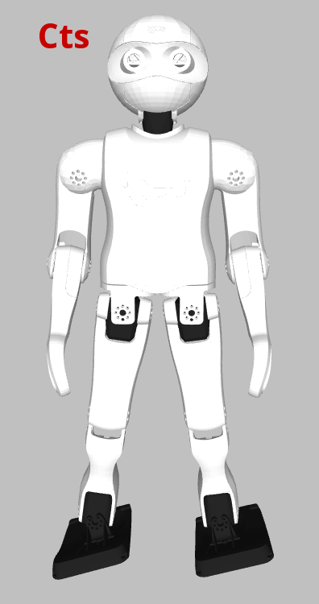
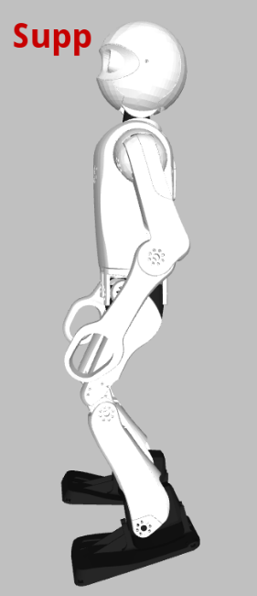
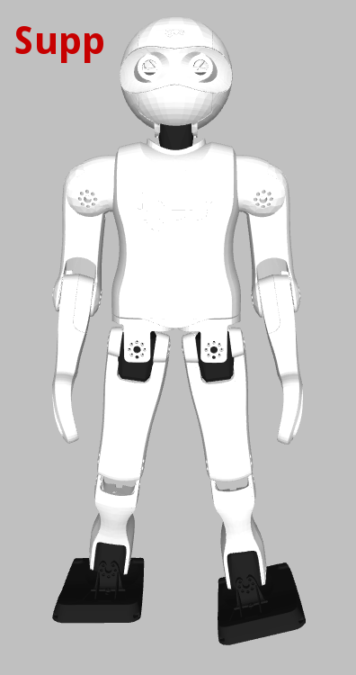
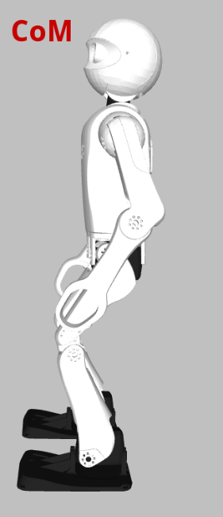
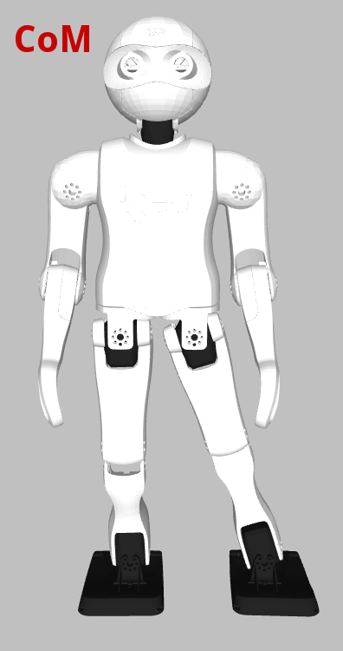
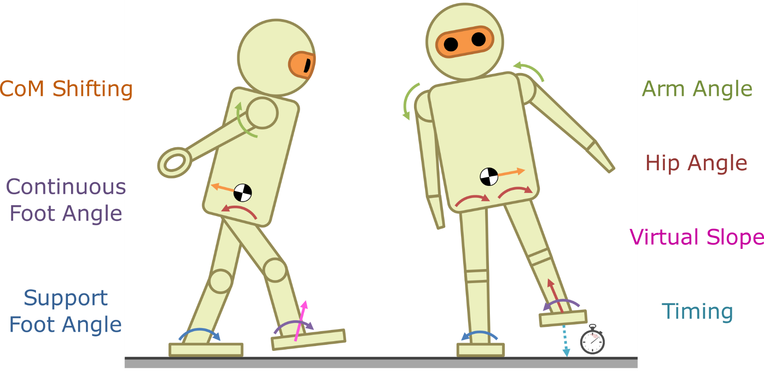
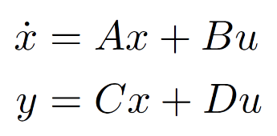
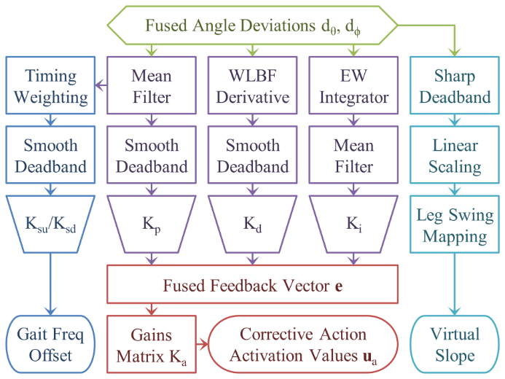
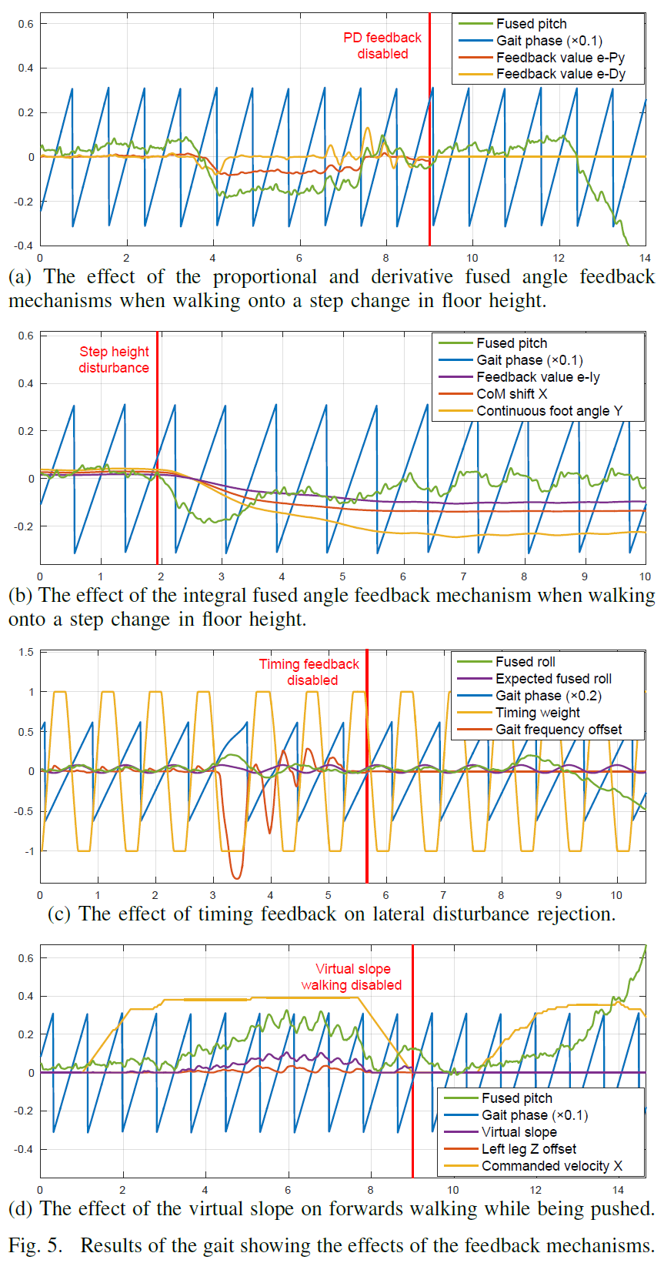
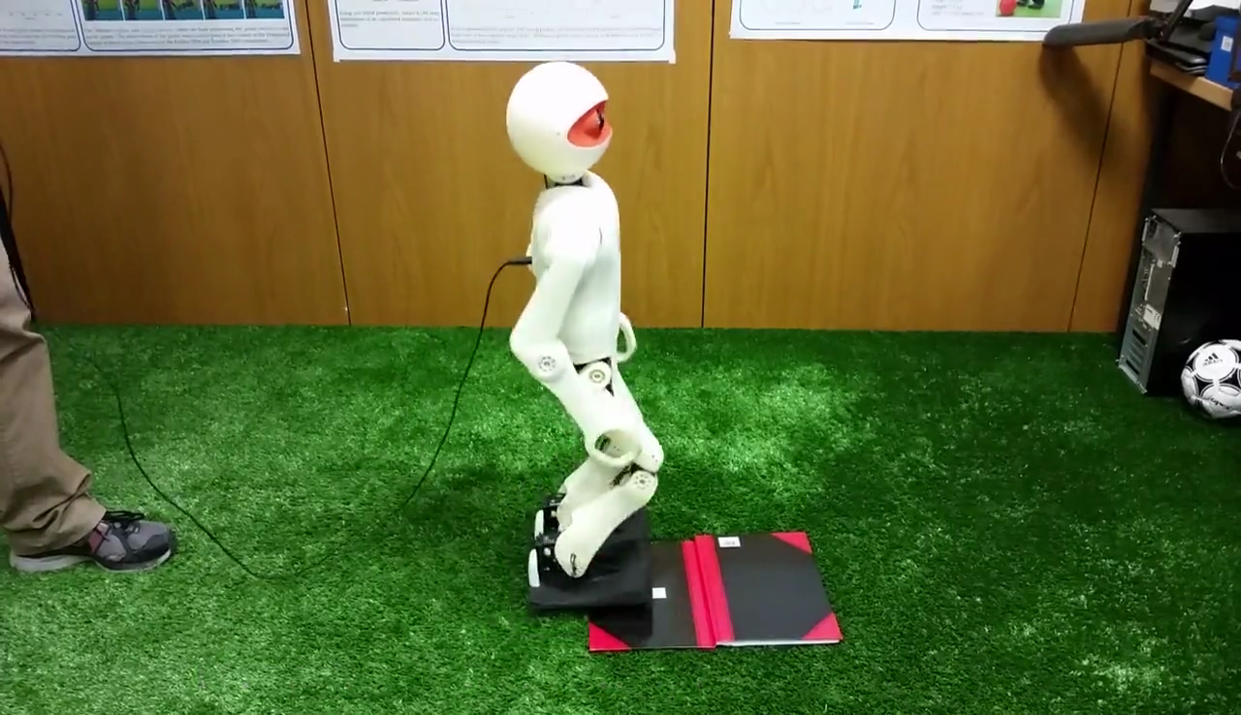
Problem Definition
Corrective Actions
A gait is proposed that uses only 6-axis IMU feedback to stabilise an open-loop omnidirectional bipedal walk. The gait is suitable for robots with low cost sensors and actuators. We aim to show that if the sensor feedback chains are carefully constructed, then relatively simple, model-free and robot-agnostic feedback mechanisms can successfully stabilise a generic bipedal gait.
The corrective actions are primitives that are weighted and superimposed on the gait based on a vector of activation values u_{a}. These combine with the timing and virtual slope feedback mechanisms to form the complete feedback path.
Arm Angle
Hip Angle
Continuous Foot Angle
Support Foot Angle
CoM Shifting
Sensors and Actuators
Fused Angle Feedback Mechanisms
Tuning of the Feedback Parameters
State Estimation: The fused angles orientation of the torso is estimated from 3-axis accelerometer and gyroscope data, using the attitude estimator from [1]. This is the only source of feedback. Three calibration routines have been implemented for the gyroscope and accelerometer to maximise the quality of the fused angle estimates.
Actuator Control Scheme: The servos are compliantly actuated to achieve good setpoint tracking, based on the servo model in [2].
The process of tuning is relatively straightforward due to the great independence of the parameters, each of which have clearly observable effects. The tuning is arguably quicker and easier than for most model-based approaches that do not work out of the box.
The sagittal PD gains can be tuned using an LQR-based approach. This makes certain assumptions, and subsequent manual fine-tuning is sometimes required due to modelling limitations.
Open-Loop Gait
The open-loop gait is based on the one in [3], but with many modifications and improvements. It is based on a central pattern generator that produces joint trajectories that can make the robot walk, even if unreliably.
The gait is formulated in a combination of the joint, abstract and inverse spaces, although predominantly the abstract space, and at each instant is expressed as a function of the gait phase µ in the range (-π, π]. µ = 0 and π corresponds to the commanded touchdown times of the two feet. If f_{g} is the current gait frequency in steps per second, then after each time step Δt the gait phase is updated using:
Based on the orientation of the torso, fused angle deviation proportional, derivative and integral feedback has been implemented, in addition to timing and virtual slope feedback schemes. The fused feedback vector e is matrix-scaled to give the activations u_{a}:
Experimental Results
Source code has been released!
VIDEO

Slide 2
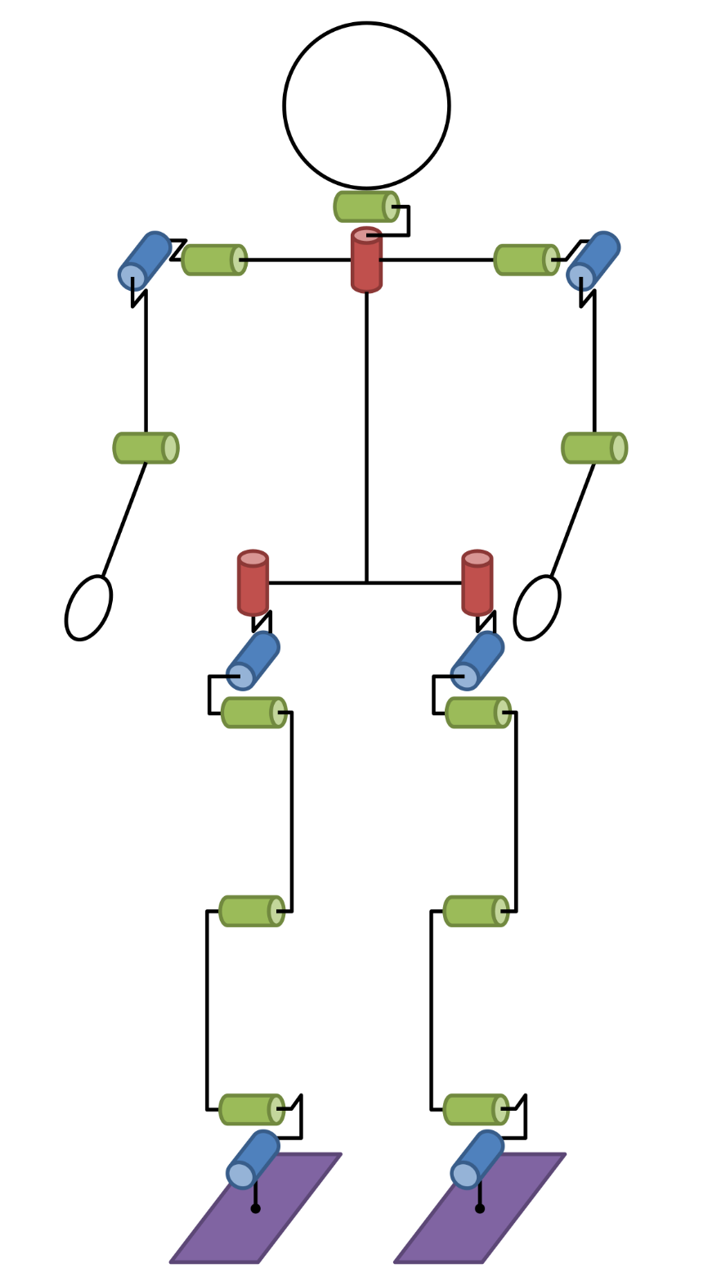
Problem Definition
What is the problem?
Walking poses many difficulties, including incomplete information, sensor delays, sensor noise, imperfect actuation, joint backlash, structural non-rigidity, uneven surfaces, and external disturbances.
Larger robots that are not expensive and high performance, are more limited in the actions they can perform, and can often not use the same approaches to walking that smaller robots can, due to a violation of underlying dynamic and kinematic assumptions.
The problems associated with low cost actuators and sensors are often not addressed by related works.
What are we proposing?
We are proposing a method for flexible and reliable omnidirectional walking that is suitable for larger robots with low cost actuators and sensors, using the concept of direct fused angle feedback. It is demonstrated that genuinely good walking results can be achieved using relatively simple feedback mechanisms, with only minimal modelling of the robot, and without measuring or controlling forces or torques. Only joint positions and a 6-axis IMU are used.
We aim to show that if the sensor feedback chains are carefully constructed, then relatively simple, model-free and robot-agnostic feedback mechanisms can successfully stabilise a generic bipedal gait.
Furthermore, the presented gait can be used as a stabilising foundation for step size adaptation schemes such as the Capture Step Framework.
Contributions
The contributions of this paper are:
The entire fused angle feedback scheme,
The method of calculating feed-forward torques for position controlled gait applications,
The listed extensions to the open-loop gait, and
The described IMU calibration routines.

Slide 3
Sensors and Actuators
State Estimation
The sole form of feedback used in the gait, other than the joint encoders for low level servo control, is that of the fused pitch and fused roll, estimated from 3-axis accelerometer and gyroscope data. The attitude estimator from [1] is used to perform the sensor fusion. The fused pitch and roll are components of the fused angles orientation representation, developed rigorously in [4] as a significantly superior alternative to Euler angles.
Sensor Calibration
In order to obtain the best orientation estimates possible, good calibration of the inertial sensors is required.
High and low temperature gyroscope scale calibrations ensure through saturated linear interpolation that the angular velocities provided by the gyroscope are accurate in magnitude.
An orientation offset calibration compensates for any differences in orientation between the trunk link frame and the frame of the inertial sensors.
A gyroscope bias auto-calibration is run online to complement the bias estimation that is performed in the attitude estimator. Brief intervals where the robot is at rest are automatically detected and used to converge the gyroscope bias estimate to the true measured value.
Actuator Control Scheme
Gaits are relatively sensitive to how well the actuators track their set position. This is influenced by factors including battery voltage, joint friction, inertia, and the relative loadings of the legs. Feed-forward control is applied to the commanded servo positions to try to compensate these factors. This allows the joints to be operated in higher ranges of compliance, reduces servo overheating and wear, increases battery life, and reduces the problems posed by impacts and disturbances.
Being position controlled, it is assumed that for a current position q, and a desired setpoint q_{d}, each servo produces a torque τ of
Based on this and a Stribeck friction model, the feed-forward control is then
The τ_{d} term is the desired feed-forward output torque, calculated on a per joint basis from the commanded joint positions, velocities and accelerations, using the full-body inverse dynamics of the robot.
A so-called single support model is created for the trunk, and for each link that is at the tip of a limb. It is assumed that the respective root links are fixed in free space, and that no other links have external contacts. The results of inverse dynamics calculations for each single support model are superimposed based on commanded support coefficients—a measure of the proportion of the robot’s weight that is expected to be carried by the root link corresponding to that single support model. This is how τ_{d} is computed.

Slide 4
Open-Loop Gait
Overview of Open-Loop Walking
The open-loop gait core used in this work is based on the one in [3], but with numerous modifications and improvements. It is based on a central pattern generator that is able to make the robot walk to some extent, but not as reliably as desired (unlike what may be the case for higher quality hardware).
The Joint, Abstract and Inverse Pose Spaces
Three ways of representing limb poses are used. The joint space pose is the vector of all joint angles, while the inverse space pose is the Cartesian coordinates and quaternion orientation of the limb end effector. The abstract space reduces the pose to parameters that define the length of the limb, the orientation of the so-called limb centre line, and the orientation of the end effector. For the leg these parameters are the leg extension, leg angles, and foot angles. We can analogously define the arm extension and arm angles.
Modifications and Improvements
Changes to the leg extension profiles to transition more smoothly between swing and support phases,
The addition of a double support phase for greater walking stability and passive oscillation damping,
The addition of a trim factor for the angle relative to the ground at which the feet are lifted during stepping,
The integration of a dynamic pose blending algorithm to enable smoother transitions to and from walking,
The incorporation of support coefficient waveforms, for use with the actuator control scheme,
The introduction of a leaning strategy based on the rate of change of the commanded gait velocity, and
The use of hip motions instead of leg angle motions for the gait command velocity-based leaning strategies.
Generating the Open-Loop Gait
The pose at each instant in time is a deterministic function of the commanded gait velocity v_{g}, and the gait phase µ in the range (-π, π]. By convention, µ = 0 and µ = π correspond to the commanded touchdown times of the individual legs. If f_{g} is the current gait frequency in steps per second, then after each time step Δt the gait phase is updated using:
Abstract Halt Pose
Abstract Waveforms
Inverse Space
Inverse Waveforms
Actuator Control Scheme
Joint Pose
-π
0
π

Slide 5
Corrective Actions
Arm Angle
The abstract arm angles are adjusted to bias the robot’s balance, and produce reaction moments that help counterbalance transient instabilities (e.g. moving the arms backwards tilts the robot backwards).
Support Foot Angle
Gait phase-dependent offsets are applied to the abstract foot angles (e.g. tilting the inside support foot edge down induces greater centre of mass swing onto the support foot). The offsets are faded in linearly just after the corresponding leg is extended fully, and faded out linearly just before the leg begins to retract again for its swing phase. As such, the offsets are applied only during the support phases.
Hip Angle
The torso of the robot is tilted within the lateral and sagittal planes to induce lean in a particular direction, with adjustment of the abstract leg extension parameters preventing a counterproductive ensuing difference in foot height (e.g. leaning towards the left makes the robot swing out more to the left).
CoM Shifting
The inverse kinematic positions of the feet relative to the torso are adjusted in the horizontal plane to shift the position of the centre of mass (CoM), thereby adjusting the centering of the robot’s mass above its support polygon (e.g. shifting the CoM to the right trims the time spent on each foot to the right).
Continuous Foot Angle
Continuous offsets are applied to the abstract foot angles to bias the tilt of the entire robot from the feet up (e.g. putting the front of the feet more down makes the robot lean more backwards).
Virtual Slope
The inverse kinematic positions of the feet relative to the torso are adjusted in the vertical direction in a gait phase-dependent manner to lift the feet more at one swing extremity. This can be thought of as what the robot would need to do to walk up or down a slope.

Slide 6
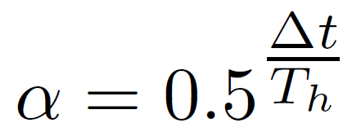
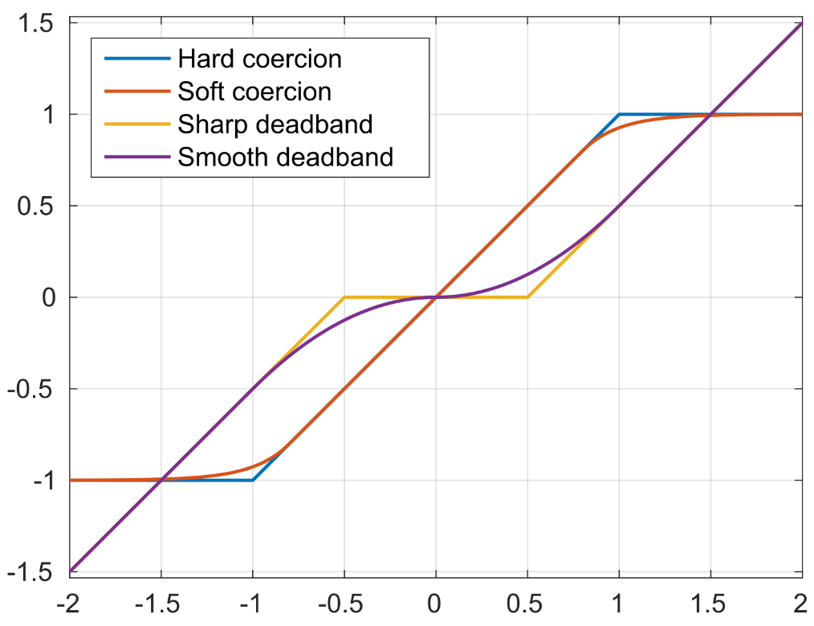
Fused Angle Feedback Mechanisms
Fused Angle Feedback Pipeline
Mean filter
Finite impulse response (FIR) running average
Smooth deadband
Weighted Line of Best Fit (WLBF) Filter
Exponentially Weighted (EW) Integrator
Timing weighting
Adjusted gait frequency
Calculation of corrective action activations

Slide 7
Tuning of the Feedback Parameters
Observations
Tuning is greatly simplified by the considerable independence of the feedback mechanisms.
The individual feedback mechanisms have clearly observable and direct actions that can be precisely isolated and tested.
Arguably, the process of tuning the proposed gait is quicker and easier than it would be for most model-based approaches that do not work out of the box.
Order of Tuning
The PD gains are tuned first, to establish the set of most effective corrective actions, and the gain ranges that produce noticeable effect without risking oscillations or instabilities.
A suitable integral feedback half-life is chosen based on the rate at which the robot should adapt to a new environment.
Timing is then considered, with the speed-up and slow-down gains being selected to suitably avoid premature stepping.
The virtual slope parameter is chosen to provide the desired margin of clearance of the foot from the ground during maximum forwards walking.
LQR Tuning of the Sagittal Transient Response
Tuning of the sagittal PD feedback mechanisms can be supported by an LQR approach. The robot is made to walk on the spot while activating the corrective actions with a multi-frequency signal. The System Identification Toolbox in MATLAB was used to fit a generic second order state space system to the observed data, giving a model of:
The PD feedback law is then given as follows, with the aim of the LQR being to minimise the performance cost function given by J.
The Q and R matrices were initially chosen based on Bryson’s rule and subsequently refined. Once we have K, the optimal PD gains are then:
Due to modelling limitations that tend to overestimate the stability of the system, the final gains that arise will usually require some manual fine-tuning to get the most out of the feedback, often an increase in the D gain.
PD Gains
I Gains
Timing
Virtual Slope

Slide 8
Experimental Results
Video
Experimental Results
The proposed gait has been evaluated on four igus Humanoid Open Platform robots, and for cross-validation purposes, the completely different Dynaped robot. In all cases the feedback mechanisms produced a robust and reliable gait, using even nearly identical parameter values, and made a significant difference to the walking ability of the robots.
Imparted the robots with disturbance rejection capabilities that were not present otherwise
Walking speeds of 21cm/s and higher on 32mm artificial grass
Able to reject 1.5cm step change in floor height, and converge to upright walking afterwards
Able to absorb lateral timing disturbances within a few steps
Prevents premature collisions of the feet with the ground when walking forwards while tilted
VIDEO
This video shows the exact same set of experiments for which the time plot data is provided on the right.
Code Release
The source code of the entire fused angle feedback gait has been released open-source as part of the igus Humanoid Open Platform software release, which can be found on GitHub at the following URL:
https://github.com/AIS-Bonn/humanoid_op_ros

