Slide 1
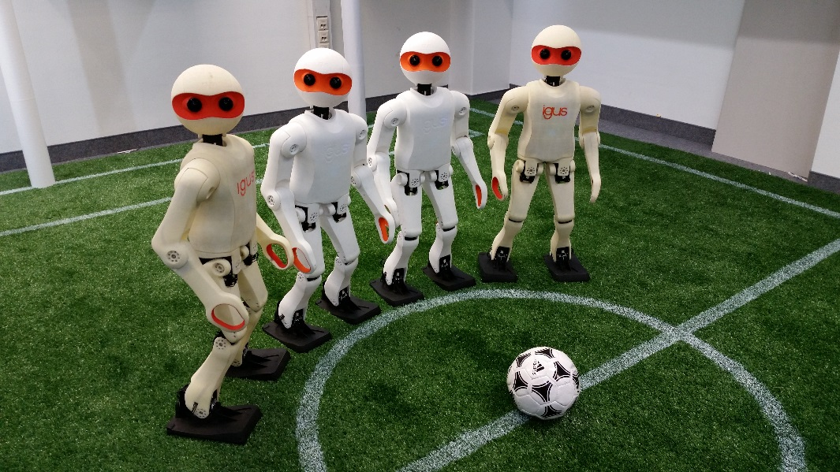
Child-sized 3D Printed igus Humanoid Open Platform
Philipp Allgeuer, Hafez Farazi, Michael Schreiber and Sven Behnke
Autonomous Intelligent Systems
University of Bonn

Slide 2
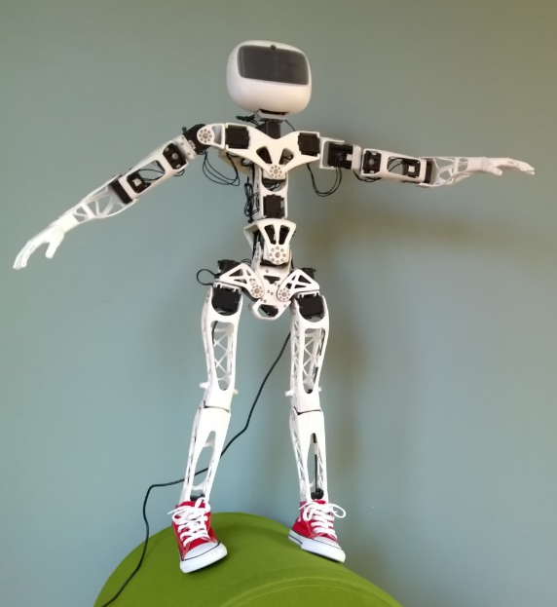
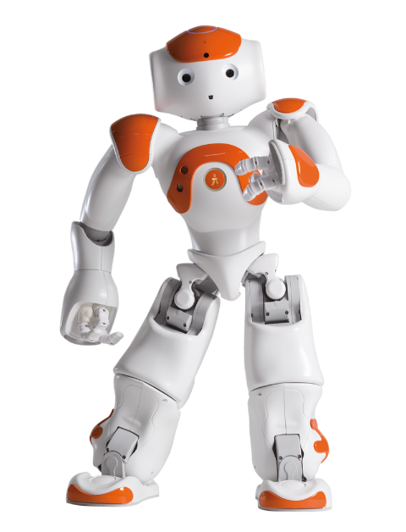
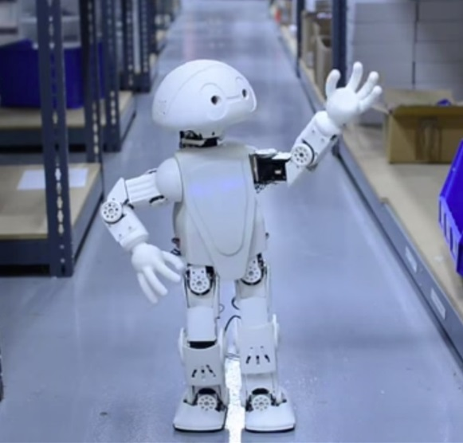
Existing Standard Platforms

Slide 3
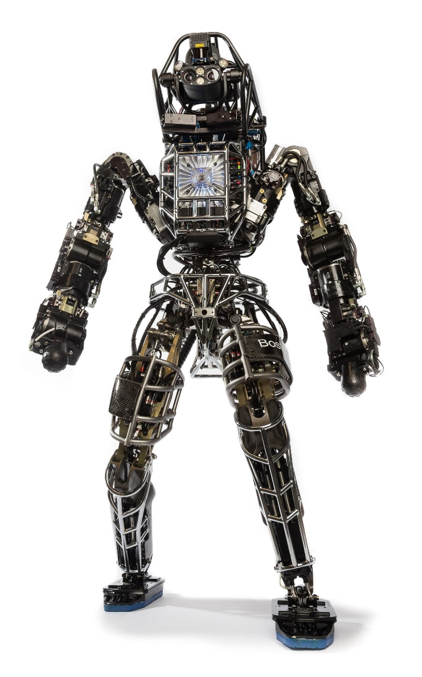
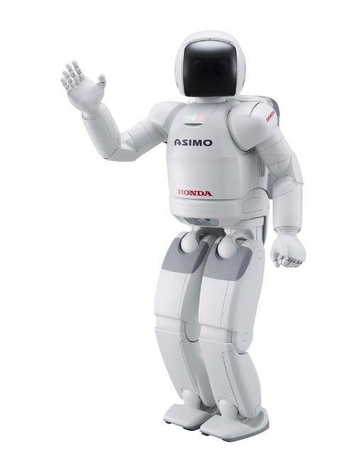
Existing Standard Platforms

Slide 4
Motivation
Why a new platform?
Lack of standard platforms in the child-sized range that have suitable characteristics and abilities.
Benefits of standard platforms?
Lower entry barrier for new research groups
Acceleration of research through collaboration and code sharing
Philosophy of the new platform?
Completely open source software and hardware

Slide 5
Design Aims
The robot should be easy to:
Manufacture
Assemble
Maintain
Customise
Operate
Extend
Furthermore:
Appealing overall aesthetic appearance is desired
3D Printing!

Slide 6
igus Humanoid Open Platform

Slide 7
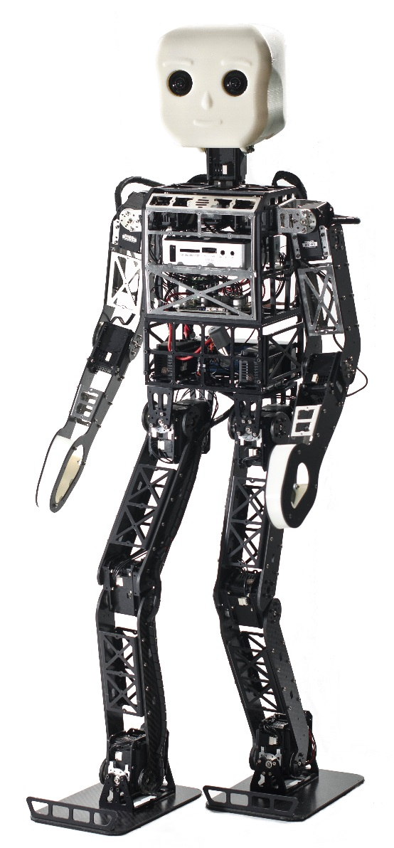
First Prototype: NimbRo-OP
NimbRo-OP:
Constructed in 2012
Test of kinematics, electronics, mechanics and software
Carbon composite, aluminium, ABS+
igus Humanoid Open Platform:
Total redesign of appearance
Kinematic improvements
Internal cable routing
3D printed polyamide (PA12)

Slide 8
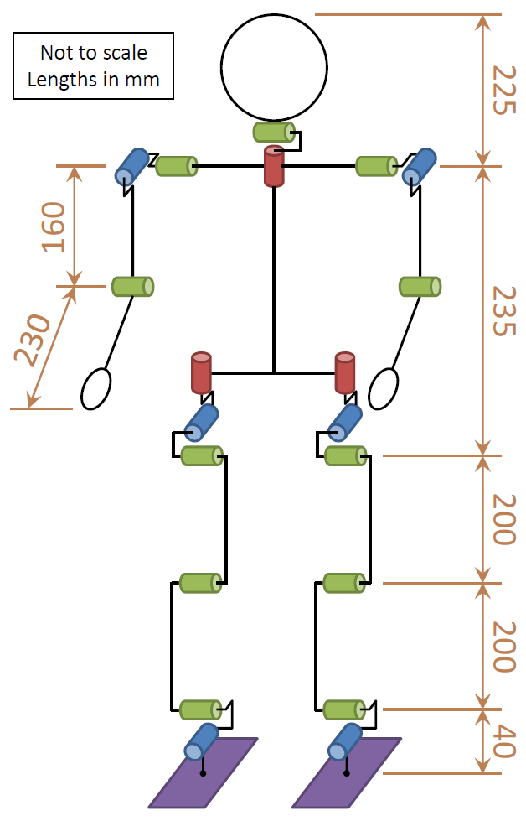
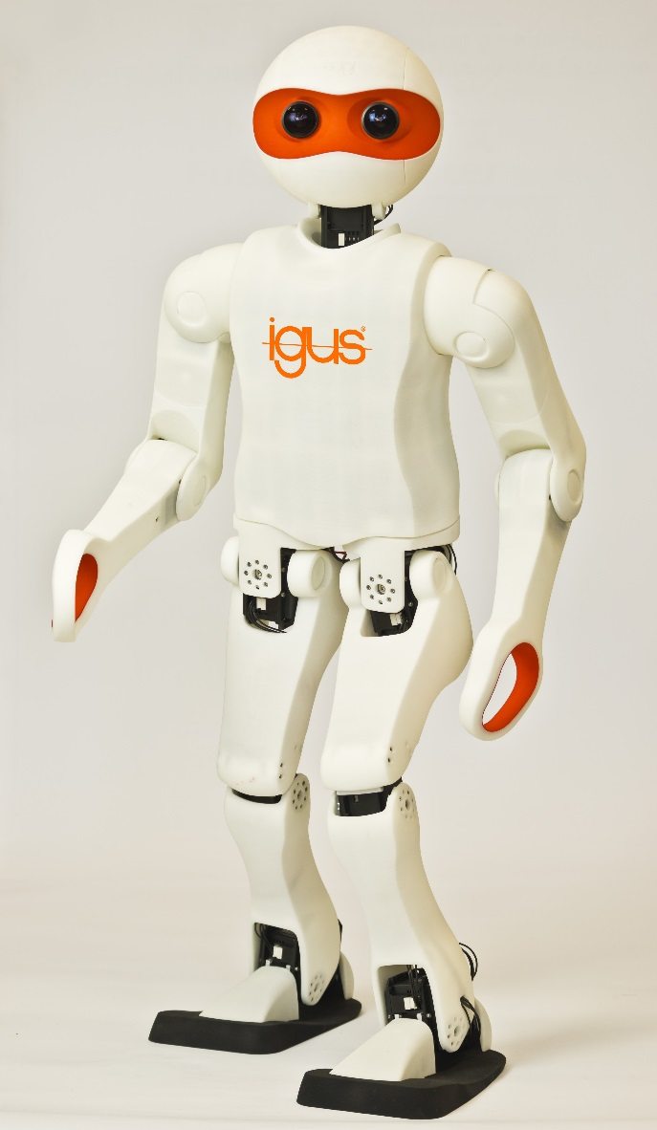
igus Humanoid Open Platform
20 DoF

Slide 9
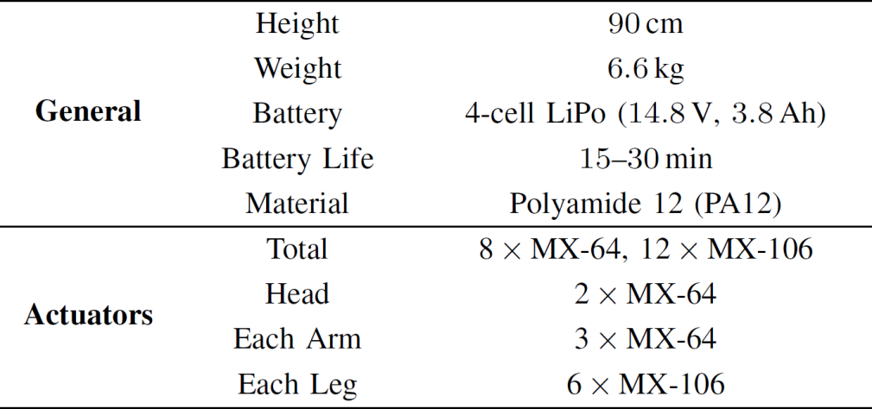
igus Humanoid Open Platform
3D printed components:
Selective laser sintering, with steps of <0.1mm
Uses ribs and wall thickness for structural rigidity
Openly available as CAD files!
90cm,
6.6kg
Battery

Slide 10
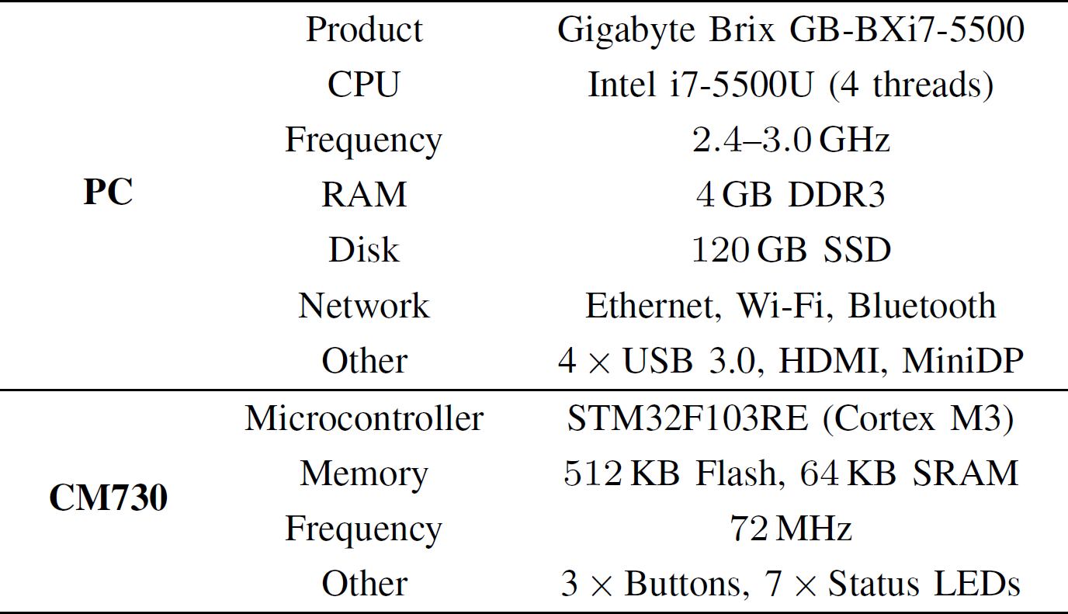
igus Humanoid Open Platform
PC
Main PC:
Runs full 64-bit Ubuntu/ROS
CM730 microcontroller:
Custom firmware, but fully back compatible with stock
CM730

Slide 11
igus Humanoid Open Platform
Camera(s)
Inertial sensors (IMU):
Gyroscope, accelerometer and magnetometer located on microcontroller board
Cameras:
Monocular or stereo vision both possible.
IMU

Slide 12
Electrical Architecture

Slide 13
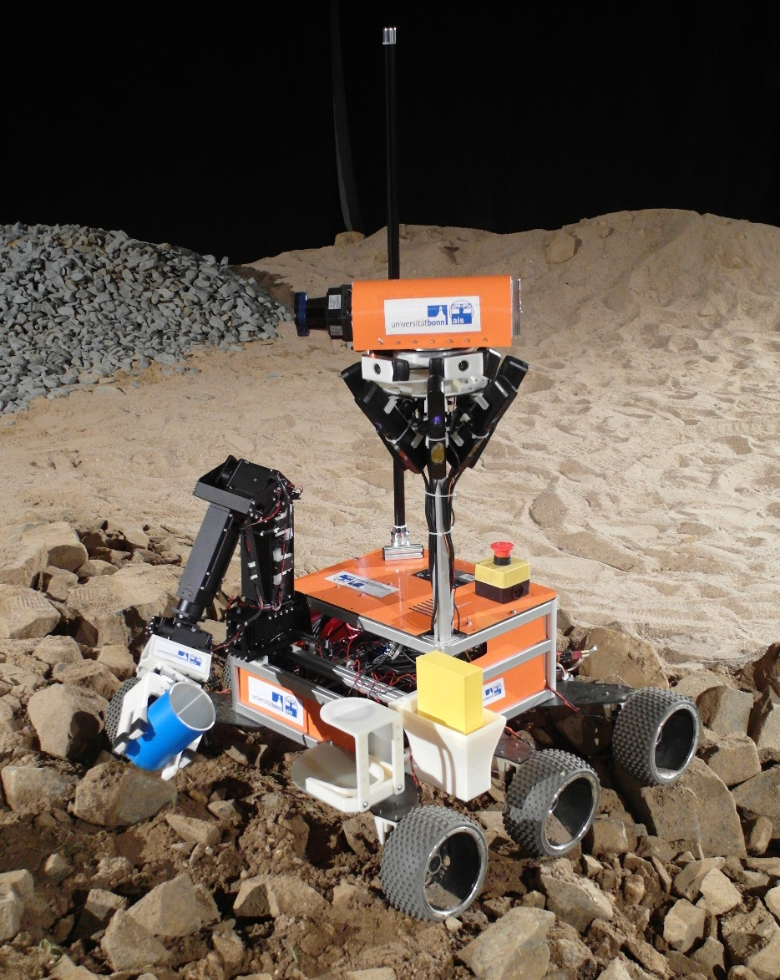
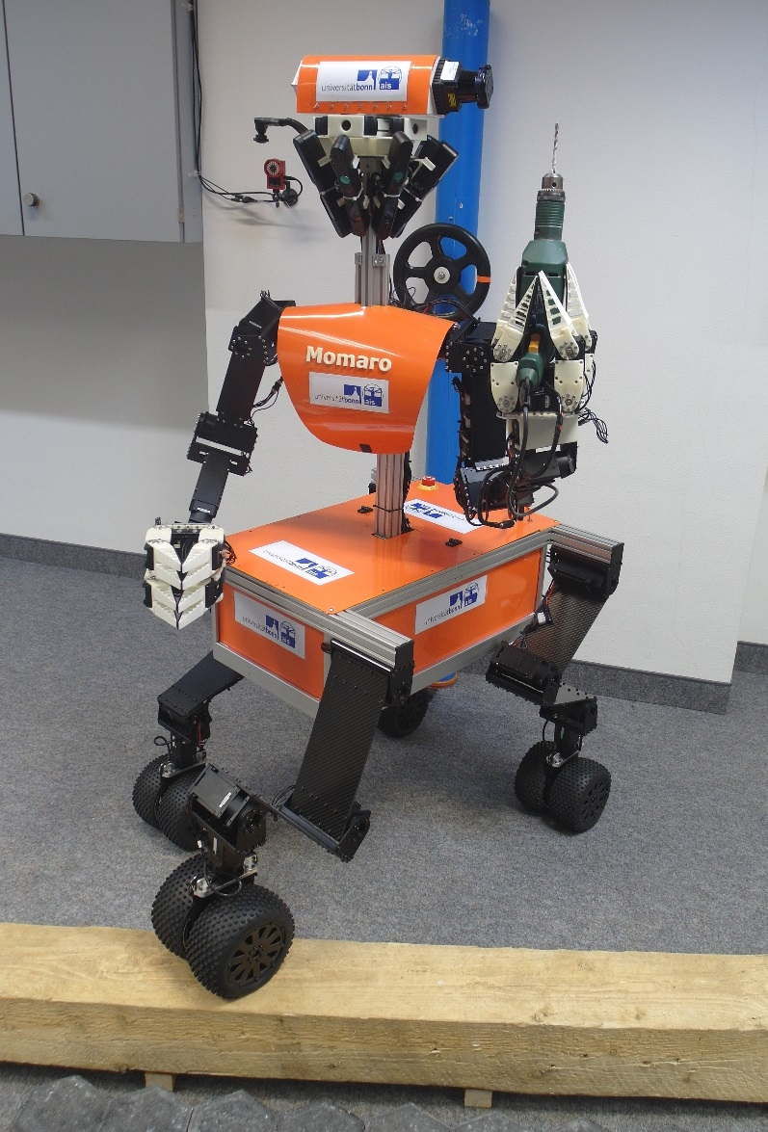
Software Architecture
Language and environment:
Written predominantly in C++
Based on the ROS middleware
Target application:
Robot soccer, but thanks to its inherent modularity, large portions of the code have been used for other applications and other robots
Source code available open source!
https://github.com/AIS-Bonn/humanoid_op_ros

Slide 14
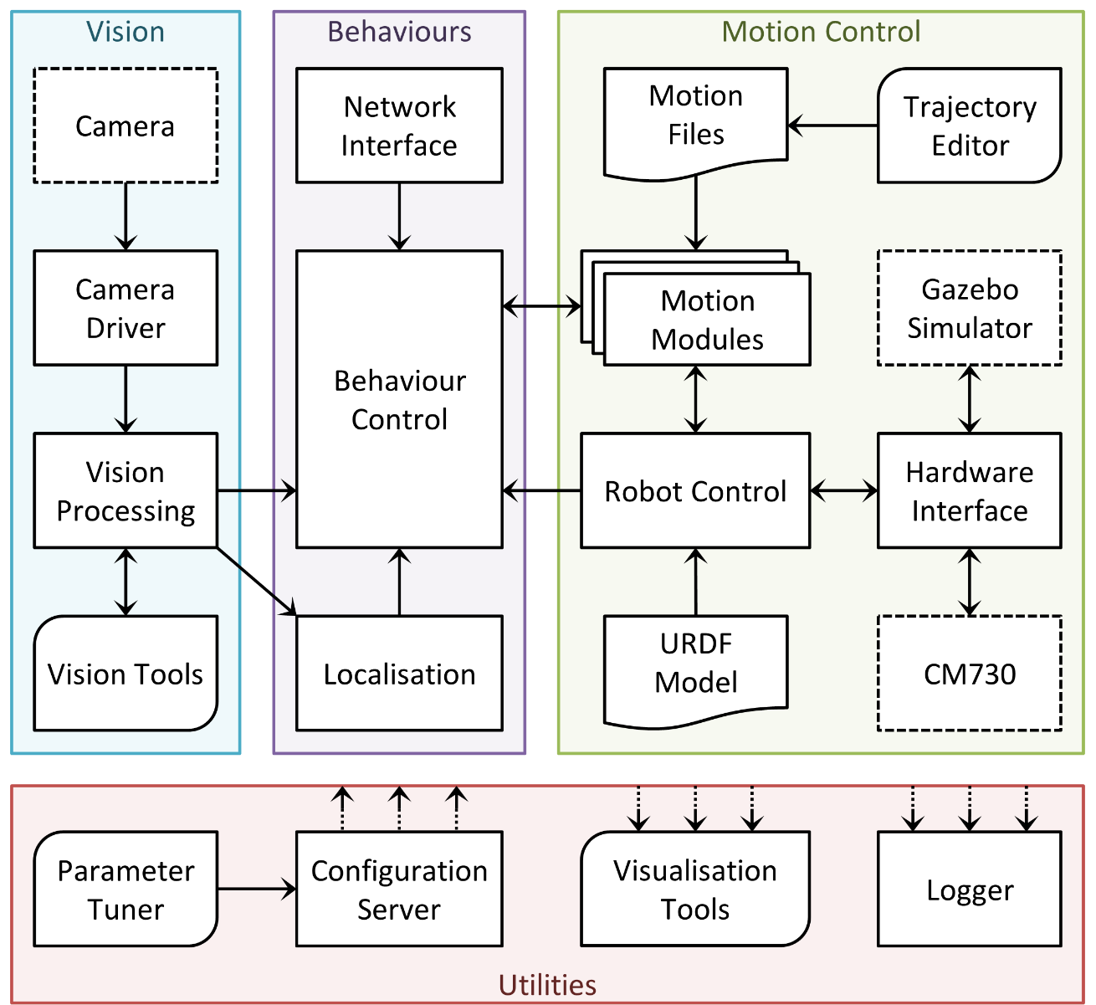
Software Architecture
Motion Control:
Robot control node
URDF model
Motion module plugin scheme
Hardware interface plugin scheme
Trajectory editor for keyframe motions

Slide 15
Software Architecture
Behaviours:
Soccer playing
Localisation on the field
Vision:
Image acquisition
Detection of soccer features, such as field, ball and goal

Slide 16
Software Architecture
Utilities:
Visualisation tools
Generic ROS topic logging node
Configuration server for dynamic updates to parameters
Greatly helps nodes to be robot agnostic!
Parameter tuner

Slide 17
Trajectory Editor

Slide 18
Trajectory Editor

Slide 19
Software Features
Compliant servo actuation:
Uses a full physical model to compute dynamics
See: Schwarz et al. 2013 ^{[13]}
Attitude Estimation:
Uses a nonlinear passive complementary filter
See: Allgeuer et al. 2014 ^{[16]}
Walking gait based on angle feedback mechanisms:
Uses an improved OL central pattern generated gait
Walks on 32mm artificial grass at up to 21cm/s

Slide 20
Video

Slide 21
Thank you for your attention!
igus Humanoid Open Platform:
http://nimbro.net/OP/
Software release:
https://github.com/AIS-Bonn/humanoid_op_ros
Hardware release:
https://github.com/igusGmbH/HumanoidOpenPlatform

Slide 22
References

