Slide 1
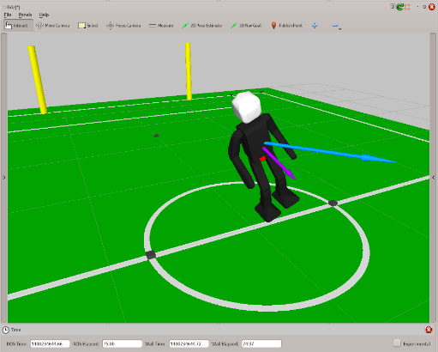
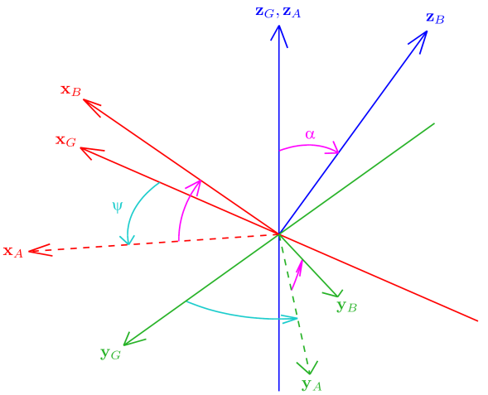
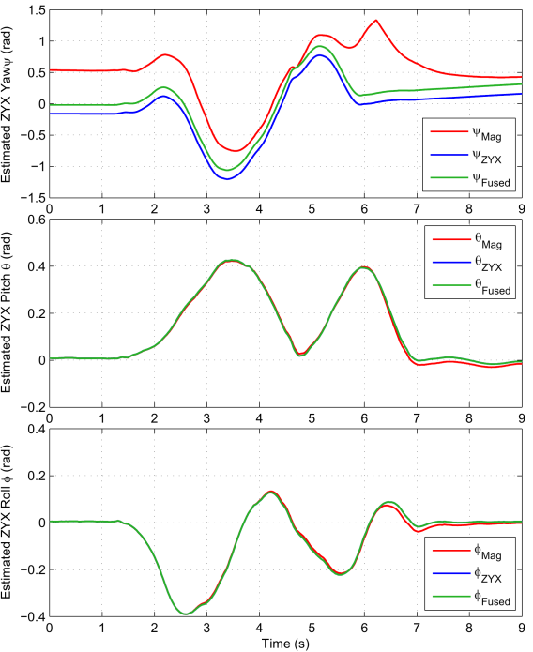
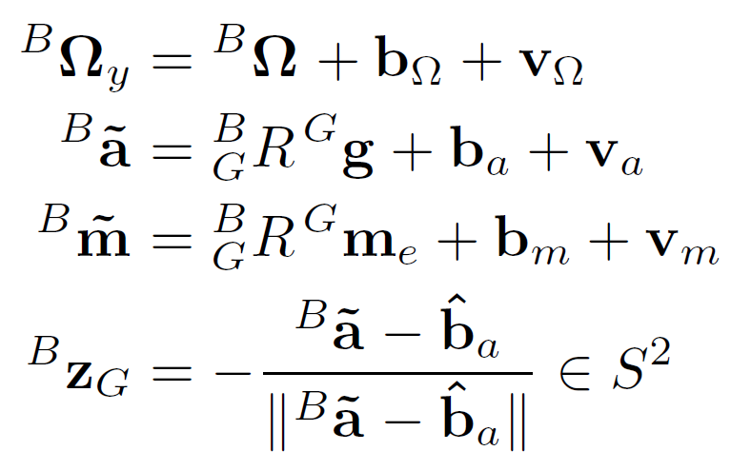
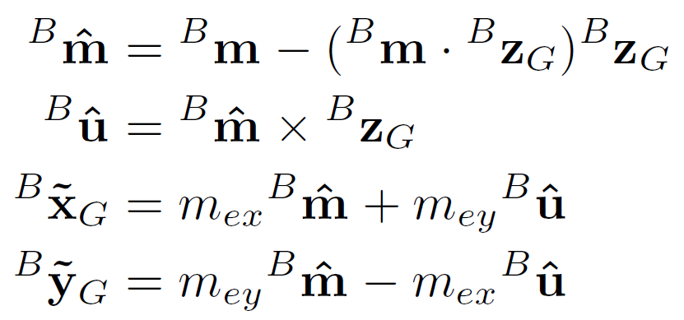
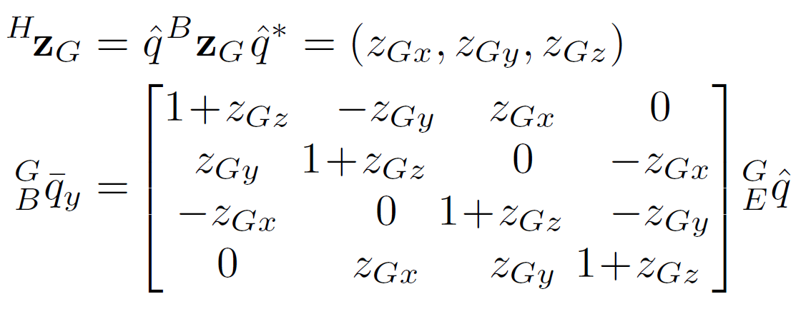
Problem Definition
Orientation Resolution Methods
Experimental Results
Knowledge of how a body is oriented is frequently invaluable information.
We propose an attitude estimator that fuses 3-axis gyro, accelerometer and magnetometer data to obtain an estimate of the orientation of a body.
The ability to deal with noisy sensors and slow processors is key for use in low cost systems. The filter should also be uniformly robust and stable.
It is assumed that measurements as detailed on the right are available (models bias and zero-mean noise).
The core issue is how to calculate q_{y} , the quaternion orientation consistent with the sensor measurements. Three orientation resolution methods have been developed to address this need. One method uses the magnetometer reading ^{B}m, while the other two are for cases where this is not possible. All methods strictly respect ^{B}z_{G} and need only calculate ^{B}x_{G} and ^{B}y_{G} to define R_{y} .
The attitude estimator has been implemented in simulation as well as on real robots (e.g. NimbRo-OP).
The estimator update code takes 110 - 145ns to execute on a single 2.40GHz CPU core (≈ 6.9 - 9.1MHz).
Data from a real robot is shown to the right, recorded during manual disturbance of the robot’s attitude.
More results demonstrating quick learning are also available.
Magnetometer Method
The axes are calculated that minimise the angular difference between the global magnetic vector and the measured one.
ZYX Yaw Resolution Method
The axes are calculated that lead to zero relative ZYX yaw from G to H, the current estimated global frame.
Open-source C++ Library Implementation
Complementary Filtering
The complete attitude estimator, including all extensions, has been implemented as a C++ library and is freely available online.
Features:
Small, performant and code-efficient cross-platform library
Ready to use, with no external dependencies
Documented and explained using Doxygen
Implements the full attitude estimation algorithm
URL: https://github.com/AIS-Bonn/attitude_estimator
1D Linear Complementary Filter
In the case of rotation within a plane, the 1D filtering approach is
This complementary filter is unsuitable for general rotations however.
3D Nonlinear Passive Complementary Filter
A generalised 3D rotation error feedback term Ω_{e} is constructed and used to calculate a quaternion estimate update angular velocity Ω.
The filter update, including continued gyro bias estimation, is then
The passive complementary filter is discussed by Mahony et al. in [1].
[1] R. Mahony, T. Hamel, and J. Pflimlin, “Nonlinear complementary filters on the special orthogonal group,” IEEE Trans. Automat. Contr., vol. 53, no. 5, pp. 1203–1218, 2008.
Fused Yaw Resolution Method
The axes are calculated that lead to zero relative fused yaw from G to H, for H the current estimated global frame.
Extensions to the Estimator
The estimator has been extended with the following features:
Quick learning for faster settling from large initial estimation errors
Equations for estimation with only 2D acceleration data
Equations for estimation with reduced order magnetometer data
Fused yaw removal for estimation without magnetometer data
Notation and Identities
Details: Rotation matrices, special orthogonal group, quaternions, calculation of quaternion vector rotation, parallel, antiparallel, robust rotation matrix to quaternion conversions, and vice versa.

Slide 2
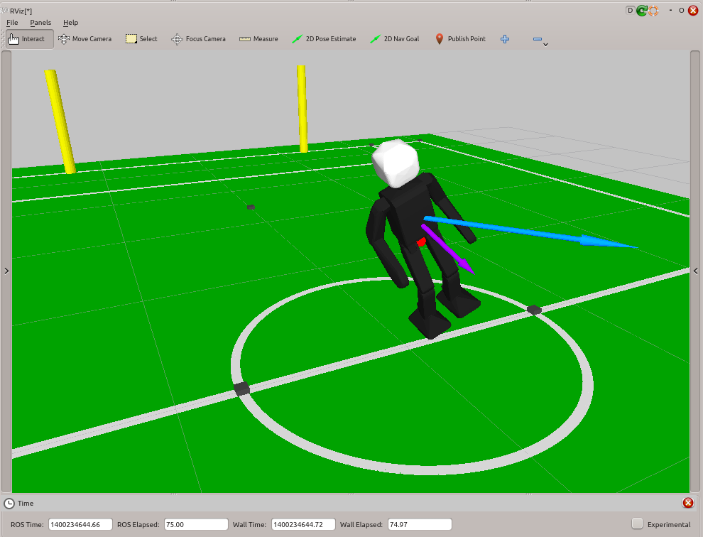
Problem Definition
Problem Overview
Attitude estimation is the task of constructing an estimate of the full 3D orientation of a body relative to some global fixed frame, based on a finite history of sensor measurements.
Knowledge of how a body is oriented relative to the world is frequently invaluable information for the purposes of localisation and/or control.
We propose an attitude estimator that fuses 3-axis gyroscope, accelerometer and magnetometer data into a quaternion orientation estimate.
The estimator should be able to function well with low cost hardware. This means that the estimator must be computationally efficient (slow processor), and be able to cope with high noise inputs without excessively sacrificing estimator response. The estimator should also be uniformly robust and stable.
Gyroscope Measurements
This sensor is assumed to measure the angular velocity of the body, in body-fixed coordinates. The measurement is assumed to be affected by a gyroscope bias b_{Ω}, and zero-mean sensor noise v_{Ω}. That is,
Accelerometer Measurements
This sensor is assumed to provide a measure of the proper acceleration of the body. This corresponds to the combination of inertial acceleration and gravity, where the latter component is assumed to dominate. The measurement is assumed to be affected by a time-invariant bias b_{a}, and zero-mean sensor noise v_{a}. An accelerometer calibration should be used to estimate ^{B}z_{G}. That is,
Magnetometer Measurements
This sensor is assumed to provide a measure of the strength and direction of the Earth’s magnetic field, in body-fixed coordinates. The measurement is assumed to be affected by a time-invariant bias b_{m}, and zero-mean sensor noise v_{m}. A hard-iron magnetometer calibration is assumed. That is,

Slide 3
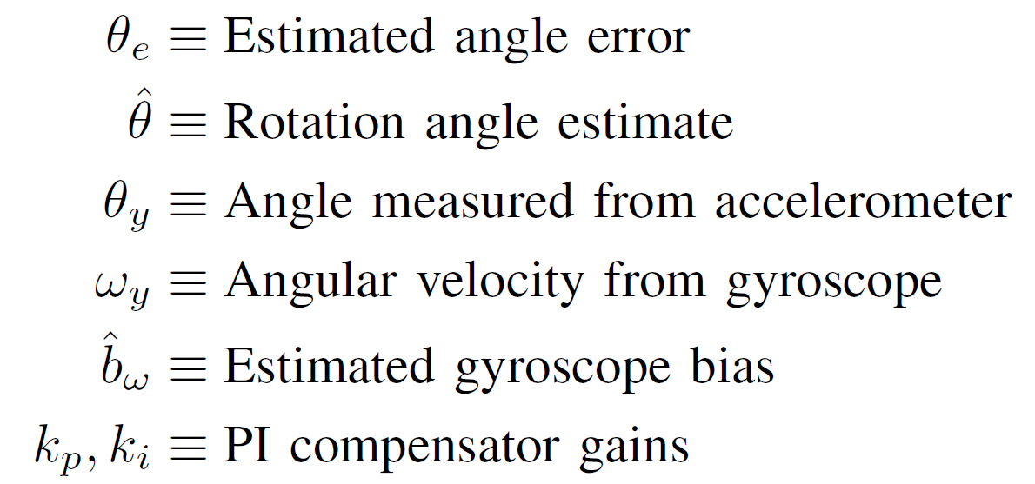
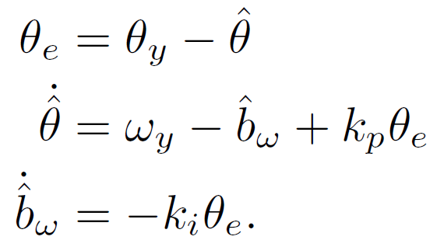
Complementary Filtering
1D Linear Complementary Filter
For simple 1D rotations within a plane, a complementary filter can be constructed that fuses the low pass attitude information from the accelerometer with the high pass attitude rate data from the gyroscope. This is achieved by integrating the angular velocity data and feeding the angle information back via a proportional-integral (PI) controller. The filter equations are given by
3D Nonlinear Passive Complementary Filter
Let {B} be the body-fixed frame, {G} be the global frame, and {E} be the estimated body-fixed frame relative to the global frame {G}, based on the current quaternion orientation estimate.
Based on the accelerometer and magnetometer measurements, we first construct a ‘measured’ orientation q_{y}. This is the purpose of the orientation resolution methods. The estimated rotation error can then be calculated, and the axis of this is used for the corrective error feedback term Ω_{e}. That is,
The calculated update angular velocity Ω is applied to the current quaternion orientation estimate, and the gyroscope bias estimate is updated based on the corrective error feedback term Ω_{e}. That is,
The similarity of the passive complementary filter to the 1D filter presented on the left should become apparent when contrasting the filter equations.
θ
ω_{y}
g
The 1D filter may naïvely be implemented independently in two of three axes in the general 3D case, but this generally gives unsatisfactory results and fails to capture much of the dynamics of 3D rotations.
Extension of Complementary Filtering to 3D
It is desired to formulate a complementary filter on the full 3D rotation space that retains the positive frequency characteristics of the 1D filter. Mahony et al. published the passive complementary filter in [1].
[1] R. Mahony, T. Hamel, and J. Pflimlin, “Nonlinear complementary filters on the special orthogonal group,” IEEE Trans. Automat. Contr., vol. 53, no. 5, pp. 1203–1218, 2008.

Slide 4
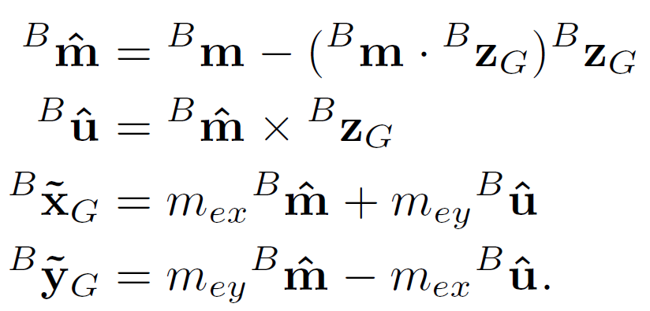
Orientation Resolution Methods
Overview
The complementary filter requires in each cycle the calculation of a measured quaternion orientation q_{y} best fitting the sensor measurements ^{B}z_{G} and ^{B}m. In general these two measurements suffice to construct a unique q_{y}, but if not, the current orientation estimate is also taken as an input.
In the following two methods it suffices to calculate the directions of ^{B}x_{G} and ^{B}y_{G}, after which q_{y} can be calculated by converting the rotation matrix R_{y} into a quaternion as shown here, where R_{y} is constructed as
Magnetometer Method
This method utilises the magnetometer measurement and seeks to minimise the angular difference between the expected global magnetic field vector ^{G}m_{e} and ^{B}m by modifying q_{y} (i.e. modifying frame {B}). This condition is seen to be satisfied when the projections of the two vectors onto the x_{G}y_{G} plane are parallel. Denoting ^{G}m_{e} = (m_{ex},m_{ey},m_{ez}), this leads to
If this fails, ^{B}m is discarded and one of the yaw resolution methods is used.
ZYX Yaw Resolution Method
Let {H} be the current estimated global coordinate frame, relative to {B}. This method seeks to find q_{y} such that the ZYX yaw of {H} with respect to {G} is zero. This ensures that the filter update only minimally affects the yaw. Thus,
In the rare case where this method fails, the ZXY yaw is zeroed instead, using
Fused Yaw Resolution Method
This method seeks to find q_{y} such that the fused yaw of {H}, defined as before, with respect to {G} is zero. This has a convenient quaternion solution, namely
This method fails only in boundary cases of the error quaternion, where the filter is insensitive.

Slide 5
Extensions to the Estimator
Quick Learning
It is desired for the attitude estimate to settle quickly from large estimation errors, yet simultaneously provide adequate general noise rejection.
Quick learning allows for two sets of PI gains to be tuned—one set that provides suitably fast transient response (quick), and one set that provides good tracking and noise rejection (nom).
A parameter λ on the unit interval is used to fade linearly between the two sets of gains over a given quick learning time, ending in the nominal tracking gains. The gain fading scheme is given by
The effect of quick learning can be seen in the Experimental Results section.
Estimation with Two-Axis Acceleration Data
If only two-axis X-Y accelerometer data is available, then the missing part of the acceleration vector can be synthesised by assuming that the norm of the measured acceleration should be the magnitude of gravity, g.
In mathematical form this is
This equation only allows for estimates in the positive z-hemisphere as the sign of the missing a_{z} component has to be assumed. For many applications, such as bipedal walking, this can be sufficient.
Estimation with Reduced Magnetometer Data
If only two-axis X-Y magnetometer data is available, then this can still be used for ^{B}m if the third unknown component is left to zero. This generally still produces satisfactory results due to the projection operation at the beginning of the magnetometer resolution method.
If magnetometer data is only available in terms of a relative heading angle ψ, then the required three-axis data can be constructed using
Estimation without Magnetometer Data
If no magnetometer data is available, then the attitude estimation is entirely reliant on the selected yaw-based orientation resolution method. This still leads to quality estimation results in the pitch and roll dimensions by setting ^{B}m to zero and removing the fused yaw of the output quaternion using
It is not recommended to remove the Euler ZYX yaw instead, as this leads to unexpected behaviour near the not uncommon case of ±90° pitch rotations.
Note that the open-loop yaw produced by the estimator remains stable with each update of q_{y} due to the yaw-zeroing approach used. Small drift velocities in the yaw can still unavoidably result however, due to the gyroscope biases.

Slide 6
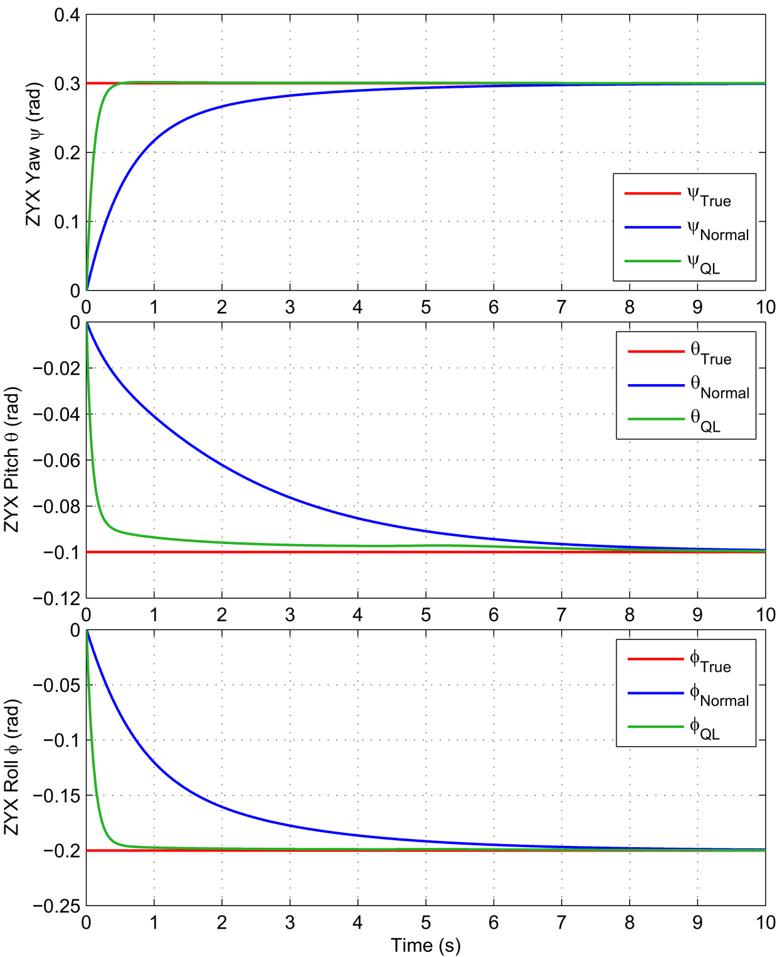
Experimental Results
Figure 1: Estimation results on the NimbRo-OP robot using the magnetometer, ZYX yaw and fused raw orientation resolution methods. The attitude of the robot was manually disturbed for a number of seconds.
Figure 2: Simulated attitude estimation results demonstrating the effect of quick learning (with a quick learning time of 3.0s) on the filter’s transient response. The simulated estimator was subjected to a step in orientation.

Slide 7
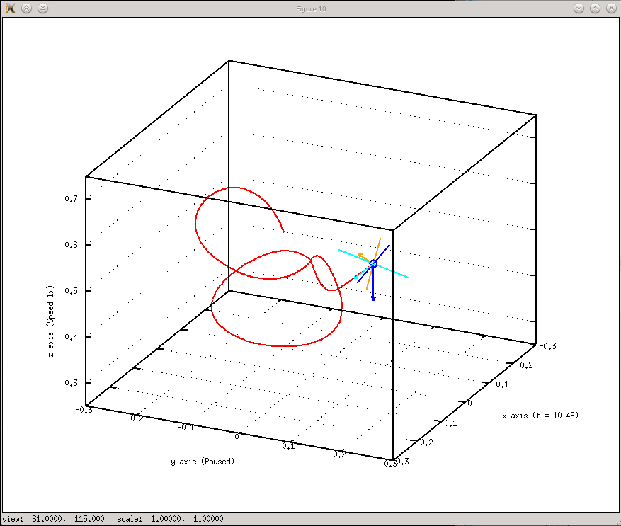
Open-source C++ Library Implementation
Attitude Estimator
A C++ implementation of a nonlinear 3D IMU fusion algorithm
https://github.com/AIS-Bonn/attitude_estimator
Attitude Estimator is a generic platform-independent C++ library that implements an IMU sensor fusion algorithm. Up to 3-axis gyroscope, accelerometer and magnetometer data can be processed into a full 3D quaternion orientation estimate, with the use of a nonlinear Passive Complementary Filter. The library is targeted at robotic applications, but is by no means limited to this. Features of the estimator include gyro bias estimation, transient quick learning, multiple estimation algorithms, tuneable estimator parameters, and near-global stability backed by theoretical analysis.
Great emphasis has been placed on having a very efficient, yet totally numerically and algorithmically robust implementation of the filter. The code size has also been kept to a minimum, and has been extremely well-commented. The programmatic interface has also been made as easy as possible. Please refer to the extensive documentation of the library for more information on its capabilities and usage caveats.

Slide 8
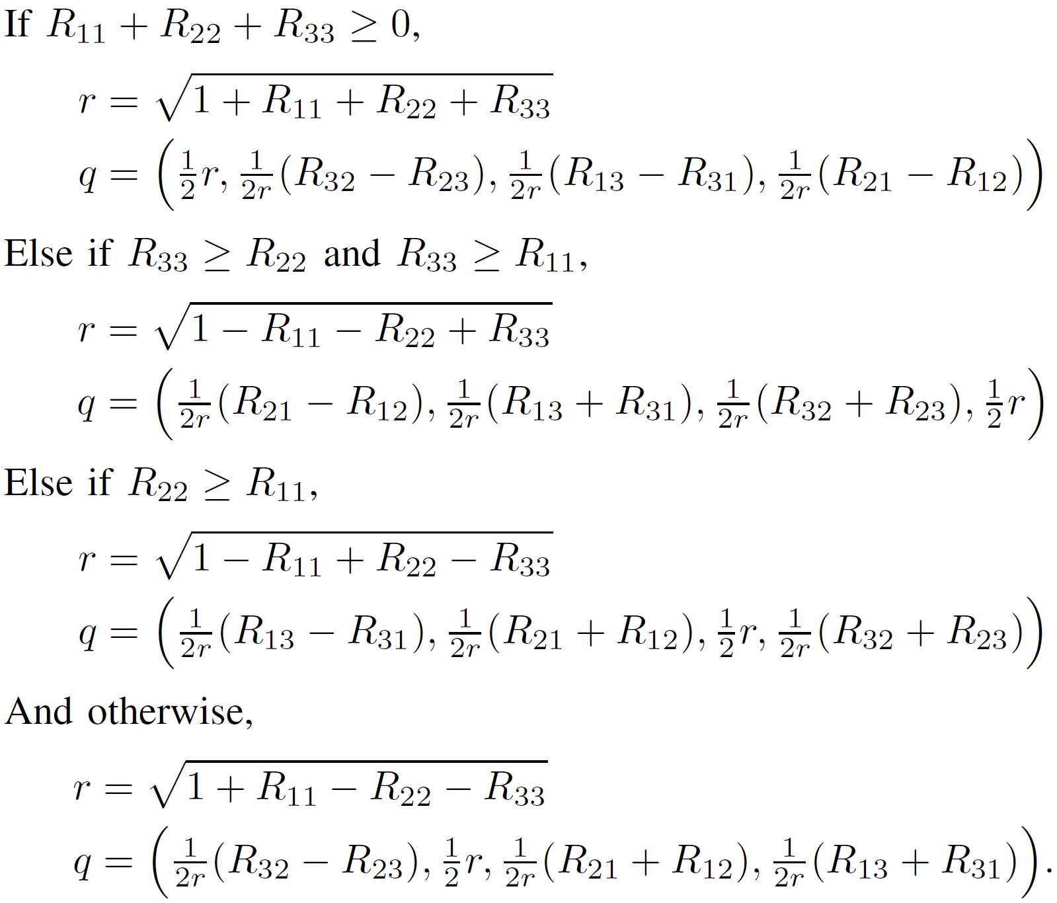
Notation and Identities
Definition: 2-Sphere
The 2-sphere S² is the set of all unit vectors in ℝ³, that is,
Definition: Rotation matrices
A rotation matrix is a 3x3 orthogonal matrix with determinant +1 that can be used to represent a rotation. The set of all rotation matrices is the special orthogonal group SO(3), and is given by
For a rotation from coordinate frame {A} to frame {B}, we have that
where for example ^{A}y_{B} is the column vector corresponding to the y-axis of frame {B}, expressed in the coordinates of frame {A}.
Definition: Quaternions
The set of all quaternions ℍ, and the subset ℚ of pure rotations, are given by
Rotation of a vector by a quaternion is most efficiently computed as
Definition: Parallel and antiparallel
Two linearly dependent vectors are parallel if they are a positive multiple of each other, and antiparallel if they are a negative multiple of each other.
Identity: Conversions between quaternions and rotation matrices
Given a quaternion q = (w, x, y, z), the equivalent rotation matrix is given by
Given a rotation matrix R, the equivalent quaternion is given by

