Slide 1


Affordance Prediction via Learned Object Attributes
Tucker Hermans James M. Rehg Aaron Bobick
Computational Perception Lab
School of Interactive Computing
Georgia Institute of Technology

Slide 2
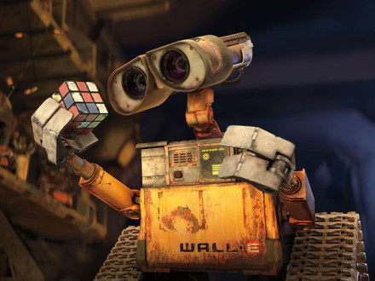
Motivation
Determine applicable actions for an object of interest
Learn this ability for previously unseen objects
Notes:
We want to do this distally

Slide 3
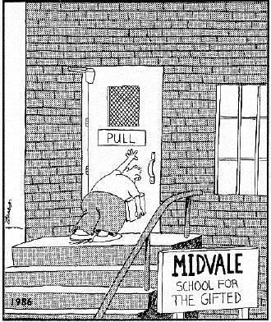
Affordances
Latent actions available in the environment
Joint function of the agent and object
Proposed by Gibson 1977

Slide 4
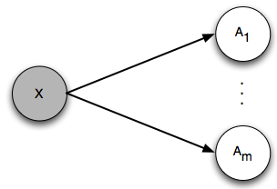
Direct Perception
Direct Perception Model
Affordances are directly perceived from the environment
Gibson’s original model of affordance perception

Slide 5
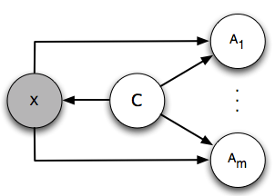
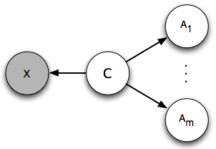
Object Models
Category Affordance Full
Category Affordance Chain
Moore, Sun, Bobick, & Rehg, IJRR 2010

Slide 6
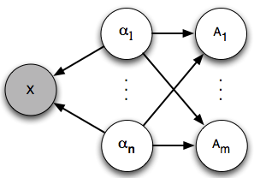
Attribute Affordance Model
Benefits of Attributes
Attribute-Affordance Model
Attributes determine affordances
Scale to novel object categories
Give a supervisory signal not present in feature selection

Slide 7
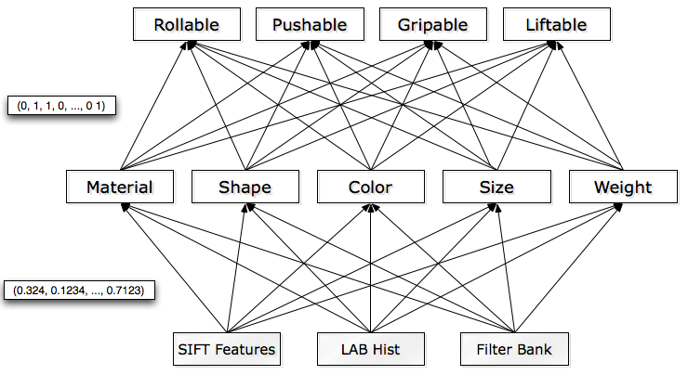
Attribute Affordance Model
Based on Lampert et. al. CVPR 09
Notes:
Learn a classifier for each attribute from the visual features.
Learn classifiers for each affordance using the attribute values as feature vectors. Inspired by Christoph Lampert’s CVPR 2009 paper.
Uses the notion of “information transfer”

Slide 8
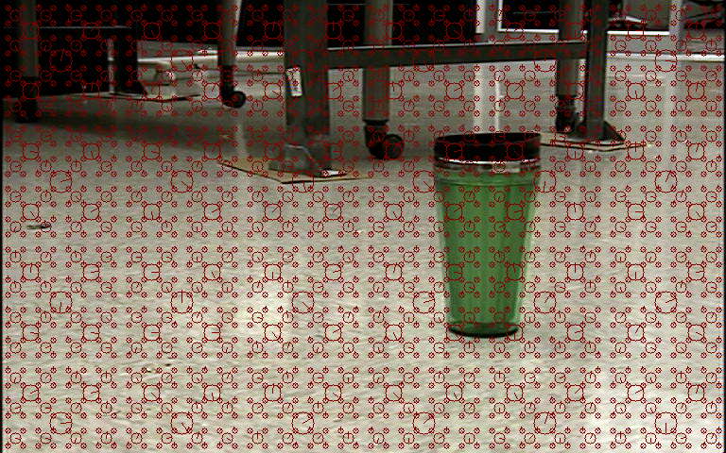

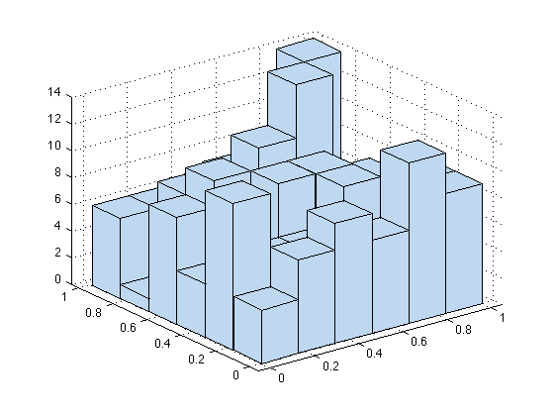
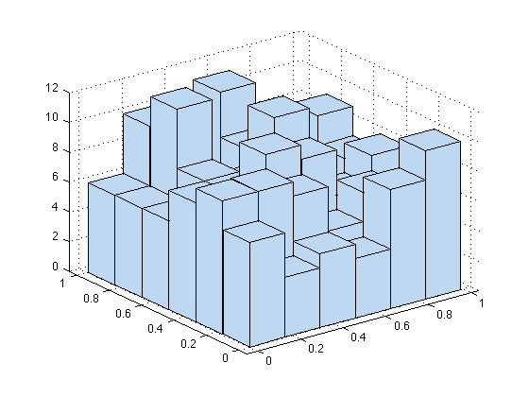
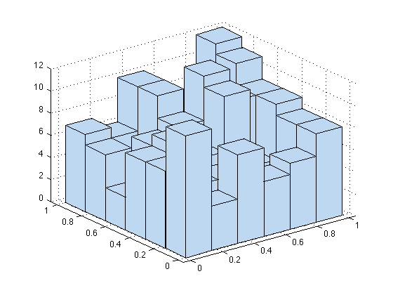
Visual Features
SIFT codewords extracted densely
Texton filter bank
LAB color histogram
…
Notes:
SIFT Codebook 512 elements (4 scales, 8 pixel x and y spacing)
LAB: 12 × 6 × 6 dimension
Textons 256 cluster centers (15 filters at 2 scales (30 filter responses form a raw feature)) [Leung and Malik IJCV, 2001]

Slide 9
Attributes
Shape: 2D-Boxy, 3D-Boxy, cylindrical, spherical
Colors: blue, red, yellow, purple, green, orange, black, white, and gray
Material: cloth, ceramic, metal, paper, plastic, rubber, and wood
Size: height and width (cm)
Weight (kg)
Total attribute feature length: 23 total elements
Notes:
Size and weight are real valued
All others are independent binary variables for each element
2d-boxy and 3d-boxy terms from [Farhadi, Endres, Hoiem, and Forsyth, CVPR 2009]
Attribute count breakdown:
Size 2
Shape 4
Colors 9
Material 7
Weight 1

Slide 10
Attribute Classifiers
Learn attribute classifiers using binary SVM and SVM regression
Use multichannel χ² kernel
Notes:
Separate channel for each of the visual feature types (SIFT, LAB Histogram, Texton filter bank)
Use the same visual features and kernel for DP and category classification
Weights are the average distance between feature vectors in the training data

Slide 11
Affordance Classifiers
Binary SVM with multichannel Euclidean and hamming distance kernel
Train on ground truth attribute values
Infer affordance using predicted attribute values
Notes:
Kernel weights the binary affordances separate from the real valued ones using hamming distance and euclidean distance respectively
Affordance classifiers are trained on the ground truth attribute labels, not predicted labels.

Slide 12
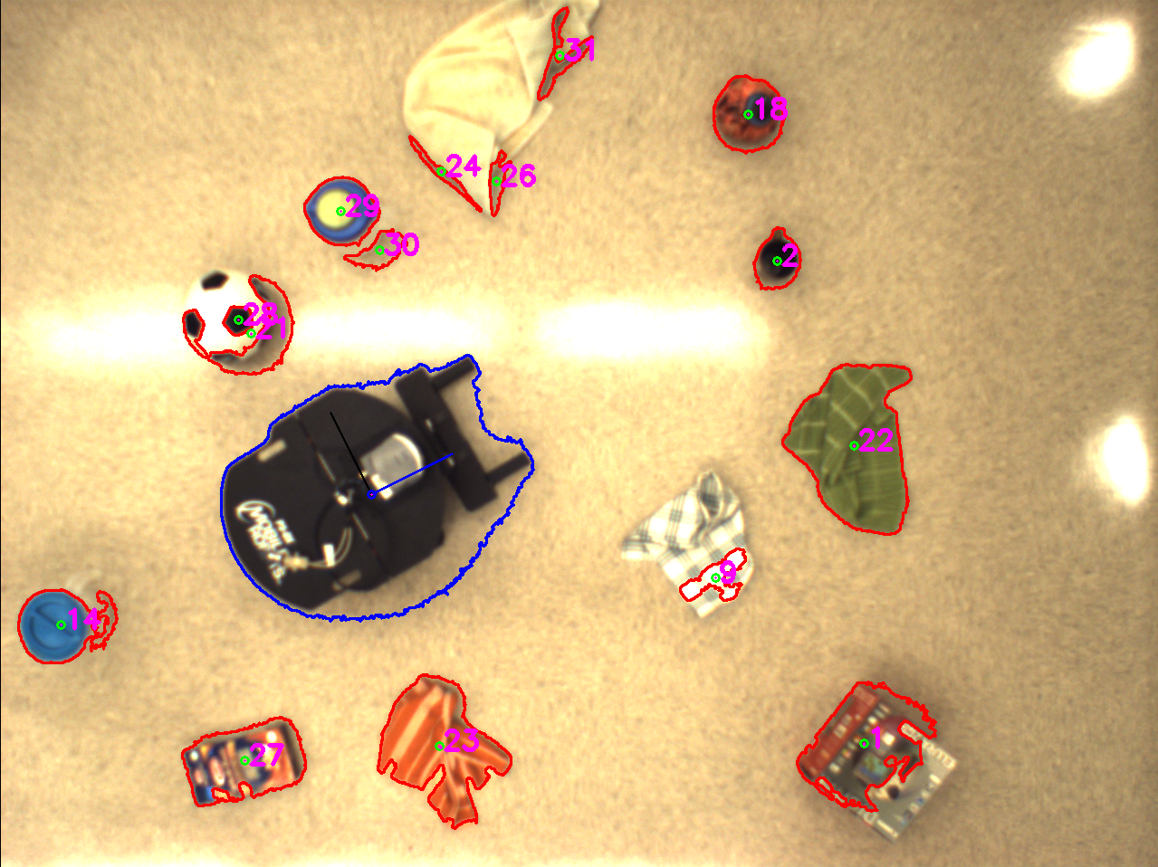
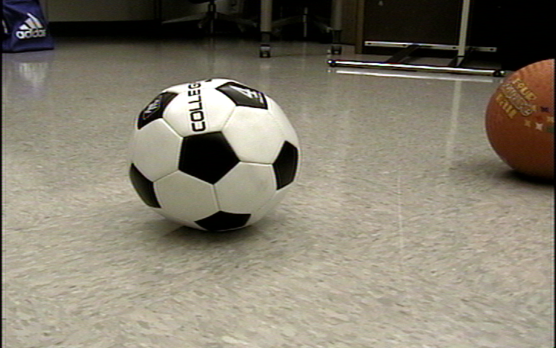
Experimental Setup
Notes:
Data Collection:
Overhead camera to give localization.
Robot autonomously turns to view object and zooms camera to give consistent magnification across different distances (i.e. remove scale issues)
Robot view from a different scenario on right
Ground truth generated by having robot perform each behavior with human recording success or failure.

Slide 13
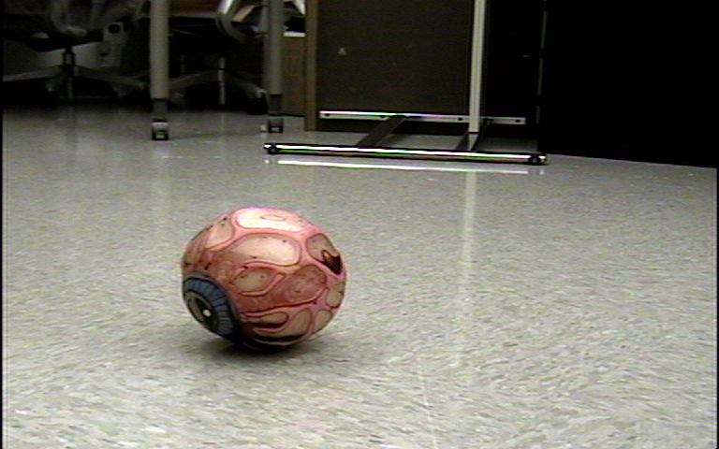
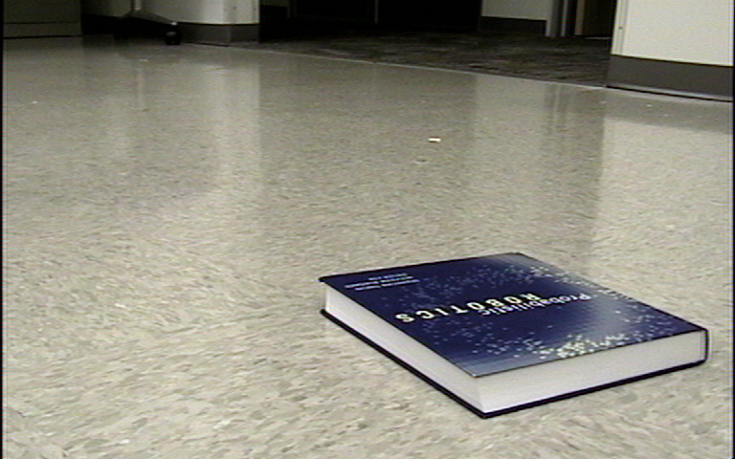
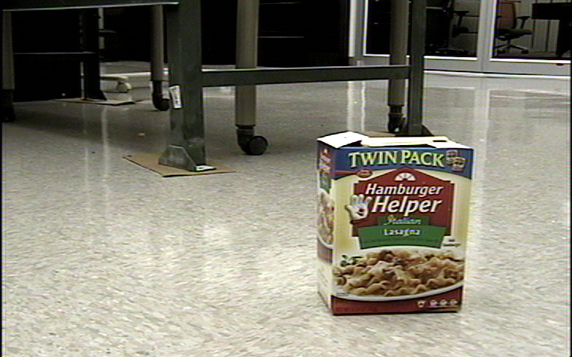
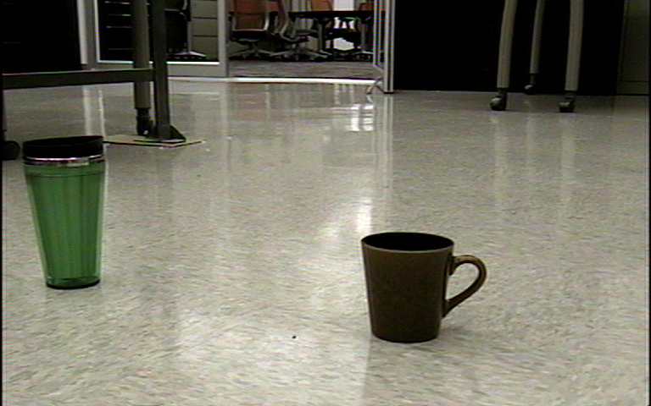
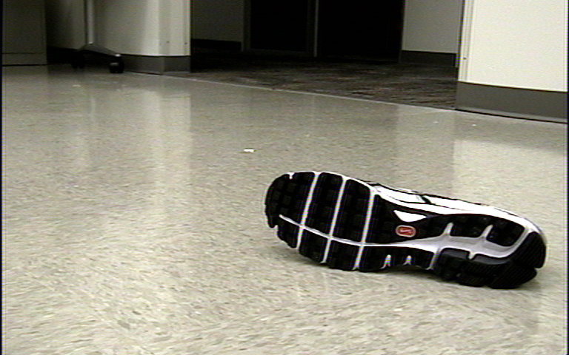
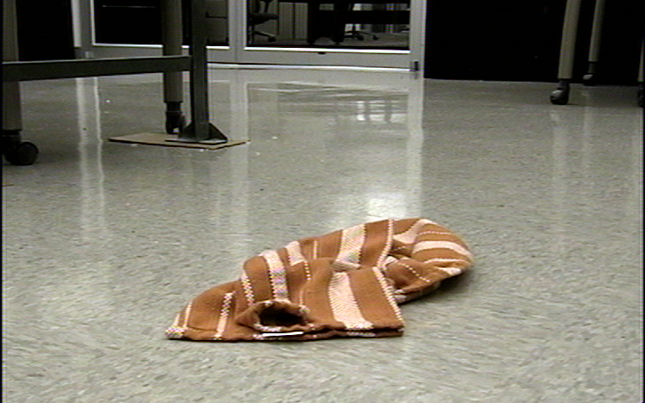
Experimental Data
Six object categories: balls, books, boxes, containers, shoes, and towels
7 Affordances: rollable, pushable, gripable, liftable, traversable, caryable, dragable
375 total images
Notes:
Containers are mugs, cups, bottles, pitchers
Liftable and carryable turned out to be the same for the objects we used (i.e. if the robot can lift it it can drive with it lifted)

Slide 14
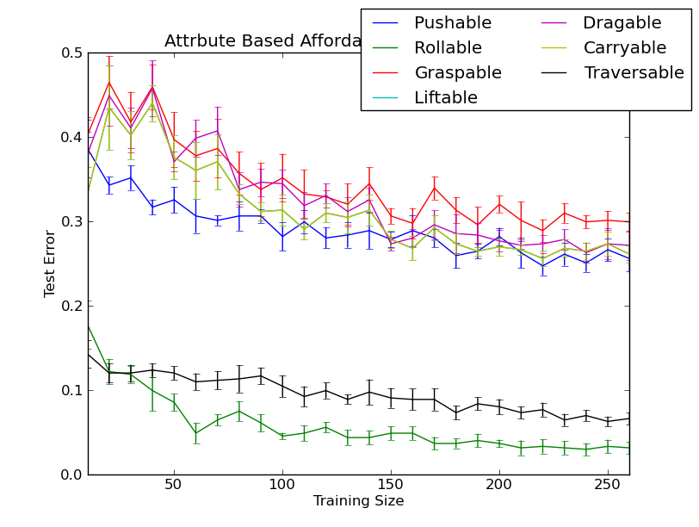
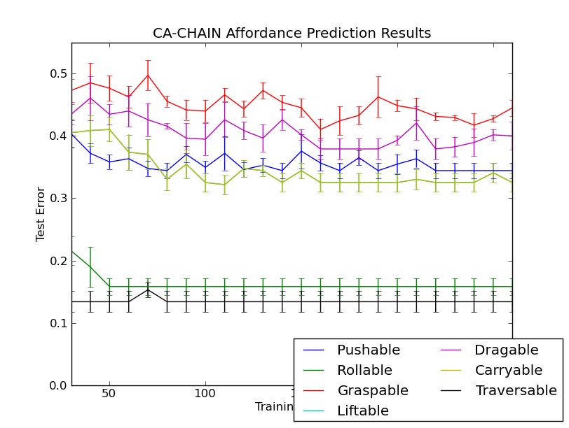
Results: Affordance Prediction
Attribute-Affordance
Category Affordance Chain
Notes:
Results are average of five training / testing splits across all data, ignoring class membership.
Testing sizes were held constant at 115 images (~30% of data).

Slide 15
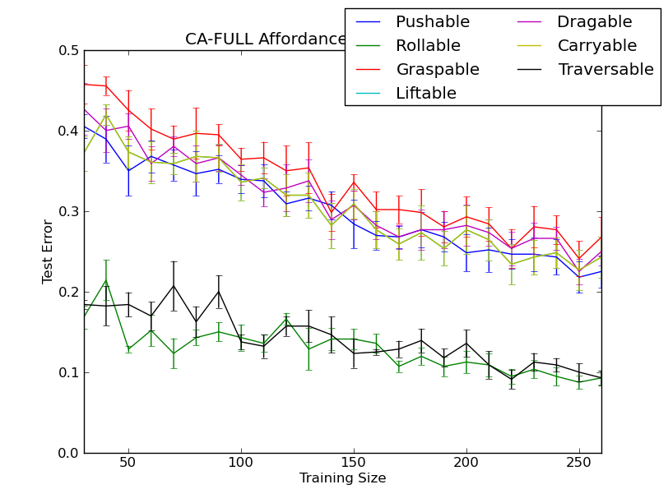
Results: Affordance Prediction
Attribute-Affordance
Category Affordance Full
Notes:
Multiclass SVM for object classification
Majority vote classifier conditioned on class for CA-Chain
DP-style SVM for each class in CA-Full
Results are average of five training / testing splits.

Slide 16
Results: Affordance Prediction
Category Affordance Chain
Category Affordance Full
Notes:
Multiclass SVM for object classification
Majority vote classifier conditioned on class for CA-Chain
DP-style SVM for each class in CA-Full
Results are average of five training / testing splits.

Slide 17
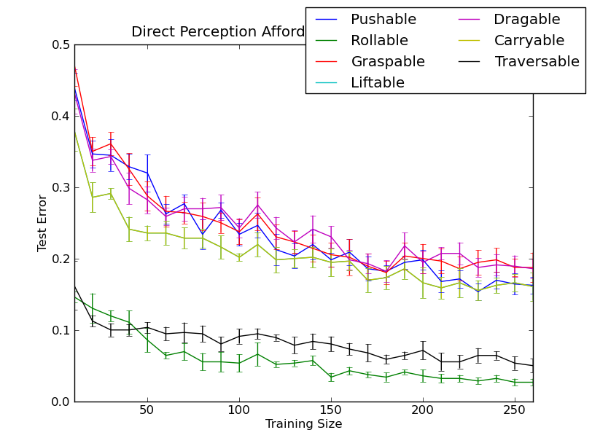
Results: Affordance Prediction
Attribute-Affordance
Direct Perception
Notes:
Results are average of five training / testing splits across all data, ignoring class membership.
Testing sizes were held constant at 115 images (~30% of data).

Slide 18
Results: Affordance Prediction
 | Attribute | DP | CA-Full | CA-Chain
Pushable | 74.43 | 83.75 | 77.50 | 65.56
Rollable | 96.87 | 97.32 | 90.71 | 84.14
Graspable | 70.09 | 81.25 | 73.21 | 55.48
Liftable | 73.91 | 83.93 | 75.71 | 67.48
Dragable | 72.87 | 81.43 | 75.00 | 60.00
Carryable | 73.91 | 83.93 | 75.71 | 67.48
Traversable | 93.39 | 95.00 | 90.71 | 86.61
Total | 81.12 | 85.46 | 79.21 | 68.57
Percent correctly classified
Notes:
Training size of 260 images. Results are average of five training / testing splits.
Percent of correctly classified affordances across all object categories

Slide 19
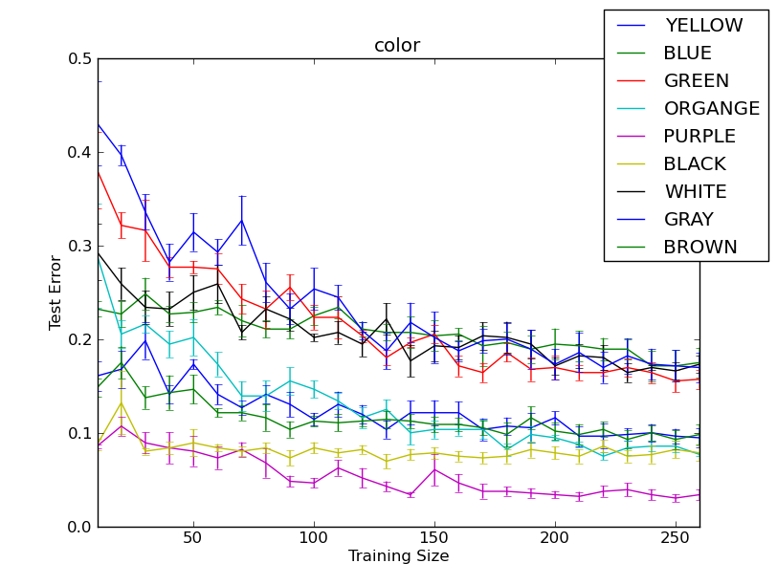
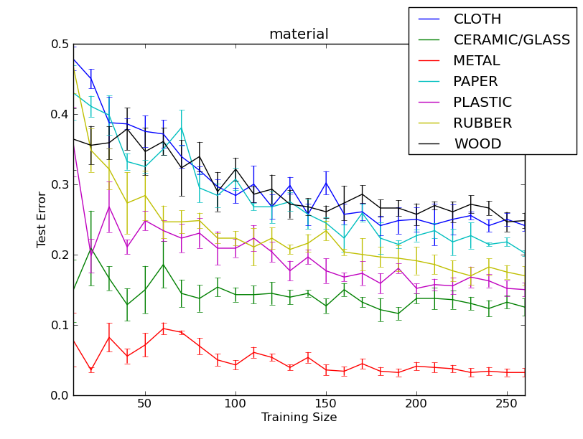
Results: Attribute Prediction
Color Prediction
Material Prediction

Slide 20
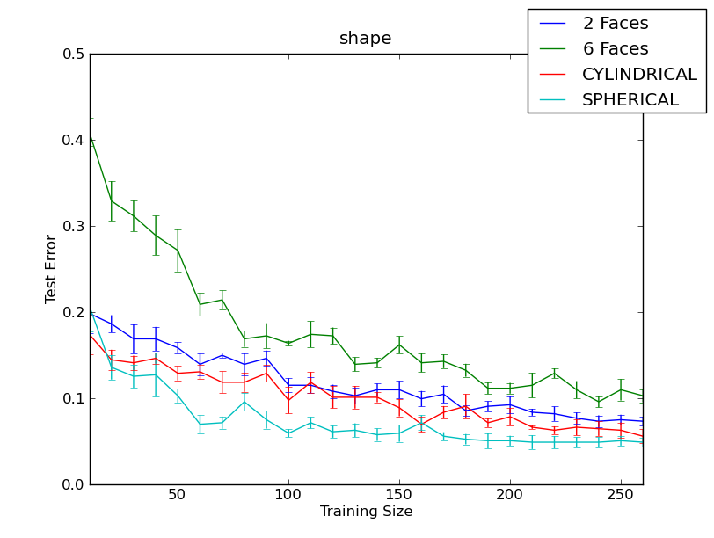
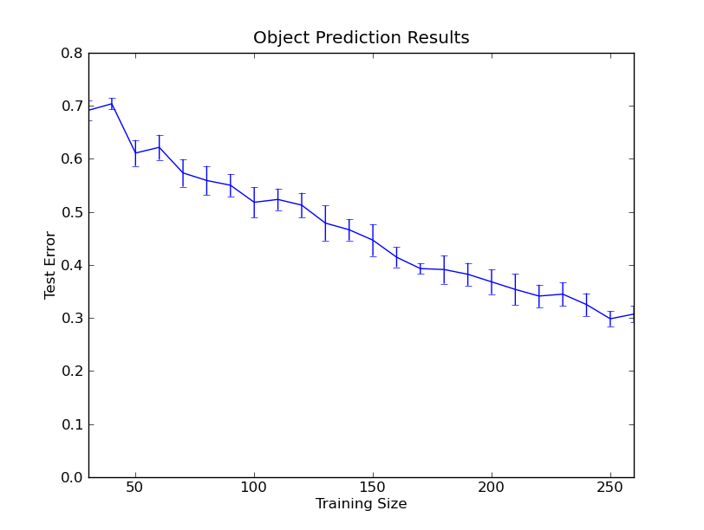
Results: Attribute Prediction
Shape Prediction
Object Category Prediction
Notes:
2-faces is “2D-boxy”
6-faces is “3D-Boxy”
Terms from [Farhadi, Ian Endres, Derek Hoiem, David Forsyth, CVPR 2009]

Slide 21
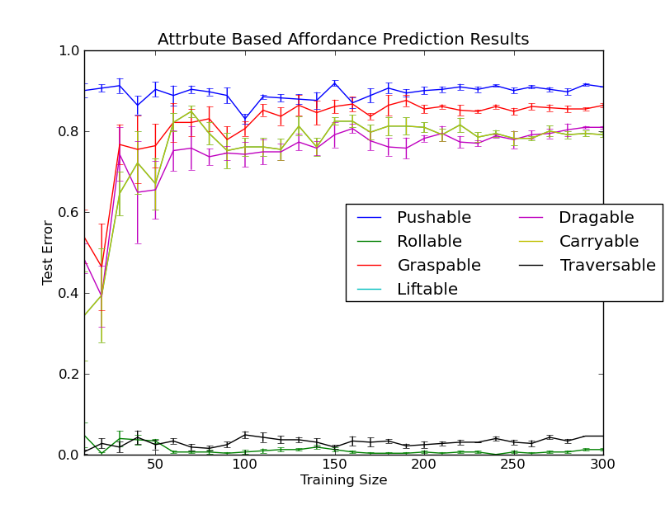
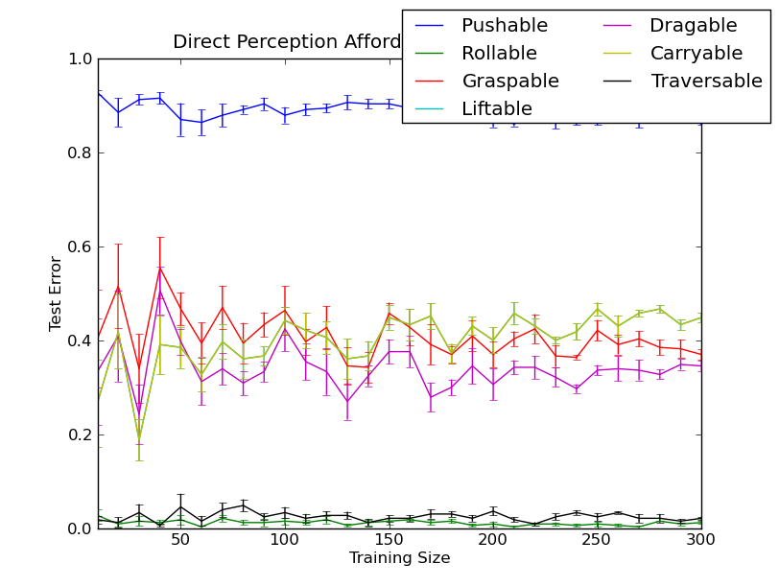
Results: Novel Object Class
Attribute-Affordance
Direct Perception
Object class “book”
Notes:
No books used in training data,
Tested on the book images.
Training size is the number of objects from categories other than the one being held out. The testing set is the entire set of objects from the unseen class. The training is exactly the same as above, just that the training set is from 5 of the object categories and the testing set is the sixth category.
On full dataset DP performed below 0.2 error at training size of 260 elements.
Attribute method was mostly below 0.3 error at 260.
The lack in improvement likely comes from small appearance overlap of the object categories chosen for these, so information transfer from previous categories is difficult.
Additionally the appearance to attribute mappings of one category are not always similar to the others, so the attribute transfer does not perform well on the new category.
As such, DP tends to perform better, since it can weight features from the much larger visual feature vector (1600 elements) to create a decision boundary, while the attribute model has the lower dimensional attribute feature vector (23 elements), where the elements are also noisy inferences.

Slide 22
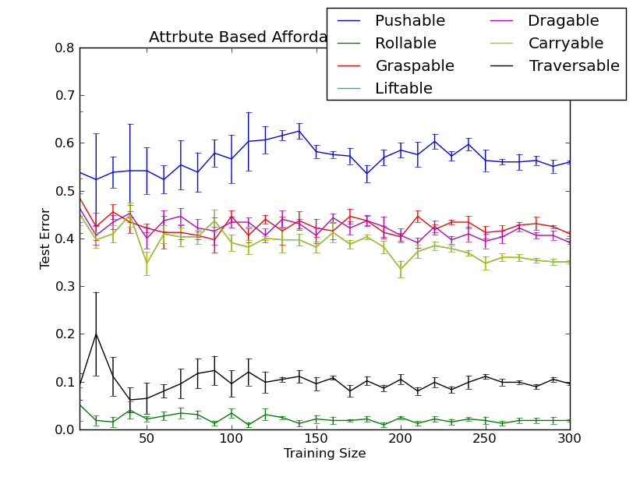
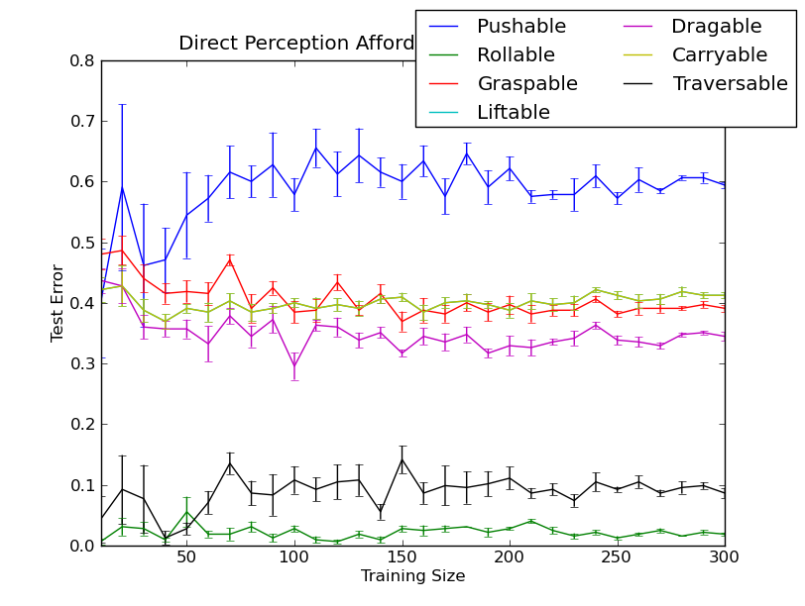
Results: Novel Object Class
Attribute-Affordance
Direct Perception
Object class “box”
Notes:
No boxes used in training data,
Tested on the box images.
On full dataset DP performed below 0.2 error at training size of 260 elements.
Attribute method was mostly below 0.3 error at 260.

Slide 23
Results: Novel Object Class
 | Balls | Books | Boxes | Container | Shoes | Towels
Attribute | 52.03 | 39.99 | 69.01 | 76.28 | 60.97 | 53.63
DP | 57.99 | 65.58 | 67.69 | 58.96 | 67.86 | 67.91
Percent of correctly classified affordances across all novel object categories
Notes:
Percent of correctly classified affordances of unseen object classes comparing between SVM based direct perception (DP) and the attribute based method (Att). Class labels represent the testing class. Results are the average of five training-testing splits with a training size of 300 images for each test.

Slide 24
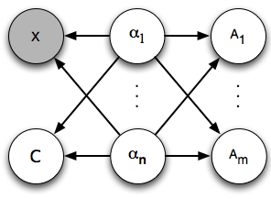
Future Work
Attribute-Category Model
Train attribute classifiers on larger auxiliary dataset
Incorporate depth sensing
Combine attribute and object models
Use parts as well as attributes
Affordances of elements other than individual objects

Slide 25
Conclusion
Current dataset does not provide a diverse enough set of object classes for attributes to provide significant information transfer
Attribute model restricts use of all features, unlike direct perception which has all visual features available
Attribute model outperformed object models
Direct perception and attribute models are comparable for small amounts of training data

Slide 26
Affordance Prediction via Learned Object Attributes
Tucker Hermans James M. Rehg Aaron Bobick
Computational Perception Lab
School of Interactive Computing
Georgia Institute of Technology

